Slide 1

What’s New in OpenShift 4.2
OpenShift Product Management

Slide 2
Purpose of this presentation
“OpenShift Roadmap Update: What’s Next”
A look ahead over the next 6 - 12+ months
Focused on major OpenShift features / initiatives
Updated quarterly (goal) and subject to change
Useful for customers who want a general OpenShift Roadmap update
“OpenShift Roadmap Update: What’s New in OpenShift x.y”
A deep dive into the next OpenShift release
Delivered with each new OpenShift release
Useful for customers who want a deep dive on latest OpenShift release
Both of these presentations are ok to use publicly
Decks will be available in PnT in multiple formats & via Google Slides
Feel free to use relevant slides, customize and make them your own
PM roadmap session recordings also available, but for internal use only

Slide 3
OpenShift 4 Platform
CLUSTER SERVICES
APPLICATION SERVICES
DEVELOPER SERVICES
Metrics, Chargeback, Registry, Logging
Middleware, Service Mesh, Functions, ISV
Dev Tools, Automated Builds, CI/CD, IDE
AUTOMATED OPERATIONS
KUBERNETES
Red Hat Enterprise Linux or RHEL CoreOS
Best IT Ops Experience
CaaS
PaaS
FaaS
Best Developer Experience

Slide 4
2019 Roadmap
Q2 CY2019
Q3 CY2019
Q4 CY19/Q1 CY20
OpenShift 4.1
OpenShift 4.2
OpenShift 4.3
OpenShift Serverless (Knative) - DP
OpenShift Pipelines (Tekton) DP2
CodeReady Workspaces
CodeReady Containers Alpha
Developer CLI (odo) Beta
Developer Console GA
OpenShift Serverless (Knative) - TP
OpenShift Pipelines (Tekton) DP3
CodeReady Containers GA
Developer CLI (odo) GA
OpenShift Serverless (Knative) - GA
OpenShift Pipelines (Tekton) TP
Helm 3 TP
DEV
DEV
DEV
Metering for Services
Windows Containers (Planned)
GPU Metering
Application Operator Binding - DP
OperatorHub
Operator Lifecycle Manager
Service Mesh (~4 month after)
OperatorHub Enhancements
Operator Deployment Field Forms
Application Migration Console
APP
APP
APP
Kubernetes 1.16 w/ CRI-O runtime
Automated Installer for RHV
Private/Internal Clusters support from the installer
Deploy to pre-existing VPC & Subnets
OVN GA w/ Windows Networking Integration (Planned)
FIPS
Pre-existing Infra Installer for OSP
OpenShift Container Storage 4.3
Kubernetes 1.13 with CRI-O runtime
RHEL CoreOS, RHEL7
Automated Installer for AWS
Pre-existing Infra Installer for Bare Metal, VMware, AWS
Automated, one-click updates
Multus (Kubernetes multi-network)
Quay v3
Kubernetes 1.14 w/ CRI-O runtime
Disconnected Install and Update
Automated Installer for Azure, OSP, GCP
Pre-existing Infra Installer for GCP
Cluster-wide Egress Proxy
OVN Tech Preview
OpenShift Container Storage 4.2 (1 month after)
PLATFORM
PLATFORM
PLATFORM
cloud.redhat.com - Multi-Cluster Mgmt
OCP Cluster Subscription Management
OpenShift Dedicated consumption pricing
cloud.redhat.com - Subscription Mgmt Improvements
Azure Red Hat OpenShift new features (private clusters)
Azure Red Hat OpenShift preview of 4.x
OSD on Google Cloud preview on 4.x
Insights Operator
Azure Red Hat OpenShift new features (monitoring, logging)
HOSTED
HOSTED
HOSTED

Slide 5



OpenShift 4.2
PLATFORM EXPANSION
WORKLOAD EXPANSION
DEVELOPER EXPERIENCE
Disconnected, air-gapped installation
Full-stack Automation for Azure, GCP. OpenStack
Migration tooling
Operators for Red Hat Integration, Business Automation, Runtimes
Special resources operator For GPU
Developer console with application topology
CodeReady Containers
Service Mesh fully supported

Slide 6
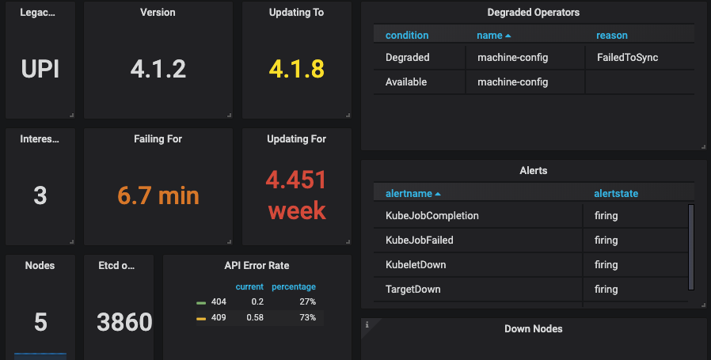
Connected Customer
4 months since GA
11 z-stream releases
186 bugs fixed
207 CVEs across RHEL+OCP
20% of bugs fixed to date have been from information obtained through telemeter

Slide 7
The New Platform Boundary
OpenShift 4 is aware of the entire infrastructure and
brings the Operating System under management
OpenShift & Kubernetes
certificates & security settings
container runtime config
allowed maintenance windows
software defined networking
AUTOMATED OPERATIONS
kernel modules
device drivers
network interfaces
security groups
Nodes & Operating System
KUBERNETES
RHEL or RHEL CoreOS
Notes:
One of the most significant changes for 4 is bringing the infrastructure under management by OpenShift and Kubernetes. Not only has OpenShift moved to a self-managed architecture but it also introduces a full stack managed approach making installation and updates seemless across the platform and the underlying operating system. Everything is managed as a single entity and customers no longer need to perform out of band management in order to upgrade their operating systems/

Slide 8
OPENSHIFT PLATFORM
OpenShift 4 Lifecycle
* Hypothetical timeline for discussion purposes
4.1
full support
Rolling 3 release support window
critical support
unsupported
4.2
4.3
New model
Release based, not date based. Rolling three release window for support.
The overall 4 series will be supported for at least three years
Minimum two years full support (likely more)
One year maintenance past the end of full support
EUS release planned
Supported for 14 months of critical bug and critical security fixes instead of the normal 5 months. If you stay on the EUS for its entire life, you must use the application migration tooling to move to a new cluster
Generally Available

Slide 9
OPENSHIFT PLATFORM
OpenShift 4 Upgrades
* Hypothetical timeline for discussion purposes
4.1
full support
critical support
unsupported
4.2
OTA upgrade
4.3
Migration tool
OTA Upgrades
Works between two minor releases in a serial manner.
Happy path = migrate through each version
On a regular cadence, migrate to the next supported version.
Optional path = migration tooling
If you fall more than two releases behind, you must use the application migration tooling to move to a new cluster.
Current minor release
Full support for all bugs and security issues
1 month full support overlap with next release to aid migrations
Previous minor release
Fixes for critical bugs and security issues for 5 months
Generally Available
Notes:
Jumping from 4.1 to 4.2 to 4.3 can be done in-place, via over the air upgrade. This process should be one click and painless, even though you need to do execute more of them than you are used to.
If you can not (or will not) progress serially through minor versions, you must use the migration tool to “jump” a release.

Slide 10


OPENSHIFT PLATFORM
Installation Experiences
OPENSHIFT CONTAINER PLATFORM
HOSTED OPENSHIFT
Full Stack Automation
Simplified opinionated “Best Practices” for cluster provisioning
Fully automated installation and updates including host container OS.
Pre-existing Infrastructure
Customer managed resources & infrastructure provisioning
Plug into existing DNS and security boundaries
Azure Red Hat OpenShift
Deploy directly from the Azure console. Jointly managed by Red Hat and Microsoft Azure engineers.
OpenShift Dedicated
Get a powerful cluster, fully
Managed by Red Hat engineers and support.
Product Manager: Katherine Dubé & Patrick Strick
Generally Available
Notes:
For OpenShift 4, there’s two primary installation experiences:
Full Stack Automation, where the installer controls all areas of the installation including infrastructure provisioning with an opinionated “best practices” deployment of OpenShift.
Pre-existing infrastructure deployments, where administrators are responsible for creating and managing their own infrastructure allowing greater customization and operational flexibility.
And finally, two hosted OpenShift offerings, OpenShift Dedicated and Azure Red Hat OpenShift, freeing up customers from having to provide operational management of their cluster and choice of cloud providers.
Let’s take a look at each of these different installation experiences in detail.

Slide 11


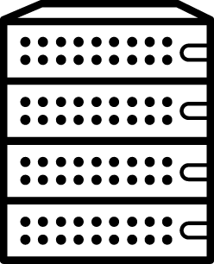



OPENSHIFT PLATFORM
4.2 Supported Providers
Full Stack Automation (IPI)
Pre-existing Infrastructure (UPI)
*
*
Bare Metal
*
* Support for full stack automated installs to pre-existing VPC & subnets and deploying as private/internal clusters is planned for 4.3.
Product Manager: Katherine Dubé
Generally Available
Notes:
For OpenShift 4, there’s two primary installation experiences:
Full Stack Automation, where the installer controls all areas of the installation including infrastructure provisioning with an opinionated “best practices” deployment of OpenShift.
Pre-existing infrastructure deployments, where administrators are responsible for creating and managing their own infrastructure allowing greater customization and operational flexibility.
For 4.2, we’ve expanded support for full stack automated deployments to include AWS, Microsoft Azure, Google Cloud Platform, and Red Hat OpenStack Platform as well as adding GCP to the existing list of user provisioned infrastructure supported providers that already includes AWS, Bare Metal, and VMware vSphere.

Slide 12
OPENSHIFT PLATFORM
Full stack automated deployments of AWS, Azure, GCP & OSP!
$ ./openshift-install --dir ./demo create cluster
? SSH Public Key /Users/demo/.ssh/id_rsa.pub
? Platform azure
? azure subscription id xxxxxxxx-xxxx-xxxx-xxxx-xxxxxxxxxxxx
? azure tenant id xxxxxxxx-xxxx-xxxx-xxxx-xxxxxxxxxxxx
? azure service principal client id xxxxxxxx-xxxx-xxxx-xxxx-xxxxxxxxxxxx
? azure service principal client secret *********************************
INFO Saving user credentials to "/Users/demo/.azure/osServicePrincipal.json"
? Region centralus
? Base Domain example.com
? Cluster Name demo
? Pull Secret [? for help] *************************************************************
INFO Creating infrastructure resources…
INFO Waiting up to 30m0s for the Kubernetes API at https://api.demo.example.com:6443...
INFO API v1.14.0+4788f50 up
INFO Waiting up to 30m0s for bootstrapping to complete...
INFO Destroying the bootstrap resources...
INFO Waiting up to 30m0s for the cluster at https://api.demo.example.com:6443 to initialize...
INFO Waiting up to 10m0s for the openshift-console route to be created...
INFO Install complete!
INFO To access the cluster as the system:admin user when using 'oc', run 'export KUBECONFIG=/Users/demo/openshift-install/demo/auth/kubeconfig'
INFO Access the OpenShift web-console here: https://console-openshift-console.apps.demo.example.com
INFO Login to the console with user: kubeadmin, password: <password>
$ ./openshift-install --dir ./demo create cluster
? SSH Public Key /Users/demo/.ssh/id_rsa.pub
? Platform gcp
? Service Account (absolute path to file or JSON content)
/Users/demo/.secrets/ServiceAccount.json
INFO Saving the credentials to "/Users/demo/.gcp/osServiceAccount.json"
? Project ID openshift-gce-devel
? Region centralus
? Base Domain example.com
? Cluster Name demo
? Pull Secret [? for help] *************************************************************
INFO Creating infrastructure resources…
INFO Waiting up to 30m0s for the Kubernetes API at https://api.demo.example.com:6443...
INFO API v1.14.0+4788f50 up
INFO Waiting up to 30m0s for bootstrapping to complete...
INFO Destroying the bootstrap resources...
INFO Waiting up to 30m0s for the cluster at https://api.demo.example.com:6443 to initialize...
INFO Waiting up to 10m0s for the openshift-console route to be created...
INFO Install complete!
INFO To access the cluster as the system:admin user when using 'oc', run 'export KUBECONFIG=/Users/demo/openshift-install/demo/auth/kubeconfig'
INFO Access the OpenShift web-console here: https://console-openshift-console.apps.demo.example.com
INFO Login to the console with user: kubeadmin, password: <password>
Simplified Cluster Creation
Easily provision a “best practices” OpenShift cluster on Microsoft Azure
CLI-based installer with interactive guided workflow
Installer takes care of provisioning the underlying Infrastructure significantly reducing deployment complexity
Faster Install
The installer typically finishes within 30 minutes
Only minimal user input needed with all non-essential install config options now handled by component operator CRD’s
Leverages RHEL CoreOS for all node types enabling full stack automation of installation and updates of both platform and host OS content
Product Manager: Katherine Dubé
Generally Available
Notes:
OpenShift 4 leverages a new CLI-based installer, called openshift-install. It’s designed to simplify provisioning OpenShift on immutable installer provisioned infrastructure using an interactive guided workflow all within about 30 minutes. This approach provides an OpenShift deployment with full stack automation of host OS and platform updates and infrastructure management right out of the box without the complexity of having to provision your own infrastructure.
Only minimal user input is needed with all non-essential installation config options now get configured post-install via component operator CRD’s.
Shown here are OpenShift 4.2 deployments on both Microsoft Azure and Google Compute Platform using the openshift-install guided workflow.

Slide 13
OPENSHIFT PLATFORM
Deploy to pre-existing infrastructure for AWS, Bare Metal, GCP, & VMware!
Customized OpenShift Deployments
Enables OpenShift to be deployed to user managed resources and pre-existing infrastructure.
Customers are responsible for provisioning all infrastructure objects including networks, load balancers, DNS, hardware/VMs and performing host OS installation
Deployments can be performed both on-premise and to the public cloud
OpenShift installer handles generating cluster assets (such as node ignition configs and kubeconfig) and aids with cluster bring-up by monitoring for bootstrap-complete and cluster-ready events
Example native provider templates (AWS CloudFormation and Google Deployment Manager) included to help with user provisioning tasks for creating infrastructure objects
While RHEL CoreOS is mandatory for the control plane, either RHEL CoreOS or RHEL 7 can be used for the worker/infra nodes
$ cat ./demo/install-config.yaml
apiVersion: v1
baseDomain: example.com
compute:
- name: worker
replicas: 0
controlPlane:
name: master
...
$ ./openshift-install --dir ./demo create ignition-config
INFO Consuming "Install Config" from target directory
$ ./openshift-install --dir ./demo wait-for bootstrap-complete INFO Waiting up to 30m0s for the Kubernetes API at https://api.demo.example.com:6443...
INFO API v1.11.0+c69f926354 up INFO Waiting up to 30m0s for the bootstrap-complete event... $ ./openshift-install --dir ./demo wait-for cluster-ready
INFO Waiting up to 30m0s for the cluster at https://api.demo.example.com:6443 to initialize... INFO Install complete!
Product Manager: Katherine Dubé
Generally Available
Notes:
For customers who require a higher degree of infrastructure customization, OpenShift 4 can also be deployed to user-managed and provisioned, pre-existing infrastructure.
Even though the deployment process is a bit different than the full stack automated deployment method since the installer isn’t used to provision the underlying infrastructure, it uses the same OpenShift installer to generate cluster assets (such as the node ignition configs and kubeconfig) and aids with the cluster bring-up by monitoring for the control plane and cluster ready events.
Once again, pre-existing infrastructure deployments have the added benefit of supporting both RHEL 7 and RHEL CoreOS for worker & infra nodes. However, RHEL CoreOS is mandatory for the control plane nodes no matter the deployment method used.
For 4.2, we’ve expanded support to also include deploying GCP to user provisioned infrastructure.

Slide 14










OPENSHIFT PLATFORM
Disconnected “Air-gapped” Installation & Upgrading
# mirror update image: $ oc adm -a <secret_json> release mirror \ --from=quay.io/<repo>/<release:version> \ --to=<local registry>/<repo> \
--to-release-image=<local registry>/<repo:version>
# provide cluster with update image to update to:
$ oc adm upgrade --to-mirror=<local repo:version>
Customer Cluster
Local Copy of Update Image
Red Hat sourced Update Image
Disconnected OpenShift Cluster
Local Container Registry
Quay.io Container Registry
Cluster updated locally
Mirrored to local registry
Admin
Overview
4.2 introduces support for installing and updating OpenShift clusters in disconnected environments
Requires local Docker 2.2 spec compliant container registry to host OpenShift content
Designed to work with the user provisioned infrastructure deployment method
Note: Will not work with Installer provisioned infrastructure deployments
Installation Procedure
Mirror OpenShift content to local container registry in the disconnected environment
Generate install-config.yaml: $ ./openshift-install create install-config --dir <dir>
Edit and add pull secret (PullSecret), CA certificate (AdditionalTrustBundle), and image content sources (ImageContentSources) to install-config.yaml
Set the OPENSHIFT_INSTALL_RELEASE_IMAGE_OVERRIDE environment variable during the creation of the ignition configs
Generate the ignition configuration: $ ./openshift-install create ignition-configs --dir <dir>
Use the resulting ignition files to bootstrap the cluster deployment
Product Manager: Katherine Dubé
Generally Available
Support for installing and updating of OpenShift clusters in air-gapped environments
Admin first need to mirror installation and update payload images to a local container registry, then openshift-install and ‘oc adm upgrade’ can be configured to leverage the offline content
Notes:
4.2 introduces support for install and updating OpenShift clusters in disconnected “air-gapped” environments. Its designed to work with any Docker 2.2 spec complaint container registry for hosting OpenShift content. Administrators first need replicate content from Quay.io to their local container registry. Once that is done, openshift-install can be configured to generate ignition configs that pull content locally rather than from Quay.io. Designed to work with user-provisioned infrastructure deployments only.
Updates are performed largely the same way. OpenShift update content must be mirrored first to the local container registry first then the administrator tells ‘oc adm upgrade’ where to pull the update content from.

Slide 15
OPENSHIFT PLATFORM
Disconnected “Air-gapped” OLM
1. Turn off default operator sources that comes with OpenShift:
Manifests
└── openshifttemplateservicebroker
├── clusterserviceversion.yaml
├── customresourcedefinition.yaml
├── package.yaml
└── etcd-XXXX
└─ <CSV’s and CRDs and a package file>
# Update the spec of operatorhub.config.openshift.io/v1:
apiVersion: config.openshift.io/v1
kind: OperatorHub
spec:
disableAllDefaultSources: true
2. Retrieve package lists for the default operator sources:
4. Create Operator Catalog Image using this dockerfile:
$ curl https://quay.io/cnr/api/v1/packages?namespace=redhat-operators > packages.txt
$ curl https://quay.io/cnr/api/v1/packages?namespace=community-operators >> packages.txt
$ curl https://quay.io/cnr/api/v1/packages?namespace=certified-operators >> packages.txt
FROM registry.redhat.io/openshift4/ose-operator-registry:4.2.0 as builder
COPY manifests manifests
RUN ./bin/initializer -o ./bundles.db
FROM scratch
COPY --from=builder /build/bundles.db /bundles.db
COPY --from=builder /build/bin/registry-server /registry-server
COPY --from=builder /bin/grpc_health_probe /bin/grpc_health_probe
EXPOSE 50051
ENTRYPOINT ["/registry-server"]
CMD ["--database", "bundles.db"]
3. Pull operator content; for example:
$ curl \ https://quay.io/cnr/api/v1/packages/redhat-operators/openshifttemplateservicebroker/3.0.0
# From that JSON take the digest and use to pull the gzipped:
$ curl -XGET \ https://quay.io/cnr/api/v1/packages/redhat-operators/openshifttemplateservicebroker/blobs/sha256/9bddc82c0fee05b243d01c6e2f0110c413eb9165cd7bb8adc25f1e88997854c9 -o openshifttemplateservicebroker.tar.gz
$ tar fczP openshifttemplateservicebroker.tar.gz manifests/
Copy the image to the internal registry and create a catalog source pointing to the newly created image:
apiVersion: operators.coreos.com/v1alpha1
kind: CatalogSource
metadata:
name: example-manifests
namespace: default
spec:
sourceType: grpc
image: <path to the the image>/example-registry:latest
In the file called ‘bundle.yaml’, you need to break data.clusterServiceVersion (each file in the list), data.Package, and data.customResourceDefinition (each file in the list) into their own files:
Product Manager: Daniel Messer
Generally Available
Notes:
For disconnected “air-gapped” environments, you will still be able use operators from the OLM catalog. However you will need to manually pull the operator sources in order to populate the the offline catalog. This manual process is only temporary workaround for 4.2, and we’re planning an automated solution in 4.3.

Slide 16


OPENSHIFT PLATFORM
Cluster-wide Egress Proxy
Customer Cluster
An admin with privileges can interact with the proxy object using ‘oc’ commands (use the ‘oc edit’ command to modify the proxy information.) Here is an example proxy config:
Internet
$ oc get proxy/cluster -o yaml
apiVersion: config.openshift.io/v1
kind: Proxy
metadata:
creationTimestamp: "2019-08-21T22:36:49Z"
generation: 2
name: cluster
resourceVersion: "24913"
selfLink: /apis/config.openshift.io/v1/proxies/cluster
uid: 2a344b01-d267-11f9-a4f3-025de4b59c38
spec:
httpProxy: http://<username>:<pswd>@<ip>:<port>
httpsProxy: https://<username>:<pswd>@<ip>:<port>
noProxy: example.com
readinessEndpoints:
- http://www.google.com
- https://www.google.com
trustedCA:
name: user-ca-bundle
status:
httpProxy: http://<username>:<pswd>@<ip>:<port>
httpsProxy: https://<username>:<pswd>@<ip>:<port>
noProxy: 10.0.0.0/16,10.128.0.0/14,127.0.0.1,169.254.169.254,172.30.0.0/16,api-int.demo.example.com,api.demo.example.openshift.com,etcd-0.demo.example.com,etcd-1.demo.example.com,etcd-2.demo.example.com,example.com,localhost
Proxy Connected OpenShift Cluster
Corporate Proxy Server
Backend Services
Quay.io Container Registry
Overview
4.2 introduces support for installing and updating OpenShift clusters through a corporate proxy server
Leverages new proxy controller within the cluster-network-operator, which is responsible for:
Reconciling a proxy object and writing spec > status upon successful validation.
Reconciling user-provided trust bundles referenced by trustedCA, validating the trust bundle certificates, merging the certificates with the system trust bundle and publishing the merged bundle to the openshift-config-managed/trusted-ca-bundle configmap.
Installation Procedure
Installer will use PROXY* environment variables from the shell it’s invoked from
Generate install-config.yaml: $ ./openshift-install create install-config --dir <dir>
Edit proxy information (httpProxy, httpsProxy, & noProxy) and CA certificate (‘additionalTrustBundle’) to install-config.yaml
Installer validates the provided install-config.yaml parameters, renders the necessary assets to create the cluster, and initiates the installation process based on the install method used: $ ./openshift-install create cluster --dir <dir>
Product Manager: Marc Curry & Katherine Dubé
Generally Available
Support for installing and updating of OpenShift clusters in air-gapped environments
Admin first need to mirror installation and update payload images to a local container registry, then openshift-install and ‘oc adm upgrade’ can be configured to leverage the offline content
Notes:
4.2 introduces support for installing and updating an OpenShift cluster through a corporate proxy server. Proxy information (httpProxy, httpsProxy, & noProxy) can be defined in the install-config which is used during the install process and can also managed post install via the cluster proxy object.
In addition, there’s support for providing your own CA bundles allowing the corporate proxy to MITM HTTPS.

Slide 17


OPENSHIFT PLATFORM
Red Hat Enterprise Linux
General Purpose OS
Immutable container host
BENEFITS
• 10+ year enterprise life cycle
• Industry standard security
• High performance on any infrastructure
• Customizable and compatible with wide
ecosystem of partner solutions
• Self-managing, over-the-air updates
• Immutable and tightly integrated with
OpenShift
• Host isolation is enforced via Containers
• Optimized performance on popular
infrastructure
WHEN TO USE
When customization and integration with additional solutions is required
When cloud-native, hands-free operations are a top priority
Product Manager: Ben Breard
Generally Available
Notes:
Similar to how openshift-install can be used for full-stack automation or to install OpenShift on pre-existing infrastructure, Red Hat Enterprise Linux provides a single operating system with two deployment options.
As shown earlier, RHEL can be used for worker nodes and provides parity for existing operational practices throughout the datacenter (and OCP v3). With RHEL CoreOS we’re providing an embedded RHEL container host that brings a new operational paradigm where the host & infrastructure are fully managed and operationalized by the cluster. Regardless of which option customers choose, they’ll get the benefits of RHEL plus the integration and stability from the kernel to the highest-level operator in OpenShift.

Slide 18
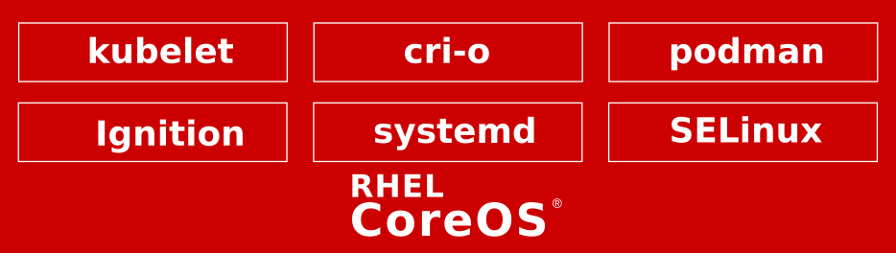
OPENSHIFT PLATFORM
Red Hat Enterprise Linux CoreOS
4.2 Image Availability:
OpenStack
GCP
Azure
Always latest RHEL 8 content:
4.18 kernel (4.18.0-80.11.1.el8_0.x86_64)
Improved IP Configuration:
Environments that require static networking should use the installer ISO. Configs will be persisted from the kernel and do not require ignition alterations:
Basic Interface:
ip=10.10.10.2::10.10.10.254:255.255.255.0:core0.example.com:enp1s0:none
Bonding:
ip=10.10.10.5::10.10.10.254:255.255.255.0:core1.example.com:bond0:none bond=bond0:enp1s0,enp7s0:mode=802.3ad,lacp_rate=fast,miimon=100,xmit_hash_policy=layer2+3
Amazon
vSphere
Bare Metal
Product Manager: Ben Breard
Generally Available

Slide 19
OPENSHIFT PLATFORM
Machine Config Operator (MCO)
Provides cluster-level configuration, enables rolling upgrades, and prevents drift between new and existing nodes. The MCO is the heart of what makes RHCOS a kube-native operating system.
Configure Kernel Arguments for the Cluster
oc create -f 50-kargs.yaml
oc edit mc/50-kargs
MCO can be paused to suspend operations
Provides control for when changes can be deployed
Custom MachinePools can have inheritance
Enables MachineConfigs to scale
apiVersion: machineconfiguration.openshift.io/v1
kind: MachineConfig
metadata:
labels:
machineconfiguration.openshift.io/role: worker
name: 50-kargs
spec:
KernelArguments:
audit=1
audit_backlog_limit=8192
net.ifnames.prefix=net
Product Manager: Ben Breard
Generally Available
Notes:
Notes
Red Hat OpenShift Container Platform 4 enables the mass production of container hosts at scale across cloud providers, virtualization platforms and bare metal. To create a true cloud platform, we had to tightly control the supply chain to increase the reliability of the sophisticated automation. Standardizing on Red Hat Enterprise Linux CoreOS (a variant of Red Hat Enterprise Linux) and CRI-O, Machine Configs, and the Machine Configuration Operator were obvious choices for enabling automation at this level.
Deep dive in this blog draft

Slide 20



BROAD ECOSYSTEM OF WORKLOADS
CRI-O Support in OpenShift
CRI-O tracks and versions identical to Kubernetes, simplifying support permutations
CRI-O 1.13
Kubernetes 1.13
OpenShift 4.1
CRI-O 1.14
Kubernetes 1.14
OpenShift 4.2
CRI-O 1.16
Kubernetes 1.16
OpenShift 4.3
Product Manager: Scott McCarty
Generally Available
Notes:
CRI-O is the best kubernetes specific container engine. Adoption is trivial since all existing Docker and OCI containers are supported and run great with CRI-O.
CRI-O is a light weight, kubernetes-native, OCI compatible container runtime that is life-cycled and managed by OpenShift. Customers no longer need to worry about which container runtime is in use - with OCP v4, it’s always the right one and it provide a complete implementation of the Kubernetes Container Runtime Interface, or CRI.
Also, gone are the days of separately managing the container engine. CRI-O is completely hands-free to run in production. The handful of tuneables that provide control and security for CRI-O are easy to configure via a CRD, and the settings will be propagated across the cluster.

Slide 21
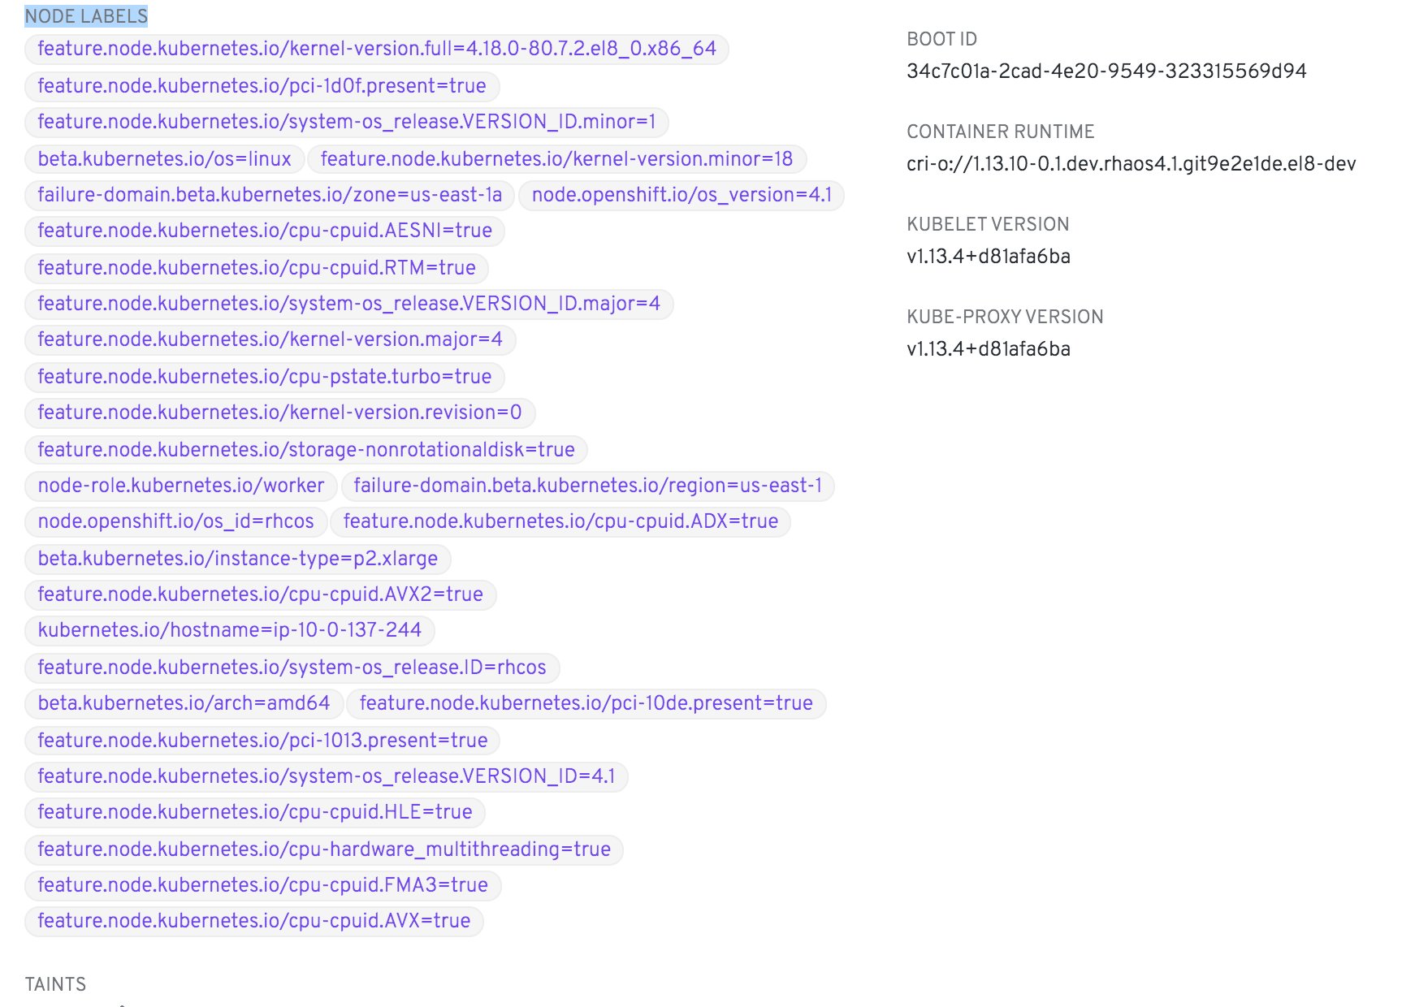
Node Feature Discovery Operator
OPENSHIFT PLATFORM
What is Node Feature Discovery (NFD)
Detects hardware features available on each node and advertises those features using node labels.
List of features managed by NFD
CPU Features: cpuid, hardware_multithreading, power, pstate
Kernel Features: config, selinux_enabled, version, os_version
Others: Presence of NVMe, NUMA, SR-IOV and GPUs
Node Feature Discovery (NFD) Operator
Manages the install and lifecycle of the NFD DaemonSet
NFD operator can be accessed via the embedded OperatorHub
Product Manager: Tushar Katarki
Notes:
Speaker: Daniel Messer

Slide 22
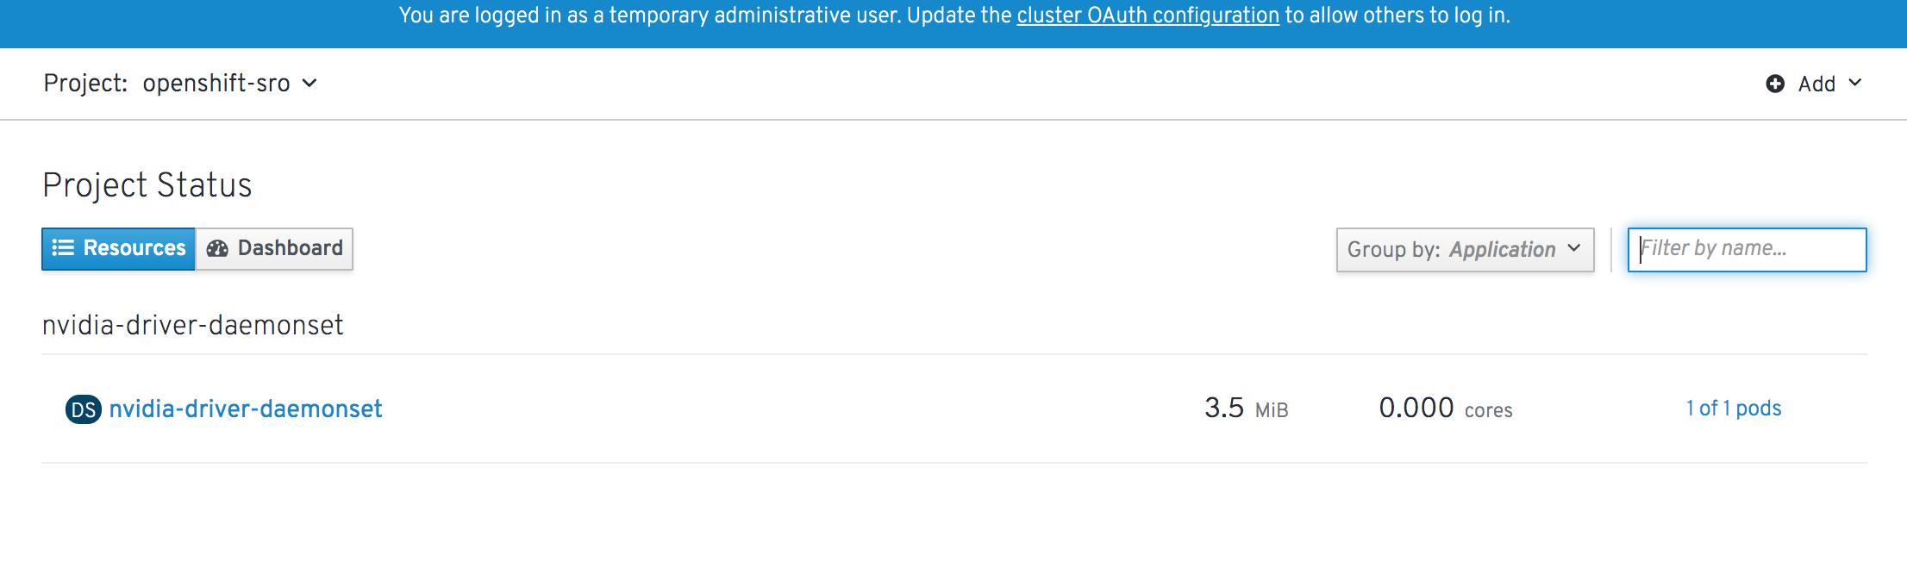
Special Resources Operator (SRO)
Developer Preview
What is Special Resources Operator (SRO)
As an operator for orchestrating special resources in a cluster that need special handling.
Implements a simple state machine, where each state implements a state and has a validation step.
What are we introducing in 4.2?
A reference implementation of the SRO for NVIDIA GPUs.
This SRO deploys:
NVIDIA Cuda driver container
NVIDIA GPU device plugin deamenoset
NVIDIA DGCM_exporter for GPU metrics
$ make -C special-resource-operator deploy
customresourcedefinition.apiextensions.k8s.io/specialresources.sro.openshift.io created
for obj in manifests/0000_namespace.yaml
<snip>
namespace/openshift-sro-operator created
namespace/openshift-sro created
specialresource.sro.openshift.io/gpu created
$
Product Manager: Tushar Katarki
Notes:
Speaker: Daniel Messer

Slide 23



Enablement of GPUs in an OpenShift Cluster
2
K8s device plugin for GPU
Special Resources Operator builds the GPU enablement stack
CRIO GPU runtime plugin
CUDA driver (or container)
GPU node_exporter for Prometheus
1
Label: GPU
NFD Operator recognizes GPUs and labels the nodes
Managing updates and lifecycle with operators. Automating the experience with operators.
Product Manager: Tushar Katarki
Notes:
Speaker: Daniel Messer
So in 4.1, GPUs are supported on RHEL7 nodes (and they are not supported on RHEL CoreOS nodes because of lack of support for CUDA driver and driver containers)
NVIDIA has been working on enabling CUDA driver and driver containers with a goal of completion in Q4CY2019. With that in place, the NFD operator and Special Resources Operator can be used to automate the enablement of GPUs.

Slide 24
Node Tuning Operator Enhancements
OPENSHIFT PLATFORM
# The CR applies custom node-level tuning for nodes that run an ingress pod with label tuned.openshift.io/ingress-pod-label=ingress-pod-label-value
oc create -f- <<_EOF_
apiVersion: tuned.openshift.io/v1
kind: Tuned
metadata:
name: ingress
namespace: openshift-cluster-node-tuning-operator
spec:
profile:
- data: |
[main]
summary=A custom OpenShift ingress profile
include=openshift-control-plane
[sysctl]
net.ipv4.ip_local_port_range="1024 65535"
net.ipv4.tcp_tw_reuse=1
name: openshift-ingress
recommend:
- match:
- label: tuned.openshift.io/ingress-pod-label
value: "ingress-pod-label-value"
type: pod
priority: 10
profile: openshift-ingress
_EOF_
What is it
Node Turning Operator was first introduced in OpenShift 4.1 and manages cluster node-level tuning; The default CR is meant for delivering standard node-level tuning.
The enhancements in 4.2 allow for customizing the tunings (for things such as High Performance etc)
How it works
For custom tuning, create your own tuned CRs. Newly created CRs will be combined with the default CR and custom tuning applied to nodes based on node/pod labels and profile priorities.
Product Manager: Tushar Katarki
Notes:
Speaker: Daniel Messer
Docs PR: https://github.com/openshift/openshift-docs/pull/16135
JIRA: https://jira.coreos.com/browse/ATS-411
The Node Tuning Operator helps you manage node-level tuning by orchestrating the tuned daemon. The majority of high-performance applications require some level of kernel tuning. The Node Tuning Operator provides a unified management interface to users of node-level sysctls and more flexibility to add custom tuning specified by user needs. The Operator manages the containerized tuned daemon for {product-title} as a Kubernetes DaemonSet. It ensures the custom tuning specification is passed to all containerized tuned daemons running in the cluster in the format that the daemons understand. The daemons run on all nodes in the cluster, one per node.
Node-level settings applied by the containerized tuned daemon are rolled back on an event that triggers a profile change or when the containerized tuned daemon is terminated gracefully by receiving and handling a termination signal.
The Node Tuning Operator is part of a standard {product-title} installation in version 4.1 and later.

Slide 25
Whitelisting of sysctl for OpenShift 4 and RHEL CoreOS
OPENSHIFT PLATFORM
What is it
Procedure to allow system admins to whitelist sysctl on a per-node basis
All safe sysctls are enabled by default; All unsafe sysctls are disabled by default, and the cluster administrator must manually enable them on a per-node basis.
New functionality introduces this feature for OpenShift 4 and RHEL CoreOS
How it works
Add a label to the node’s MachineConfigPool
Create a KubeletConfig custom resource on the node with the specificed whitelist of sysctls
Set sysctls on pods using the pod's `securityContext`
# Add a label to the MachineConfigPool where the containers where containers with the unsafe sysctls will run
$oc edit machineconfigpool worker
apiVersion: machineconfiguration.openshift.io/v1
kind: MachineConfigPool
metadata:
creationTimestamp: 2019-02-08T14:52:39Z
generation: 1
labels:
custom-kubelet: sysctl (1)
# Add a key: pair label.
# Create a KubeletConfig Custom Resource (CR)
apiVersion: machineconfiguration.openshift.io/v1
kind: KubeletConfig
metadata:
name: custom-kubelet
spec:
machineConfigPoolSelector:
matchLabels:
custom-kubelet: sysctl (1)
kubeletConfig:
allowedUnsafeSysctls: (2)
- "kernel.msg*"
- "net.ipv4.route.min_pmtu"
$ oc apply -f set-sysctl-worker.yaml
Product Manager: Tushar Katarki
Notes:
Speaker: Daniel Messer
PR: https://github.com/openshift/openshift-docs/pull/16194

Slide 26


INSTALLER PROVISIONED OPENSHIFT-ON-OPENSTACK
OpenShift Container Platform
OSP 13 (Long Life Release) and OSP 15
The OCP installer provisions (no customization):
Networks
Internal Load Balancers¹
Internal DNS¹
OpenStack Instances
RHEL CoreOS
CoreOS Ignition Configs
OpenShift Worker Nodes
OpenShift Cluster Resources
Kuryr:
Manually enabled (not default)
Target OSP requires Neutron trunk ports² + Octavia
Supports OCP network policies
IP Block support
Red Hat OpenStack Platform Overcloud
OpenShift Cluster
openshift-install
⋯
Product Manager: Ramon Acedo
¹External Load Balancers (routing) and external DNS servers are provided by the user.
²Neutron trunk ports are enabled by default on Director deployments.
Notes:
4.2 introduces full-stack automation (installer provisioned) support for deploying OpenShift clusters on OpenStack.
The installer uses the OpenStack APIs in conjunction with the Kubernetes OpenStack Cloud Provider to create all the required OpenStack resources, such as VMs, networks, security groups, object storage, etc., needed to deploy OpenShift 4 and properly configure the cluster to run on the Red Hat OpenStack Platform.
OpenShift 4.2 can be deployed on OSP 13 (our current long life release) and OSP 15 (GA planned for September 19).
Kuryr exists to improve the network performance of pods when running workloads on OpenStack. Kuryr is an SDN solution combining a Kubernetes CNI plugin (kuryr-kubernetes) and OpenStack Neutron to provide interconnectivity between Kubernetes pods and OpenStack virtual instances.
Its recommended to use the Kuryr option when Recommended when Neutron tenant networks are used for OpenShift Application Nodes. The Kuryr option is not recommended when:
Using only OpenStack VLAN-based provider networks (Kuryr is not needed)
You have many OpenShift services and few hypervisors:
For each OpenShift service, Octavia will run a VM with a load balancer in it

Slide 27

OVN TECHNICAL PREVIEW
OpenShift Container Platform
OPENSHIFT
KUBERNETES CNI
OVN
If we are to continue to grow OpenShift as a product, we need to make it easier to grow and improve our networking capabilities, with less investment, while maintaining stability at scale.
OVN has many advantages, including acceleration of customer-driven feature requirements, some of which are pre-enabled:
Low barrier to integration (implementation of virtual networking via OVS)
SDN portfolio consolidation / common network technology
Virtually eliminate iptables scale issues
Heterogeneous Linux/Windows clusters
Ability to have a cluster network that spans on-prem nodes and cloud nodes
Full Network Policy Support
Egress IP per pod
Distributed L4 Ingress/Egress firewall
Distributed services LB
Multi-Network/Interface
Heterogeneous clusters w/ Windows nodes
Capability to span on-prem & cloud nodes
Traffic isolation / Multi-tenancy
DPDK support
Encrypted tunnels
IPv6 / DHCPv6
QoS, Control/Data plane separation
⋯
Product Manager: Marc Curry
Notes:
OVN is Technical Preview at 4.2.
Roadmap: Targeting GA (not detault) at 4.3, and GA (default, feature parity with openshift-sdn) at 4.4.

Slide 28



ENABLE INTERNAL INGRESS CONTROLLERS FOR PRIVATE CLUSTERS
OpenShift Container Platform
When creating an IngressController, the provisioned cloud load balancer is Internet-facing by default.
Customers deploying fully private clusters need the ability to route traffic from Services wholly within the cluster.
AWS Cloud
Route 53
Users can now declare an ingress controller as internal, in addition to the default of external, using an annotation as described in Kubernetes’ platform-specific implementation details.
While possible, mutating the internal/external status of a load balancer service is not supported. Changing the scope of an existing ingress controller will temporarily impact ingress availability.
Region
apiVersion: operator.openshift.io/v1
kind: IngressController
metadata:
namespace: openshift-ingress-operator
name: internal
spec:
domain: internal.cluster.example.com
endpointPublishingStrategy:
type: LoadBalancerService
loadBalancer:
scope: Internal
ELB
Ingress Controller
Service A
Service B
Service C
Product Manager: Marc Curry
Notes:
User traffic from the Internet normally arrives to the external load balancer and is forwarded to the backend services, e.g. the ingress controller service’s NodePort on the Kubernetes nodes. The ingress controller examines the request traffic to see if it matches any ingress rules, e.g host name, path or both. If the request traffic matches, the ingress controller diverts the traffic to the proper service. The benefit of using ingress is that only the ingress controller service is exposed to the external world (via NodePort, in this example). All other services are private/internal and can only be reached via the Cluster IP and port. It is not only secure but also easy to manage the exposure of services.
In the case of an internal ingress controller, the provisioned load balancer can be private to the cluster, so no traffic is allowed from the Internet.
Enabling this feature for install-time ingress is targeting 4.3. Early indications from the 4.3 design has uncovered a 4.2 procedure that may eventually be supported.

Slide 29

KUBERNETES CNI PLUG-IN ADDS & ENHANCEMENTS
OpenShift Container Platform
Several Kubernetes CNI Plug-Ins are added or enhanced in OCP 4.2 to grow capability.
SR-IOV Solution:
Remains Technical Preview at 4.2
RDMA / RoCE Support
DPDK Mode for SR-IOV VFs
Admission Controller
Operator
New CNI Plug-Ins:
IPVLAN
Bridge with VLAN
Static IPAM
Kubernetes
CRDs
CNI “meta plugin” ( )
default
plugin#2
OpenShift SDN CNI
CNI plug-in with new functionality
New, optional, secondary data plane plug-ins:
IPVLAN
bridge w/ VLAN
static IPAM
Pod
eth0
net0
OpenShift SDN CNI (default)
new capability
Product Manager: Marc Curry

Slide 30



Security Themes
Control Application Security
Defend the Infrastructure
Automate Compliance
Connect workload identity to Cloud provider authorization
Application certificate lifecycle management
Encrypt etcd datastore
Enhanced certificate management
RHEL CoreOS disk encryption
VPN / VPC support
Consume group membership from Identity Provider
External Keycloak integration
Disconnected / air-gapped install
FIPS compliance
Cipher Suite Configuration
Compliance Operator

Slide 31
Security Summary & Roadmap
Near Term (4.2)
Medium Term (4.3)
Long Term (4.4+)
Disconnected / air-gapped install and upgrade
Cluster-wide egress proxy
Whitelisting of sysctl (kernel parameters)
Mutual TLS, tracing for East / West network traffic with OpenShift Service Mesh
VPC / VPN support
Encrypt etcd datastore
FIPS compliance
RHCOS disk encryption
Enable GitOps based cluster config management with Argo CD
External DNS (DNS Forwarding)
IPv6 (secondary data plane interfaces)
Automate rotation of Service CA
Service for application certificate lifecycle management
External Keycloak integration
Consume group membership from external Identity Provider
Compliance operator
Global Options to Enable HTTP Strict Transport Security (HSTS)
Full Support for IPv6, HTTP/2
Global Cipher and TLS Policy API
‹#›
Notes:
SysCtls: Previously available in OCP 3. Now supported in OCP 4.2
What is it
Procedure to allow system admins to whitelist sysctl on a per-node basis
All safe sysctls are enabled by default; All unsafe sysctls are disabled by default, and the cluster administrator must manually enable them on a per-node basis.
New functionality introduces this feature for OpenShift 4 and RHEL CoreOS
How it works
Add a label to the node’s MachineConfigPool
Create a KubeletConfig custom resource on the node with the specificed whitelist of sysctls
Set sysctls on pods using the pod's `securityContext`

Slide 32



OPENSHIFT CSI
OPENSHIFT STORAGE
4.1
4.2
Kubernetes
Kubernetes
Storage
Operator
Container Storage Interface
Updated Storage
Plugin
Storage
Operator
Storage Operator
Storage Operator
OCS
Plugin
3PP
Plugin
Independant
Update
CSI: ENABLING OCS AND PARTNERS
Product Manager: Duncan Hardie
Notes:
Notes for 4.1
Conversion of storage drivers to operators
What is an operator?
An Operator is a method of packaging, deploying and managing a Kubernetes application. A Kubernetes application is an application that is both deployed on Kubernetes and managed using the Kubernetes APIs and kubectl tooling
Notes for 4.2 release
Container Storage Interface (CSI) to GA
Why introduce Container Storage Interface in Kubernetes?
This is mainly to enable OCS and partners with their CSI plugins
There are however other benefits:
Although Kubernetes already provides a powerful volume plugin system that makes it easy to consume different types of block and file storage, adding support for new volume plugins has been challenging. Because volume plugins are currently “in-tree”—volume plugins are part of the core Kubernetes code and shipped with the core Kubernetes binaries—vendors wanting to add support for their storage system to Kubernetes (or even fix a bug in an existing volume plugin) must align themselves with the Kubernetes release process.
With the adoption of the Container Storage Interface, the Kubernetes volume layer becomes truly extensible. Third party storage developers can now write and deploy volume plugins exposing new storage systems in Kubernetes without ever having to touch the core Kubernetes code. This will result in even more options for the storage that backs Kubernetes users’ stateful containerized workloads.
Taken from https://kubernetes.io/blog/2018/04/10/container-storage-interface-beta/
Note at this point it is just the API we are making available
CSI drivers contained in operators will be available in future releases
Some third party vendors may choose to make options available before the 4.3 release
In-tree and external provisioners will continue to be available up until the CSI versions come into the release
In terms of partners, we have the container certification program but that doesn't qualify anything with OpenShift. For that, they need to join the connected zone workspace on the partner portal and fill out their submission form and which point they will engage with the Storage OpenShift team for architecture validation and TSAnet and doc requirement on their (the 3rd party's ) side.

Slide 33
STORAGE DEVICES
OPENSHIFT STORAGE
Storage Focus
Cluster Storage Operator
Sets up the default storage class
Looks through cloud provider and sets up the correct storage class
Drivers themselves remain in-tree for now, CSI versions to follow later
New GA storage in 4.2
Local Volume
Raw Block
Cloud providers (AWS, GCP, Azure, vSphere)
Local Volume
Supported
AWS EBS | iSCSI
Azure File & Disk | Fibre Channel
GCE PD | HostPath
VMware vSphere Disk | Local Volume NEW
NFS | Raw Block NEW
Product Manager: Duncan Hardie
Notes:
Note for Raw Block GA these support levels:
Supported i.e. GA:
Raw Block with Cloud Providers (AWS, GCP, vSphere, Azure)
Raw Block with Local Volumes
Tech Preview:
Raw Block with iSCSI
Developer Preview:
Raw Block with Cinder
Raw Block with Fibre Channel
Not Supported:
Raw Block with RBD (Ceph)
Raw Block with Gluster

Slide 34
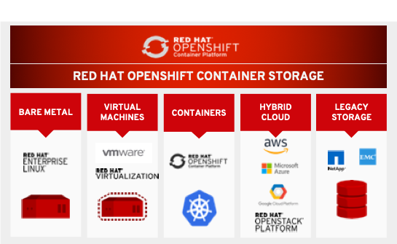
OPENSHIFT PLATFORM
OpenShift Container Storage 4.2
Persistent data services for OCP Hybrid Cloud
Complete Data Services: RWO, RWX & S3(new) (block, file & object)
Persistent storage for all OCP Infra and Applications
Build and deploy anywhere -Consistent Storage Consumption, management, and operations
OCS 4.2 support with OCP 4.2
Platform support: AWS and VMware
Converged Mode support : Run as a service on OCP Cluster
Consistent S3 across hybrid cloud
OCS 4.3
Additional Platform: Bare Metal, Azure Cloud
Independent Mode : Run OCS outside of OCP Cluster
Hybrid and Multi-cloud S3
Notes:
With OCP 4.2, we also have OCS 4.2 GA providing persistent storage for applications and OCP infrastructure services
OCS 4.2 will provide complete data services for OCP, including dynamic provisioning of object buckets. This S3 capability is new in OCS 4.2. Further we are adding consistent S3 interface across public and on prem infra.
For the first release we are supporting AWS and VMware platforms with option to deploy OCS as a service on top of OCP.
In 4.3 timeframe we are going to add additional platform Bare metal and Azure cloud.

Slide 35




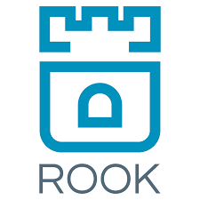

OPENSHIFT PLATFORM
OCS 4.2: Change in Technology Stack
Goal to have complete storage for OCP whatever the needs
Need for scalable S3 object stack (New apps, infra like chargeback, metering)
Red Hat Ceph is scalable object stack with block and file
Recently acquired Noobaa - consistent S3 interface over Ceph RGW, AWS S3, Azure Blob; Federation & multi-cloud capable
Rook operator framework for simple install, manage, expand
OCS 3
OCS 4
No change in OCS SKU or pricing
Full integrated migration support from OCP +OCS 3.11 to OCP + OCS 4.2
Product Manager: Sudhir Prasad
Notes:
You may have heard that with OCS 4.2 we have changed the technology stack. We have switched the underlying technology from Ansible and Gluster to Rook, Ceph and Nooba.
OCS goal is to provide complete storage for OCP. New cloud native applications like AI/ML had the need for S3 object interface.
Ceph is known for sclable object stack.
Also with recently acquired Noobaa, we can now provide consistent S3 like interface across different infrastructreu AWS, Vmware, Azure etc.
Please note there is no chnage in OCS SKU or OCS pricing, they stay the same as OCS 3. Further we fully support intgrated migration of workloads with data from OCP+OCS 3 cluster to OCP+OCS 4 cluster

Slide 36
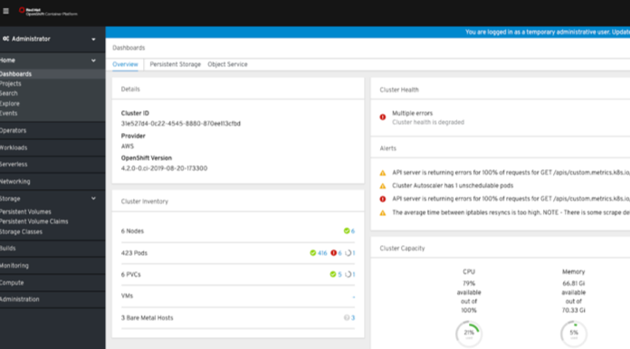
OPENSHIFT PLATFORM
OCS - Deeper integration with OCP
Operator driven - install, expand, manage,
Integrated monitoring using OCP dashboard
Integrated management - Operator driven expand
Integrated Prometheus metrics, telemetry, must-gather, alerts
Persistent Storage
Object Service
Health, Capacity Configuration, Alerts
Progress towards making the OCP + OCS as one integrated container platform
Product Manager: Sudhir Prasad
Health, Capacity, Performance, Configuration, Alerts
Notes:
Apart from providing complete storage, OCS 4.2 have much deeper integration with OCP.
Install, manage and expand are all operator driven
OCS monitoring is integrated with OCP dashboard & prometheous for health, Capacity & configuration monitoring

Slide 37
OPENSHIFT MULTICLUSTER
Multi-Cluster Platform Services
OpenShift Cluster Manager SaaS Service
Reference gitOps Architectures
(ie ArgoCD, Razee, Flux)
IBM Multi Cloud Manager
Cluster Registry
Multi-Cluster Monitoring
MultiCluster App Deployments
MultiCluster Configuration
Cluster Policy Management
Compliance
Present Today
Single Cluster Registry
Multi-Cluster Monitoring
MultiCluster Hive IPI Installer
MultiCluster Updates
MultiCluster App Deployments
OpenShift Cluster Manager On Premise
H1CY2020
Platform Services
Cross IaaS Auth
Central Quay Registry
gitOps
MultiCluster Service Mesh
Console and CLI Changes
H2CY2020
CY2021
OpenShift Core
Full Stack Install &
Over-the-air updates
Metering, Monitoring and Logging
Kubernetes
Networking &
Storage / OCS
Security
Multi-Cluster Platform Services for Federated App Deployments
Federated Networking
Federated
Storage
Submariner
GlobalLoadBalancer
Cross IaaS DNS
Noobaa
Ceph GEO Replication
Product Manager: Duncan Hardie
Notes:
Today for multiple OpenShift clusters you can see they exist and be shown their overall health via the cloud.redhat.com portal. This is the OpenShift Cluster Manager (OCM) and it is a great tool for connected customers.
Today you can also target a OpenShift cluster as you would any Kubernetes cluster with any of the gitOps solutions on the market.
And finally, Today, you can purchase the IBM Multi Cloud Manager on OpenShift and leverage it in a supported manner from IBM for all the use cases it offers.
Red Hat and IBM engineering are working together on the next phase of this multi cluster story. You haven’t heard us talk about Hive in awhile. Hive is a way to deploy a installation head cluster that you can then ask, via kubectl to custom resource definition (CRDs), for other OpenShift clusters. It is driven via the IPI installation APIs. We want to bring that on premise along with some of the views from OCM. This will be how we connect an on premise OCM to the existing OCM SaaS service on cloud.redhat.com.
Next, we want to open source parts of the IBM Multi Cloud Manager. We think it is important that the application deployment APIs have a community. We also view this as a way to evolve the kubfed project at the same time and mix our intellectual property with IBM’s in the open around topics such as federated Prometheus and Thanos. We hope to mix these technologies into the best possible solution for our customers.
Lastly, we are bringing the full force of Red Hat - the leading open source infrastructure company -- to this multi cloud problem. We have our networking teams working on building out the Submariner open source project for spanning networks across longer distances. And we have our storage engineering working on building our NooBaa and ceph technologies to offer a storage solution that allows you to move where you want to move.
This is a multiple stage approach that offers our customers something today.

Slide 38



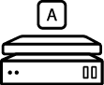

BROAD ECOSYSTEM OF WORKLOADS
Red Hat Quay v3.1 (released)
Repository Mirroring¹
Read-Only Repositories
Allows to continually synchronize image repositories are a subset of those from external source registries into Quay (content ingress point / content whitelists)
To prevent undesirable content changes temporarily or forever (binary archives, (temporarily) frozen repositories) Users can switch repository states via UI
Quay Setup Operator ²
Support for RHOCS3 / NooBaa¹
Automates the initial deployment of Quay and Clair and simplifies updates & day 2 ops Configures all relevant OpenShift objects (routes, secrets, etc.)
Allows to continually synchronize image repositories are a subset of those from external source registries into Quay (content ingress point / content whitelists)
Learn more: https://www.redhat.com/en/blog/red-hat-quay-31-now-even-better-across-distributed-environments
Product Manager: Dirk Herrmann
¹ Tech Preview ² Dev Preview
Notes:
What’s new in v3 field enablement: https://bit.ly/2VLjYUU
On the Quay side we released the first RH branded Quay version at the week before Summit. It primarily introduces multi-arch support which also includes support for MS Windows images. We also rebased all 3 Quay images onto RHEL and added a new config UI which allows customers to save and upload a quay configuration and to automatically deploy quay configuration changes via green-blue deployments if quay runs on kubernetes or openshift. The upgrade to v3 is documented and only requires two short downtimes to change one line of the configuration file.
In addition to the features we introduced a couple of surrounding items such as a new lifecycle and support policy, a customer self-service eval form and a small but import pricing change for HA setups. There is also a ton of new customer facing and field enablement collateral including a new roadmap deck and recording, competitive training, an extended sales FAQ and a new technical FAQ, a sales overview and sales deep dive training and so on. All of those can be found in the new Quay mojo group shown here and OneStop as well. I also did an initial field enablement for APAC last week summarizing all those changes which is linked from the internal announcement blog where the link is shown here as well.
It's worth to mention that although Quay is a standalone product it can be used with OpenShift already today, with or without using the openshift internal registry. The existing documentation on how to run Quay ON openshift is currently under review and we will improve and extend it pretty soon. We're also working with our field teams on an entirely new documentation on how to use quay WITH openshift to close a well-known and important documentation gap asked by many customers and RH internal folks. More to come soon, so stay tuned.

Slide 39
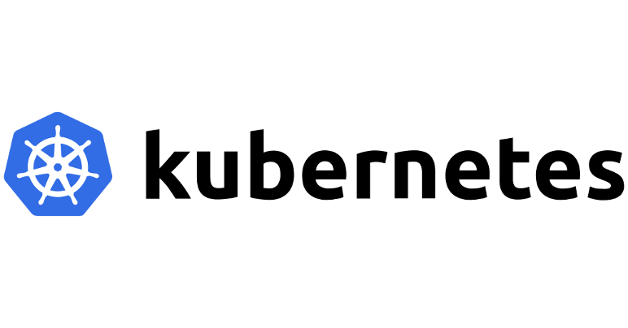



BROAD ECOSYSTEM OF WORKLOADS
Red Hat Quay v3.2 and beyond
Features targeted for Quay v3.2 (Dec ‘19)
Open Sourcing Quay
Security Annotations Operator (SAO)
Clair Scan Results shown in OpenShift Console (project, pod, cluster views)
Repository Mirroring Enhancements
Quay - OpenShift Integration Operator
Support for RHOCS4 via NooBaa MCG
(Curated) Vulnerability Metadata Sources
API
Scan Results (Attestations)
Pod
Pod
App
App
Security Annotations Operator (SAO)
Product Manager: Dirk Herrmann
Generally Available
Notes:
What’s new in v3 field enablement: https://bit.ly/2VLjYUU
On the Quay side we released the first RH branded Quay version at the week before Summit. It primarily introduces multi-arch support which also includes support for MS Windows images. We also rebased all 3 Quay images onto RHEL and added a new config UI which allows customers to save and upload a quay configuration and to automatically deploy quay configuration changes via green-blue deployments if quay runs on kubernetes or openshift. The upgrade to v3 is documented and only requires two short downtimes to change one line of the configuration file.
In addition to the features we introduced a couple of surrounding items such as a new lifecycle and support policy, a customer self-service eval form and a small but import pricing change for HA setups. There is also a ton of new customer facing and field enablement collateral including a new roadmap deck and recording, competitive training, an extended sales FAQ and a new technical FAQ, a sales overview and sales deep dive training and so on. All of those can be found in the new Quay mojo group shown here and OneStop as well. I also did an initial field enablement for APAC last week summarizing all those changes which is linked from the internal announcement blog where the link is shown here as well.
It's worth to mention that although Quay is a standalone product it can be used with OpenShift already today, with or without using the openshift internal registry. The existing documentation on how to run Quay ON openshift is currently under review and we will improve and extend it pretty soon. We're also working with our field teams on an entirely new documentation on how to use quay WITH openshift to close a well-known and important documentation gap asked by many customers and RH internal folks. More to come soon, so stay tuned.

Slide 40

Cloud-like Simplicity, Everywhere
Full-stack automated operations across any on-premises,
cloud, or hybrid infrastructure
cloud.redhat.com
AWS
VMware
Bare Metal
...

Slide 41
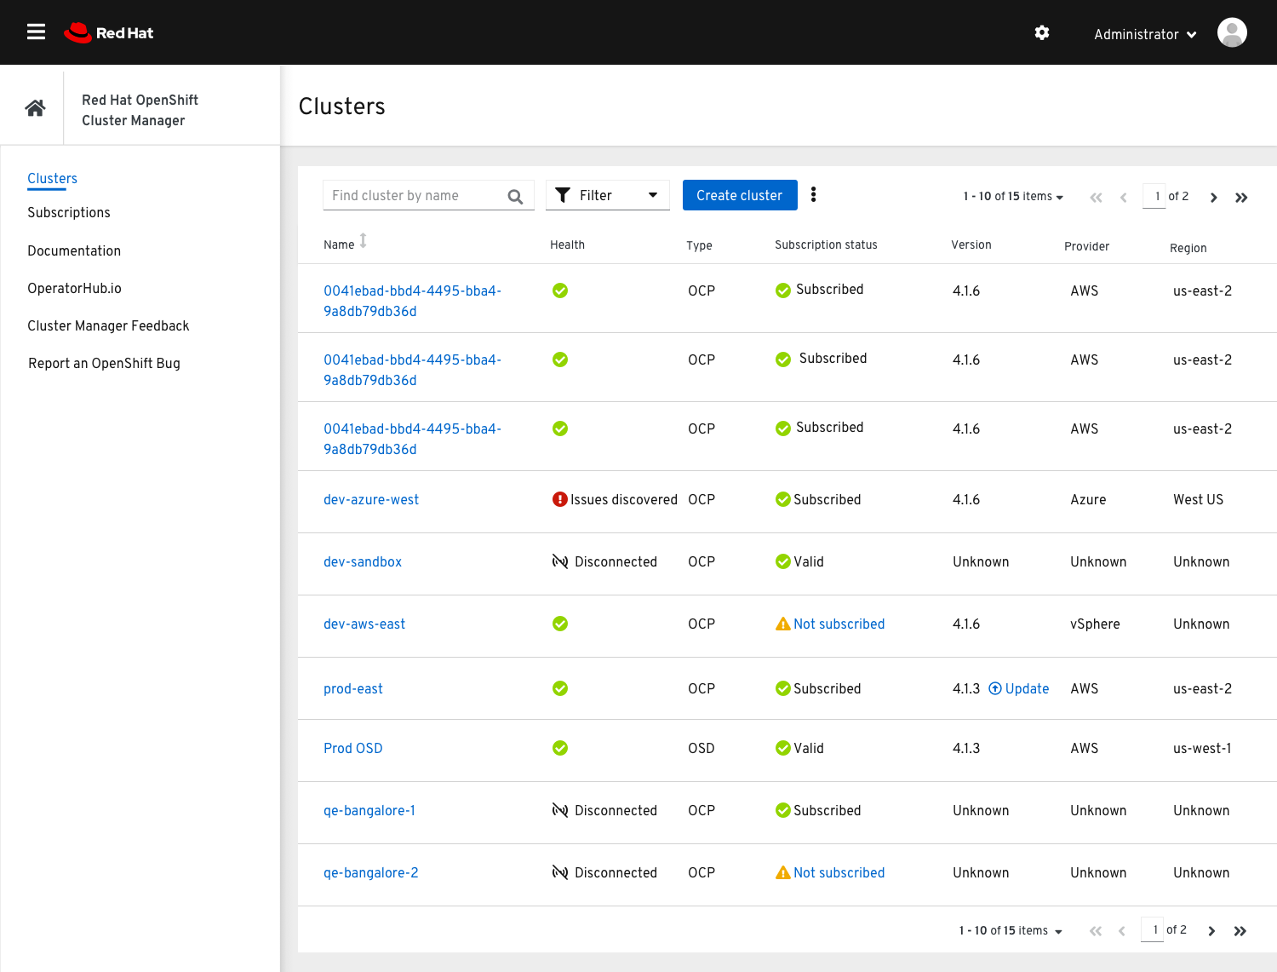
CLOUD-LIKE SIMPLICITY, EVERYWHERE
OpenShift Cluster Manager cloud.redhat.com/openshift
Enhanced OpenShift Web Console Integration
Bi-directional navigation to and from the OpenShift web console for cluster administrators. Deep linking from OCM to the console where relevant.
OpenShift Dedicated cluster management
Self-service cluster provisioning, scaling, and basic management for OpenShift Dedicated customers (4.1+).
Cluster Monitoring
New tab available on all cluster detail pages helps cluster administrators discover critical issues impacting their clusters.
Cluster Updates & New Metrics
OCM provides a link to your cluster’s settings page when updates are available for your cluster. Infrastructure provider and region are now captured and displayed for all clusters, where available.
More OpenShift Install Options
New infrastructure providers, including CodeReady Containers, are now listed as install options.
Product Manager: Jake Lucky
Generally Available

Slide 42
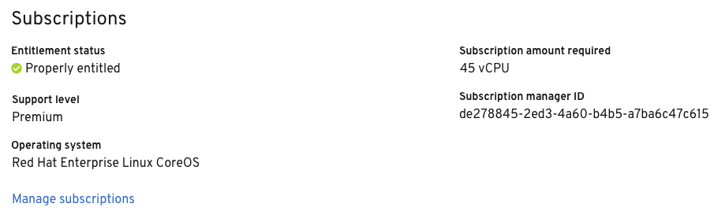
CLOUD-LIKE SIMPLICITY, EVERYWHERE
Subscription Management cloud.redhat.com/openshift
Disconnected Cluster Registration
Register your disconnected clusters with Red Hat to receive support and updates using the online process.
Subscription Compliance Summary
View subscription compliance status across all of your clusters at a glance.
Public Documentation
Outlining the OpenShift 4 subscription management process, added to the public OCP 4.X docs.
OCP 4 Subscription Management
Improved Metrics Collection
RHEL workers, entitled via RHSM, are automatically excluded from remaining entitlement required for your cluster.
Infrastructure Node Labeling
Nodes labeled with the infra node role will be excluded from entitlement required for your cluster.
Generally Available
Product Manager: Jake Lucky

Slide 43
IMPROVE OBSERVABILITY
More visibility for OpenShift Components
Our goal is to provide a 360° view for Openshift
.
In every release, we are increasing the number of OpenShift components monitored out of the box.
If you don’t see a component being yet monitored, please reach out the the respective engineering team.
More than 30 OpenShift-related services we monitor w/ OCP 4.2 (compared to ~5-8 in 3.11).
Generally Available
Product Manager: Christian Heidenreich
Notes:
Every engineering team more and more invests into enabling monitoring for their components running on OpenShift. We started our initiative in 4.1 and our goal is to provide a 360° view for OpenShift admins by the end of next year. That includes all component exposing metrics, alerting rules and dashboards. With every release, we are getting closer to achieve that goal.

Slide 44
IMPROVE OBSERVABILITY
Configure tolerations for monitoring components
Allow customers to deploy Prometheus and other components of the cluster monitoring stack on tainted nodes.
.
1. Edit the cluster-monitoring-config ConfigMap:
$ oc -n openshift-monitoring edit configmap cluster-monitoring-config
2. Specify tolerations for the component:
apiVersion: v1
kind: ConfigMap
metadata:
name: cluster-monitoring-config
namespace: openshift-monitoring
data:
config.yaml: |
prometheus:
nodeSelector:
foo: bar
tolerations:
- key: “key1”
operator: “Equal”
value: “value1”
effect: “NoSchedule”
Generally Available
Product Manager: Christian Heidenreich
Notes:
New configuration for 4.2.

Slide 45
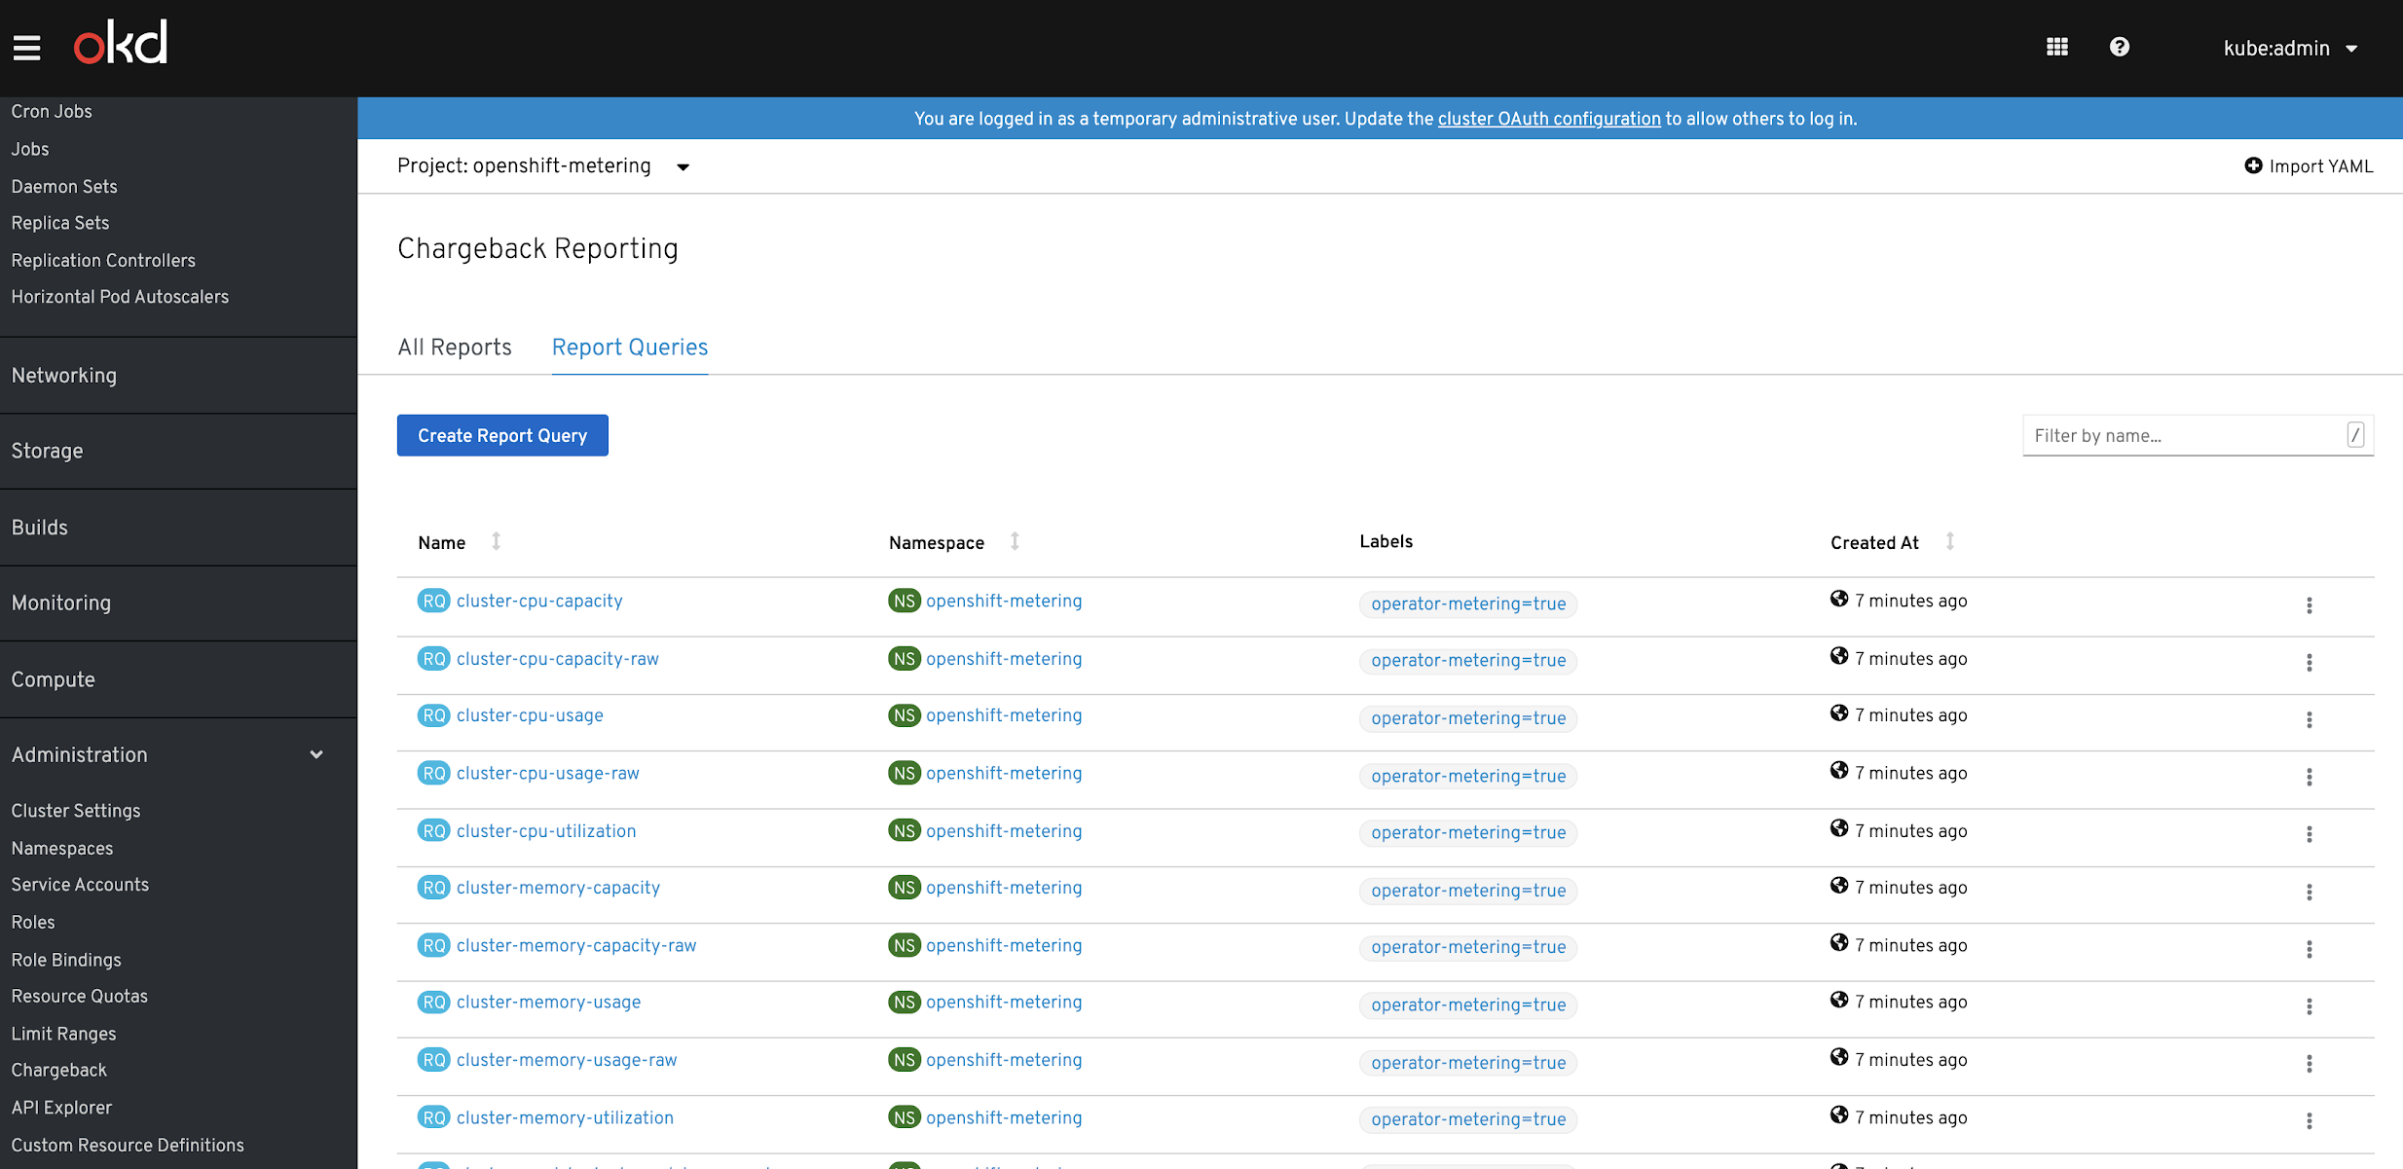
IMPROVE OBSERVABILITY
Metering
ShowBack/ChargeBack Reports available from OperatorHub
.
Base functionality on all providers
Tie into cloud providers for $$
Included reports for 80% use-case
Customers can write custom reports and time periods
Offer basic UI reporting but main use is to plug into customer’s BI tool of choice
CPU
Memory
Storage
Request
Actual Usage
Utilization %
Pod
Namespace
Node
Cluster
Generally Available
Product Manager: Christian Heidenreich
Notes:
GA in 4.2.

Slide 46
Cluster Logging
IMPROVE OBSERVABILITY
Overall performance improvements in collecting logs in 4.x w/ fluentd
Tripled the amount of logs we collect and at the same time reduced resource consumption by ~50%
3.11 | 4.1
750 - 1000 1Kb messages/second/fluentd over 10 namespaces at ~600Mb RSS memory used and 75-85% utilization of a single core. | 2250 - 2500 1Kb messages/second/fluentd over 10 namespaces at ~325Mb RSS memory used and 35% utilization of a single core.
Be notified when something is wrong with Fluentd with new alerting rules in OCP 4.2.
Product Manager: Christian Heidenreich
Generally Available
Notes:
As we are working towards significantly improving our overall stability and performance, it is worth to call out (in general) how much we improved between 3.11 and 4.x already.
Besides continuing improving performance, we will also ship new alerting rules with OCP 4.2 that we make available in our cluster monitoring stack out of the box. More to come in future releases of course.
New alerting rules we are shipping:
Notify users if a Fluentd node is down
Notify users if Fluentd queue length exceeds 32
Notify users if Fluentd queue length increases consistently by 1 over 12h
Notify users if Fluentd error count exceeds 10 in a minute
File: https://github.com/openshift/cluster-logging-operator/blob/master/files/fluentd/fluentd_prometheus_alerts.yaml

Slide 47
A broad ecosystem of workloads
Operator-backed services allow for a
SaaS experience on your own infrastructure
Relational DBs
Big Data
Monitoring
Security
NoSQL DBs
DevOps
AL/ML
Messaging
Storage

Slide 48





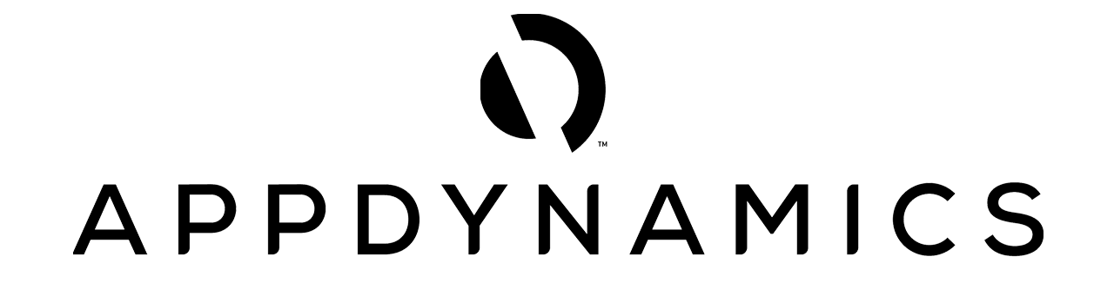












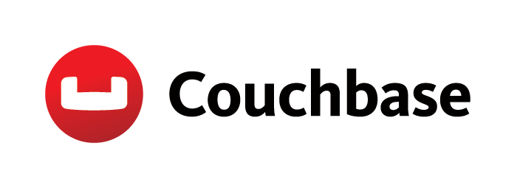















BROAD ECOSYSTEM OF WORKLOADS
Red Hat Certified Operators
DEVOPS
APM
DATA SERVICES
DATABASE
SECURITY
STORAGE
Product Manager: Daniel Messer
Generally Available

Slide 49
BROAD ECOSYSTEM OF WORKLOADS
OperatorHub data sources
Operator Metadata from quay.io
Backend for all default sources, cluster needs to be online
Supplies Red Hat Operators, ISV Operators and Community Operator
Custom sources supported in customer-owned quay.io namespaces
Operator Metadata in container images
Already used internally used by OLM
Operator package data is served from a SQlite database, bundled up in a container image
Custom sources supported in customer-owner image registries
Cluster can be disconnected / air-gapped
Operator Package Metadata
Package name e.g. prometheus
Channel name e.g. stable
Operator Bundle 1
Operator Bundle 2
...
Channel name e.g. tech-preview
Operator Bundle 3
Product Manager: Daniel Messer
Generally Available

Slide 50


Proxy Support
BROAD ECOSYSTEM OF WORKLOADS
OpenShift 4.2 Cluster
OPERATOR
LIFECYCLE MANAGER
Cluster Proxy Config
spec:
containers:
- name: my-container
image: ...
env:
- name: HTTP_PROXY
value: "..."
- name: HTTPS_PROXY
value: "..."
Operator
Pod
Product Manager: Daniel Messer
Generally Available

Slide 51



Operator Telemetry
BROAD ECOSYSTEM OF WORKLOADS
OpenShift 4.2 Cluster
OPERATOR
LIFECYCLE MANAGER
4.2: OLM reports installed Operators name and version
4.3: OLM reports installed Operators name, version and health state
v1.0.1
v2.0.0
v1.3.5
v4.1.2
Product Manager: Daniel Messer
Generally Available

Slide 52



BROAD ECOSYSTEM OF WORKLOADS
4.1 Static Dependency Resolution
Operator Framework Dependency Graphs
resolves to
requires
jaeger.jaegertracing.io/v1
Jaeger Operator
requires
YourOperator v1.1.2
resolves to
cockroachdb.charts.helm.k8s.io/v1alpha1
CockroachDB Operator
Product Manager: Daniel Messer
Generally Available

Slide 53
BROAD ECOSYSTEM OF WORKLOADS
4.2 Automated Dependency Resolution
Operator Framework Dependency Graphs
resolves to
installed by
requires
jaeger.jaegertracing.io/v1
Jaeger Operator
OPERATOR
LIFECYCLE MANAGER
requires
YourOperator v1.1.2
resolves to
installed by
cockroachdb.charts.helm.k8s.io/v1alpha1
CockroachDB Operator
Product Manager: Daniel Messer
Generally Available

Slide 54




CLI UX Enhancements
BROAD ECOSYSTEM OF WORKLOADS
OPERATOR
LIFECYCLE MANAGER
Subscription for YourOperator
Catalog containing YourOperator
Release Channel for YourOperator
Instance of YourOperator
Primary object for status information about:
Subscription
Catalog
OperatorGroup
InstallPlan
Create Subscription
Product Manager: Daniel Messer
Generally Available

Slide 55
Allow regular users to install Operators
BROAD ECOSYSTEM OF WORKLOADS
Namespace / Project
SA Role
In 4.1: only users carrying cluster-admin roles are allowed to install Operators
In 4.2: administrators can delegate install to users
cluster-admin select namespaces in which namespace admins can install operators self-sufficiently
cluster-admin defines ServiceAccount in this namespace
all installed Operators in this namespace get equal or lower permissions of this ServiceAccount
RBAC is typically limited to this namespace
Service Account
cannot be greater than
Operator Group
Operator Role
Product Manager: Daniel Messer
Generally Available

Slide 56

BROAD ECOSYSTEM OF WORKLOADS
OPERATOR
SDK
Build Operators for your apps
Helm Chart
Ansible Playbooks APBs
Helm SDK
Ansible SDK
Go SDK
Build operators from Helm chart, without any coding
Build operators from Ansible playbooks and APBs
Build advanced operators for full lifecycle management
Product Manager: Daniel Messer
Generally Available

Slide 57
BROAD ECOSYSTEM OF WORKLOADS
Red Hat Operator SDK
Helm-based Operator
Support for Helm 2.14
Helm 3 Support under investigation
SDK automatically generates RBAC for your chart
Ansible-based Operator
Support for Prometheus Metrics
Uses UBI base-image
Molecule-based e2e testing
Golang-based Operator
Supporting Kubernetes 1.14
Remove $GOPATH dependency
Go module support
Support for Prometheus Metrics
Generate OpenAPI spec
Framework Integration
Single command to install / uninstall OLM: operatork-sdk alpha olm [install|status|uninstall]
Product Manager: Daniel Messer
Generally Available

Slide 58
BROAD ECOSYSTEM OF WORKLOADS
Service Brokers
Service Brokers / OSBAPI
Admins install Service Brokers via OperatorHub
Devs consume via Developer Catalog
No new functionality / only bugfixes / CVEs
Preparing for deprecation in OpenShift 4.3
Upgrade to OpenShift 4.4 will be stopped if brokers are still present
Product Manager: Daniel Messer
Generally Available
Notes:
We announced future Deprecation in OCP 3.11. The plan is to remove the code so it doesn't appear in OCP 4.4. We will stop your upgrade to OCP 4.4 of you have the service broker loaded. We are investigating allowing ISV who still like service brokers to bring their own service catalog to the platform. So far we haven't found a lot of interest as most prefer the operator feature set.

Slide 59
OpenShift Console
The future is now.
Extending the Console
Improve Observability
Administration made easy
Scaling your Cluster
Notes:
Speaker: Steve Speicher

Slide 60
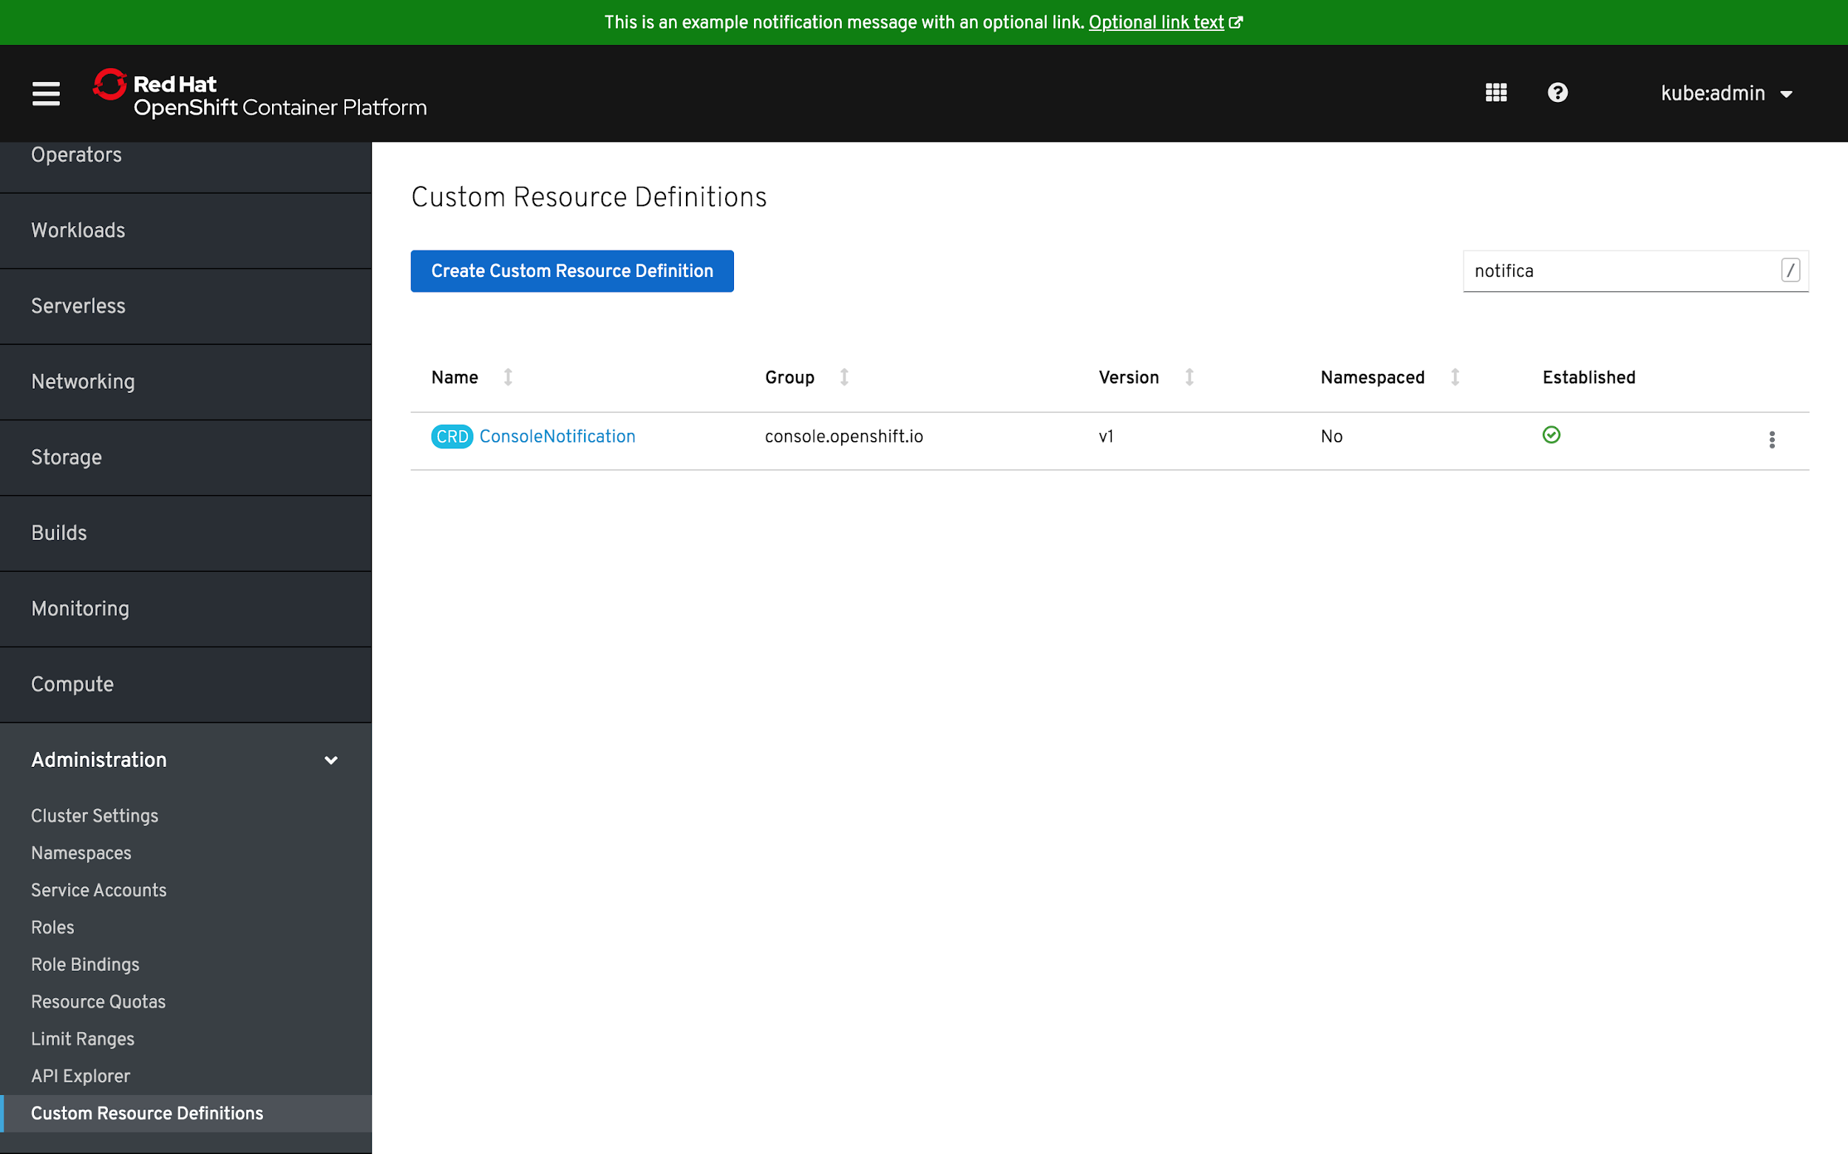
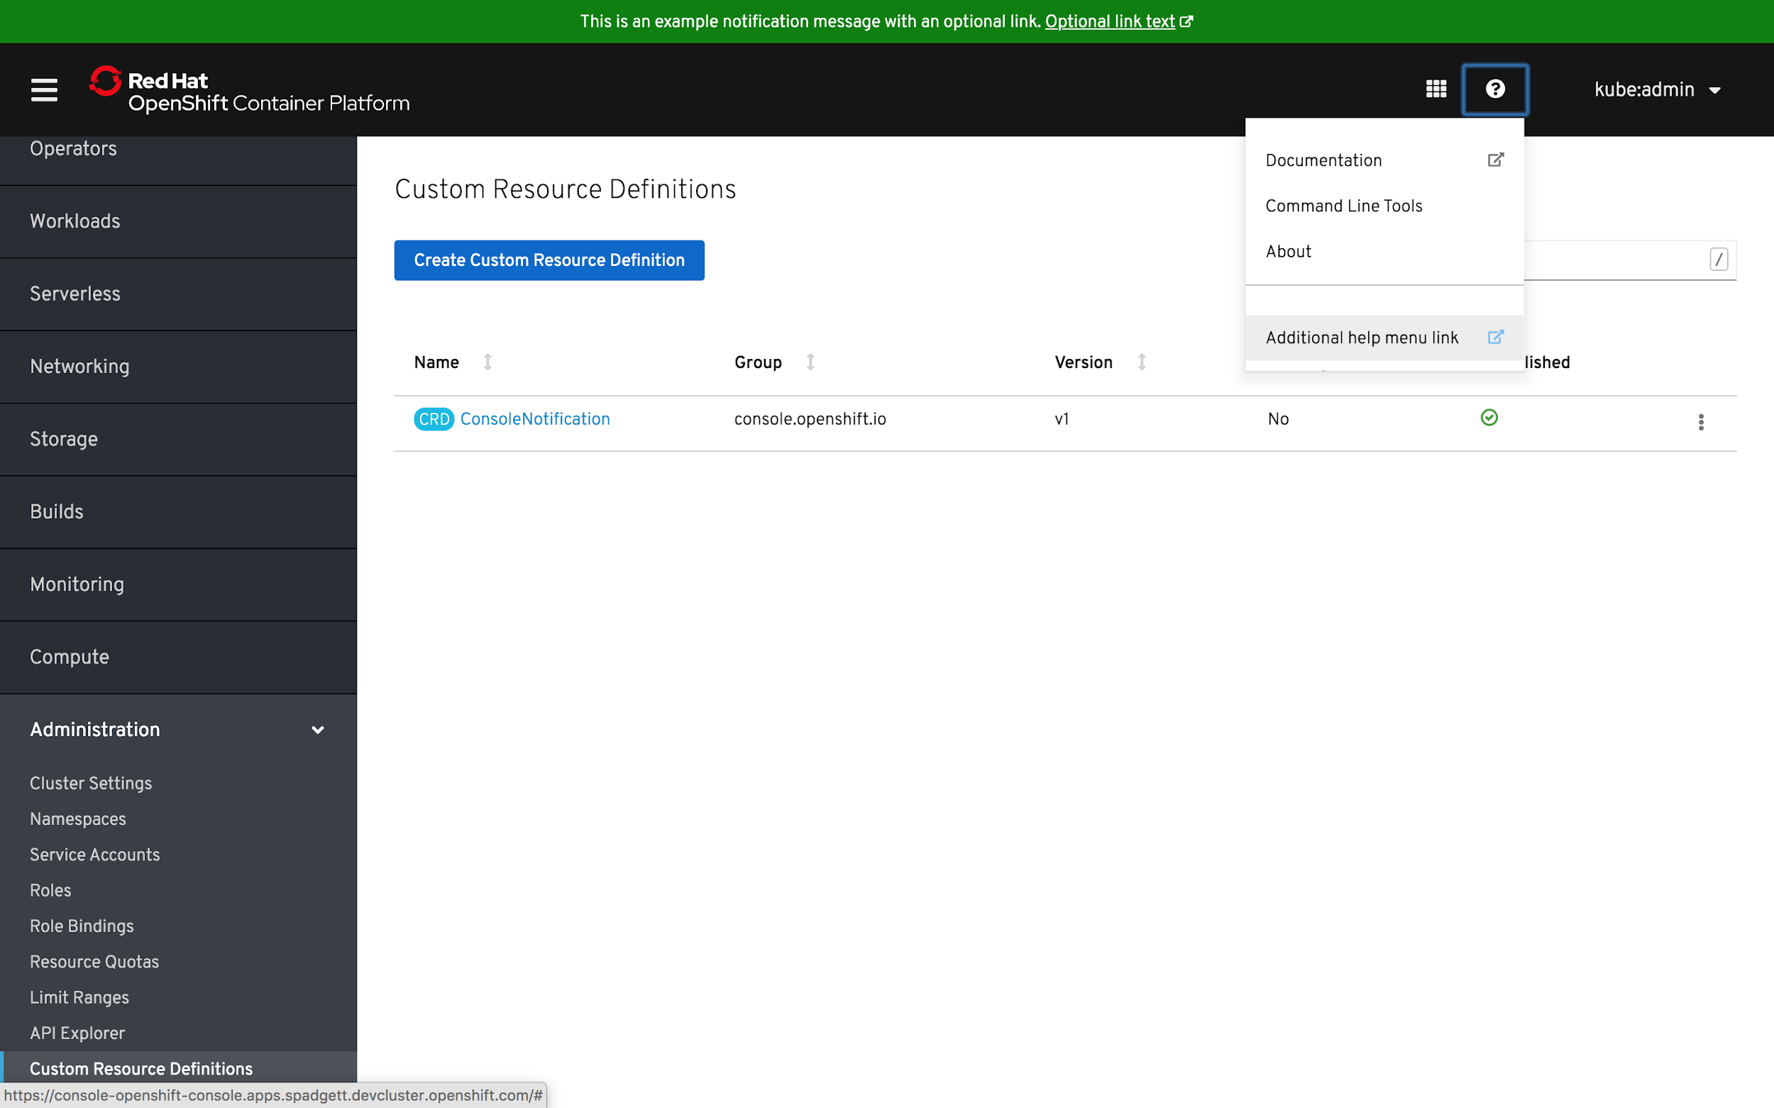
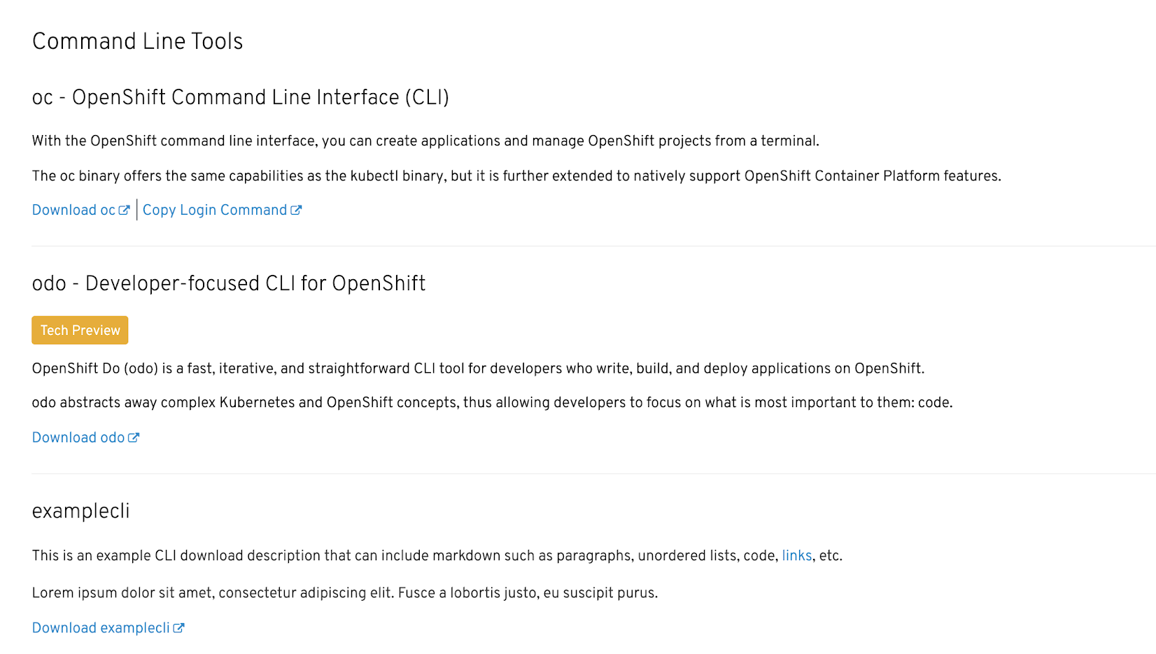
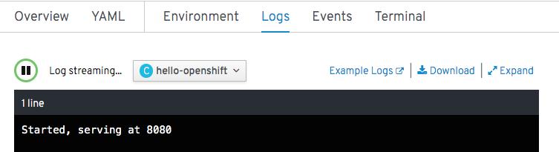
EXTENDING THE CONSOLE
Console Customization for Clusters
Console Customization built with CRDs
Cluster admins will be given the ability to customize certain aspects of the web console for all cluster users.
Customizations include:
Links - ConsoleLinks CRD
Help Menu, User Menu, Application Menu
Notifications - ConsoleNotifications CRD
Top, Bottom, Top and Bottom
Branding - Console-Config ConfigMap
Logo, About
Command Lines - ConsoleCLIDownload CRD
Add your own Command lines
External Log Links - ConsoleExternalLogLinks CRD
Product Manager: Ali Mobrem
Generally Available
Notes:
Speaker: Steve Speicher

Slide 61
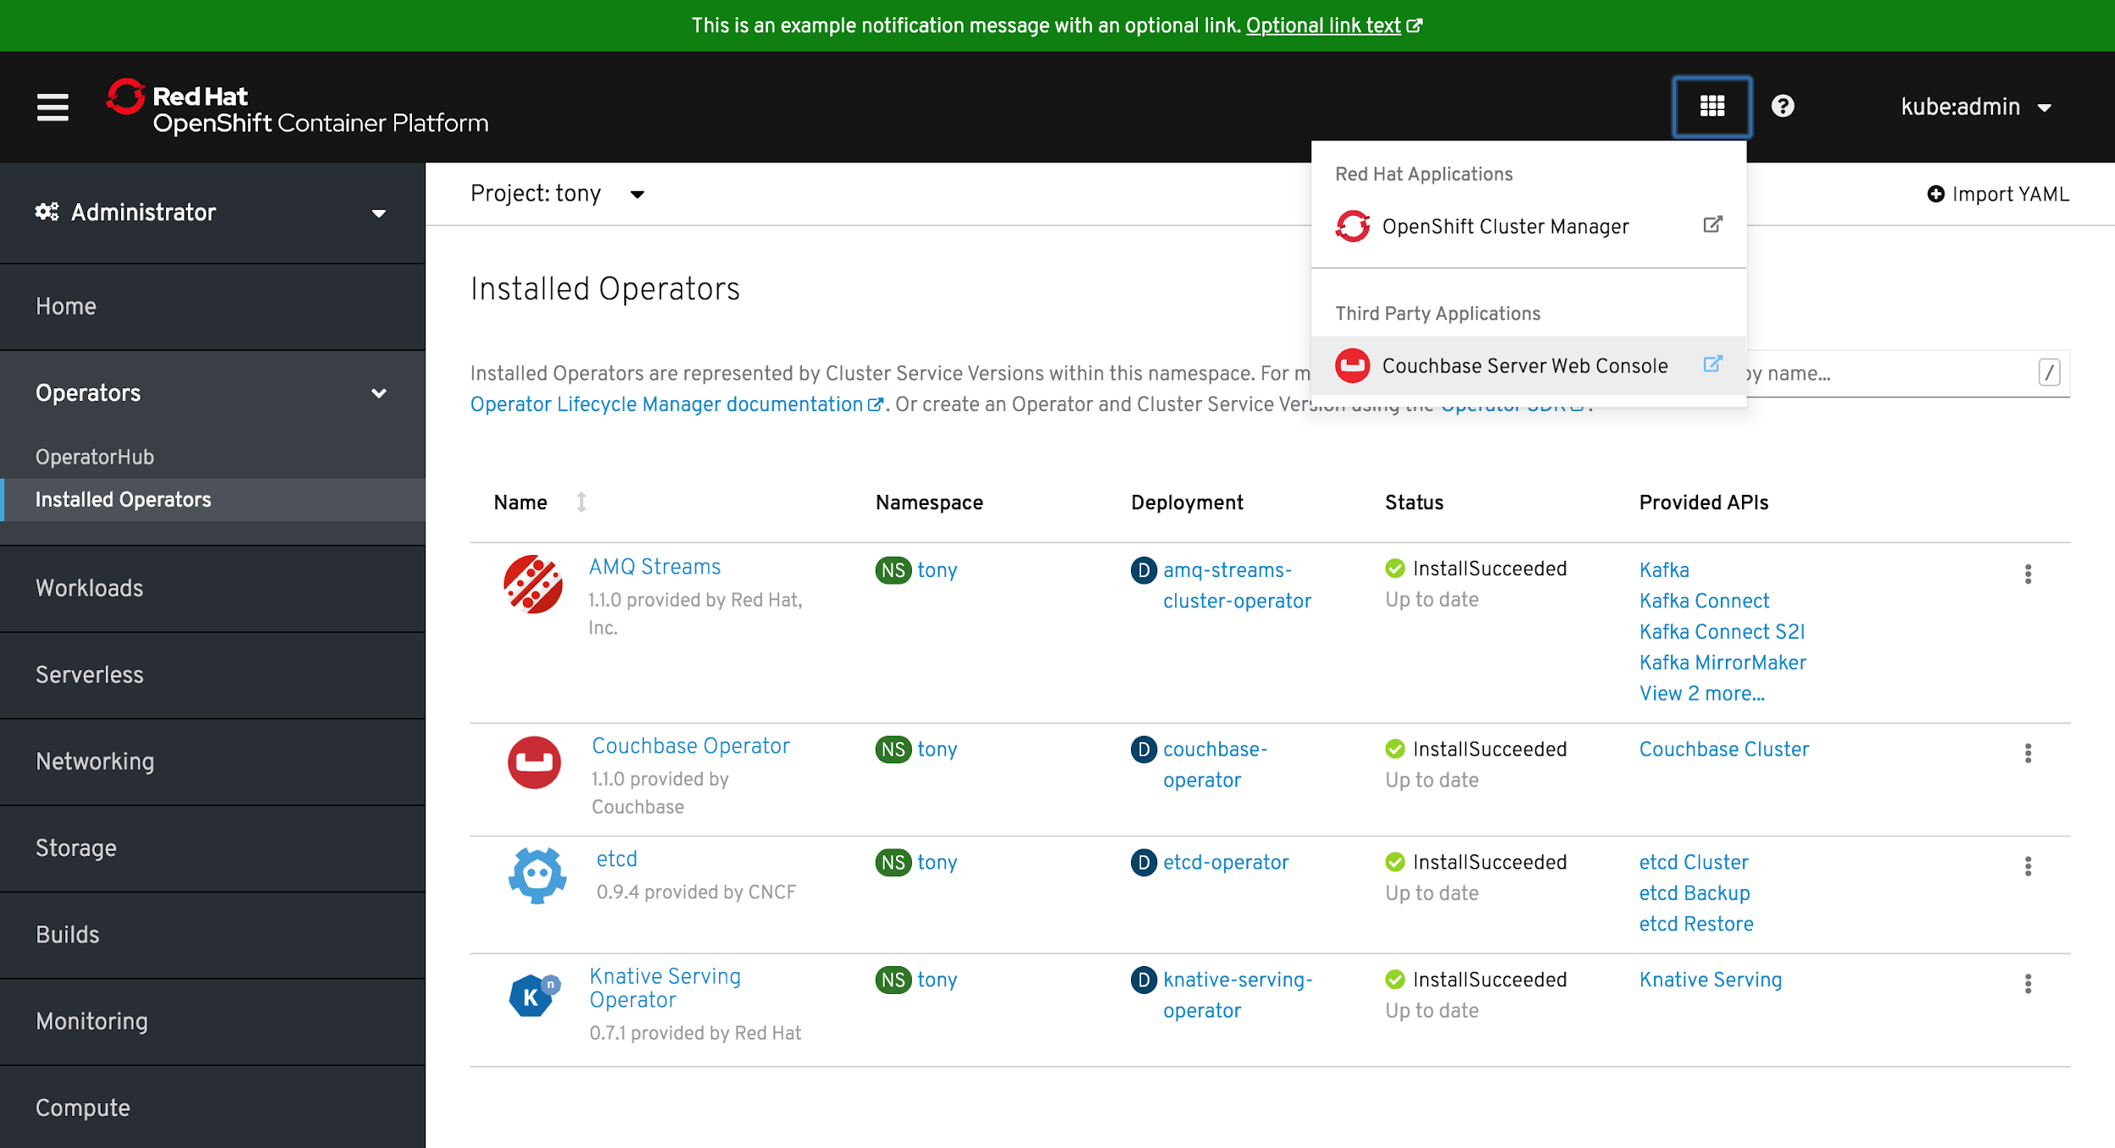
EXTENDING THE CONSOLE
Expose Third Party App Console for Operator-backed Services
Expose Operator-backed service Console through console CRD
Easily integrate/onboard third-party user interfaces in order to develop, administer, and configure Operator-backed services.
Product Manager: Ali Mobrem
Notes:
Speaker: Steve Speicher

Slide 62
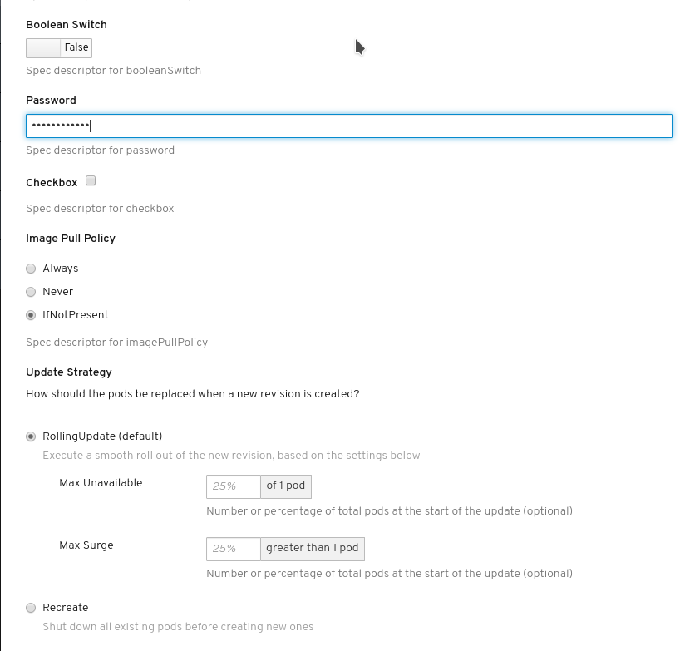
EXTENDING THE CONSOLE
Enhanced Declarative UI for Operator-backed Services
Declarative dynamic UI for creating/mutating the CustomResources managed by the Operators
Generic creation form is generated/validated based on OpenAPIV3Schema
Operator Lifecycle Manager (OLM) descriptors override the generic form generated by the OpenAPIV3Schema with advanced custom widgets
A set of new widgets associated with the specDescriptors:
- text
- number
- password
- fieldGroup
- checkbox
- k8sResourcePrefix
- updateStrategy
- imagePullPolicy
- nodeAffinity
- podAffinity
- podAntiAffinity
- radioButton
- advanced
- fieldGroup
- arrayFieldGroup
Product Manager: Tony Wu
Notes:
Speaker: Steve Speicher

Slide 63
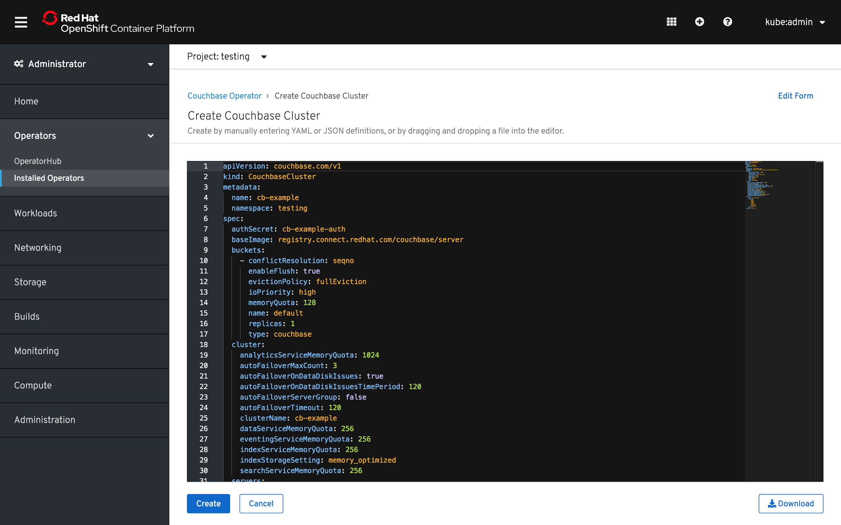
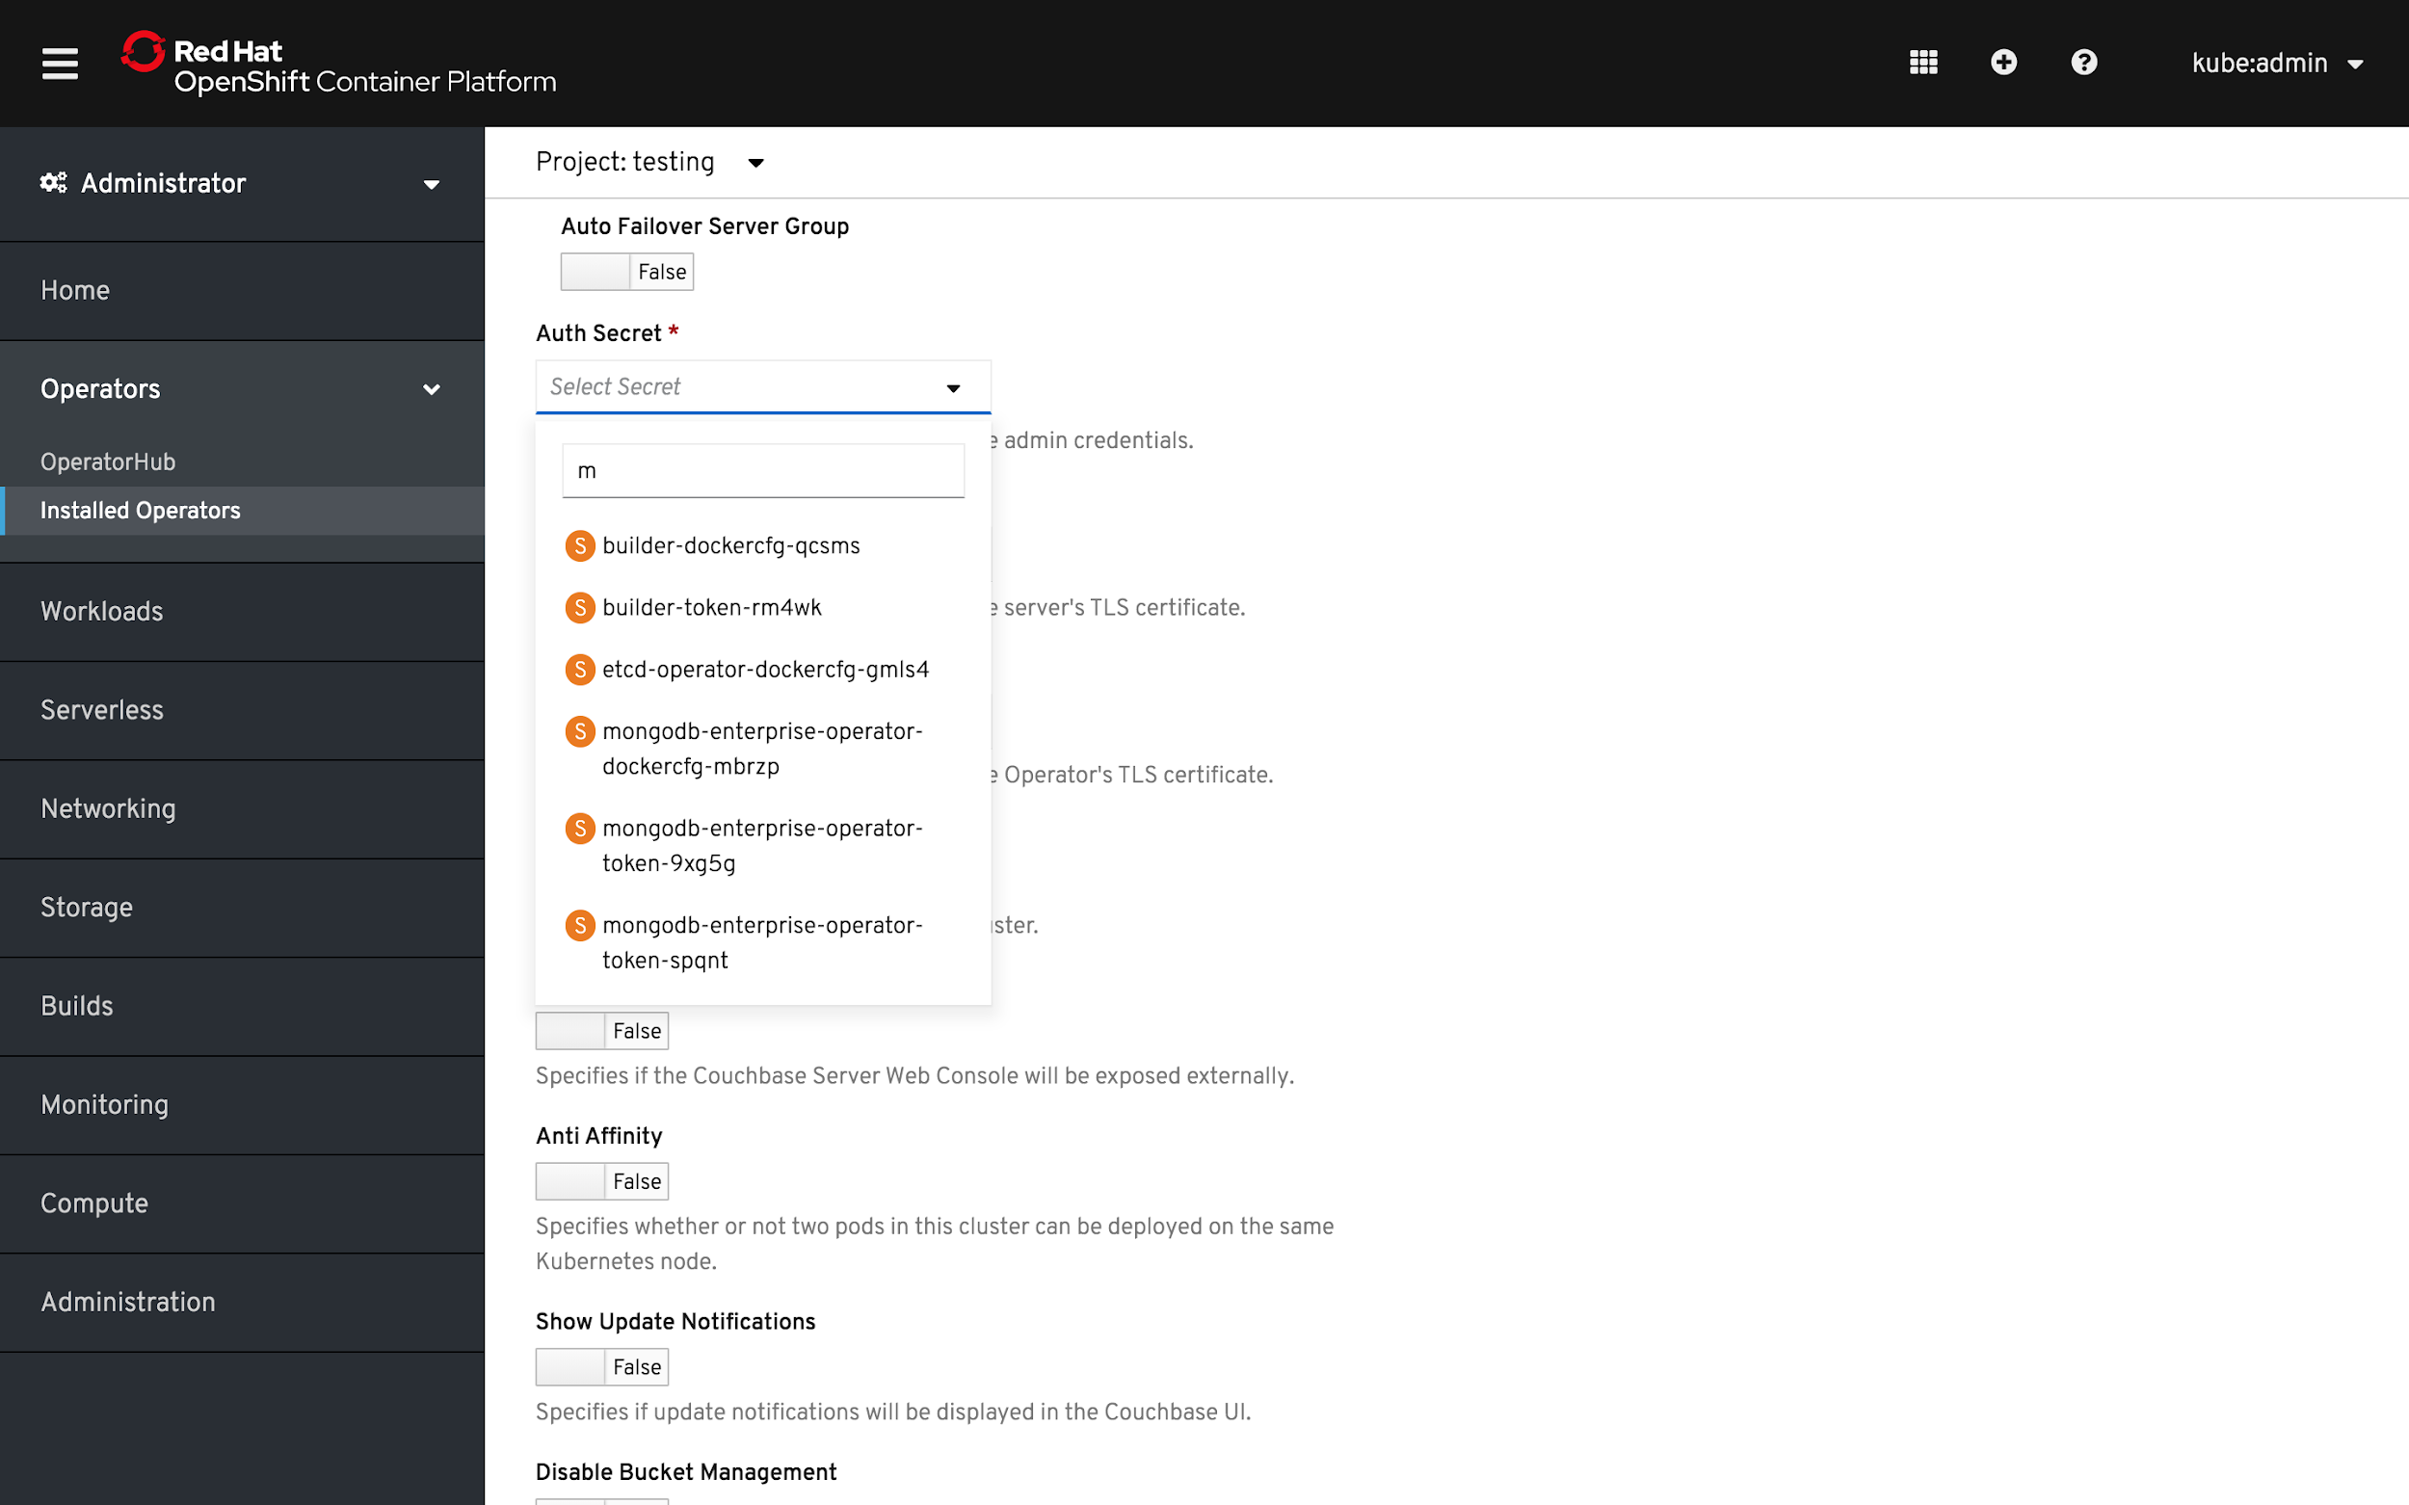
EXTENDING THE CONSOLE
Create/Edit View for Operator-backed Services
Reduce friction for deploying operator backed applications
Rich UI for creating and mutating the app instances
Reusable UI widgets
New Operators get UIs without touching openshift/console codebase at all
Extending the Console
ISVs can built their own UI widgets and contribute back
Product Manager: Tony Wu
Notes:
Speaker: Steve Speicher

Slide 64
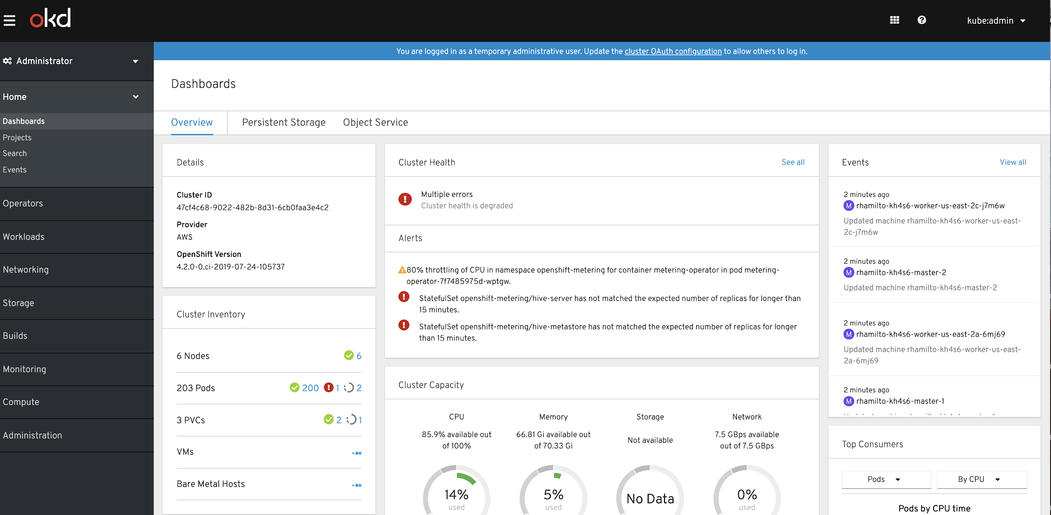
IMPROVE OBSERVABILITY
Enhanced Visibility with the New Dashboard
Cluster-wide Dashboard gives Admins Clear Insights
Drill down in context from the new dashboard widgets:
.
Cluster Details
Cluster Health
Cluster Inventory
Cluster Capacity
Cluster Utilization
Top Consumers
Product Manager: Ali Mobrem
Notes:
Speaker: Steve Speicher

Slide 65
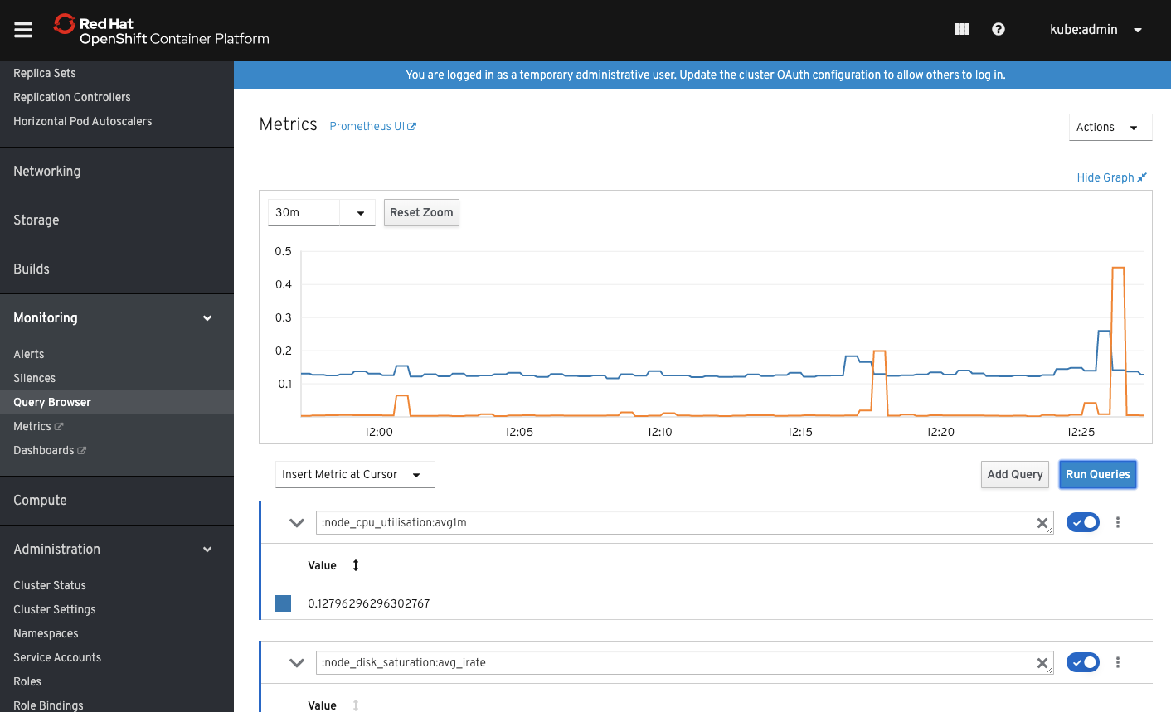
IMPROVE OBSERVABILITY
Metrics with the new Query Browser
Ad-hoc Query Browser
A native interface to create graphs on the fly to help triage what was going on in your cluster.
Use PromQL to query cluster-level metrics and plot results into a graph.
Decide whether you want to see your results in a graph or as text put into a table view.
Product Manager: Christian Heidenreich
Notes:
Speaker: Steve Speicher

Slide 66
IMPROVE OBSERVABILITY
ChargeBack Reports for metering
Managing your Chargeback Reports inside the Console
.
Chargeback/Showback - Break down the reserved and utilized resources requested by applications.
Pod, Namespace, Node & Cluster Reports - Built in reports exist to break down CPU, RAM and Storage in any way you desire.
Scheduled Reports - Schedule reports to run on a standard interval, eg. daily or monthly
Post-Processing - Reports are generated in CSV format and stored in persistent storage for further post-processing. Use this to send reminder emails, integrate into your ERP system, or graph on a dashboard.
CPU
Memory
Storage
Request
Actual Usage
Utilization %
Pod
Namespace
Node
Cluster
Generally Available
Product Manager: Christian Heidenreich
Notes:
Speaker: Steve Speicher

Slide 67
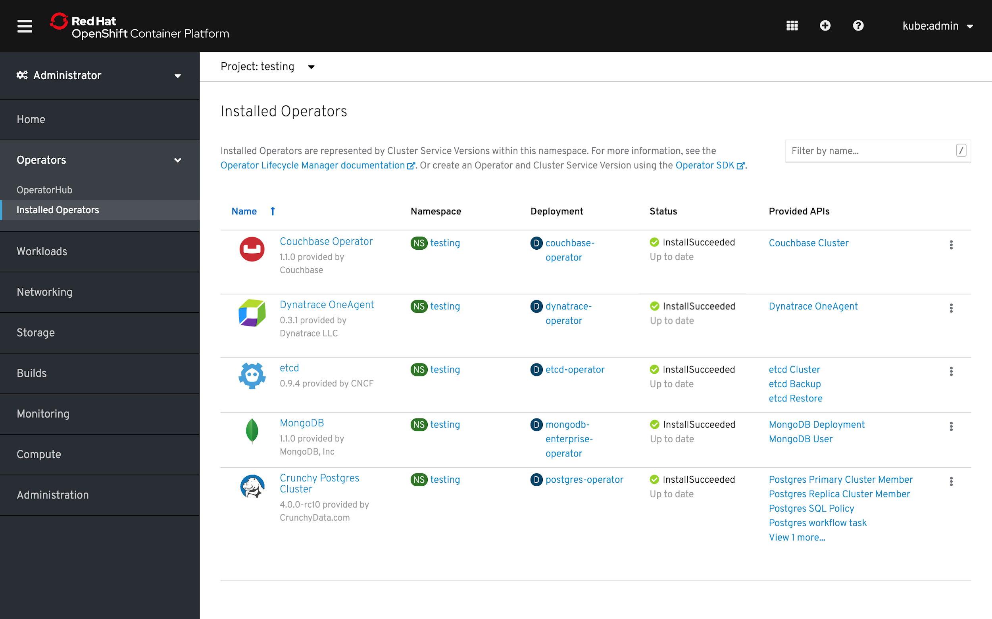
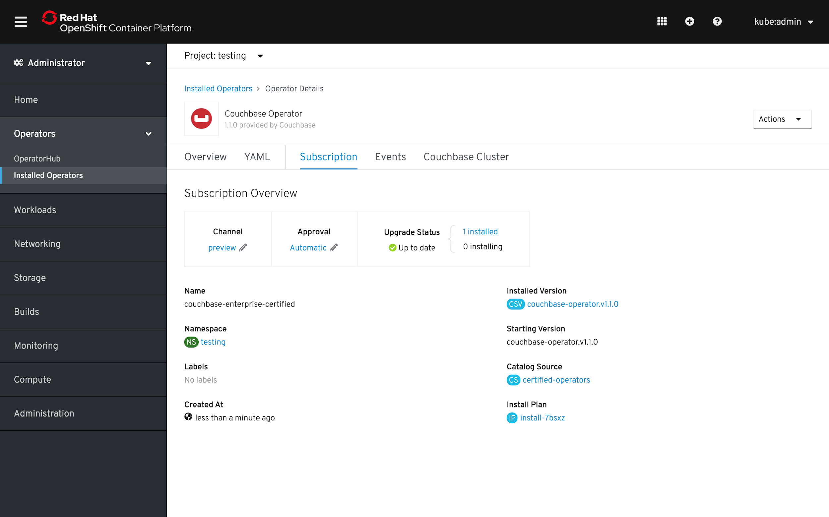
ADMINISTRATION MADE EASY
Operator UI Improvements for Operator Lifecycle Manager (OLM)
Streamlined navigation and Operator management flows
New OLM UI provides a user-focussed, task-oriented approach when it comes to surfacing the OLM concepts to a user.
Product Manager: Ali Mobrem
Notes:
Speaker: Steve Speicher

Slide 68
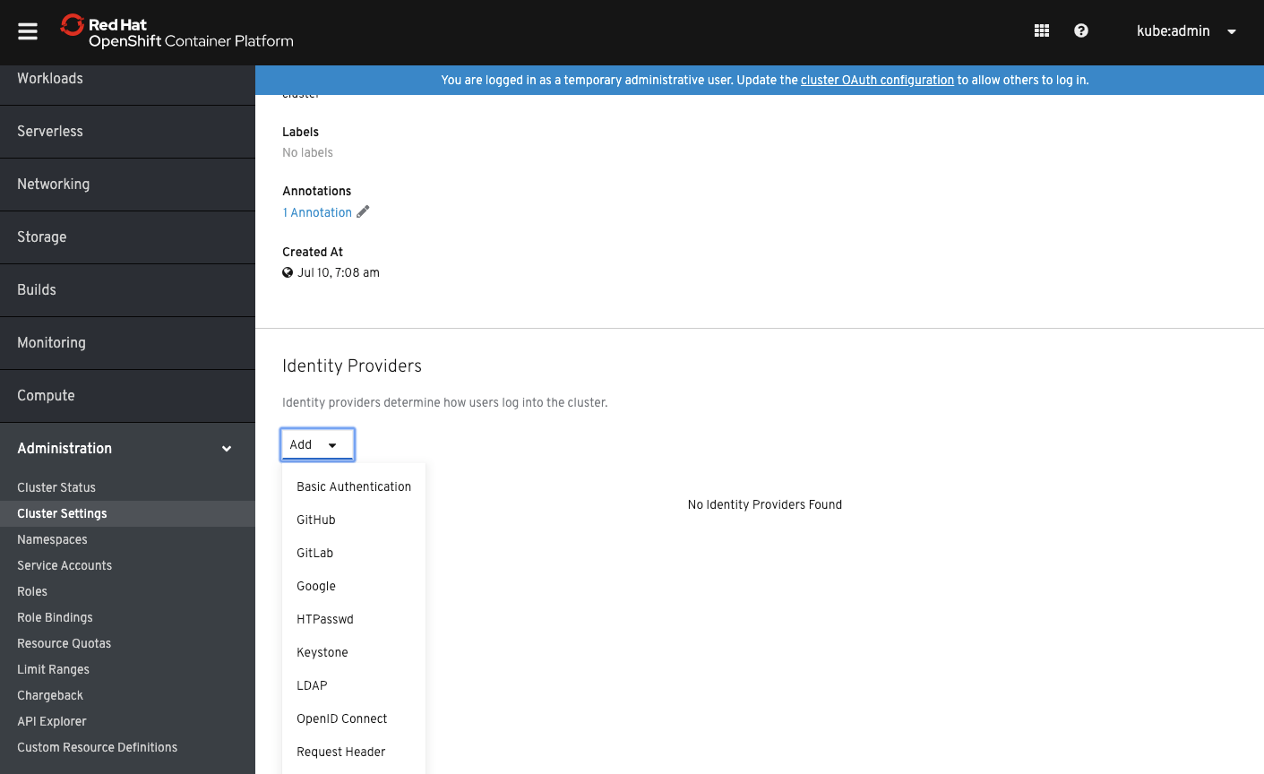

ADMINISTRATION MADE EASY
Configuring Authentication for your desired Identity Providers
Customize and determine how users log into the cluster
Basic Authentication
GitHub
GitLab
Google
HTPasswd
Keystone
LDAP
OpenID Connect
Request Header
Product Manager: Ali Mobrem
Notes:
Speaker: Steve Speicher

Slide 69
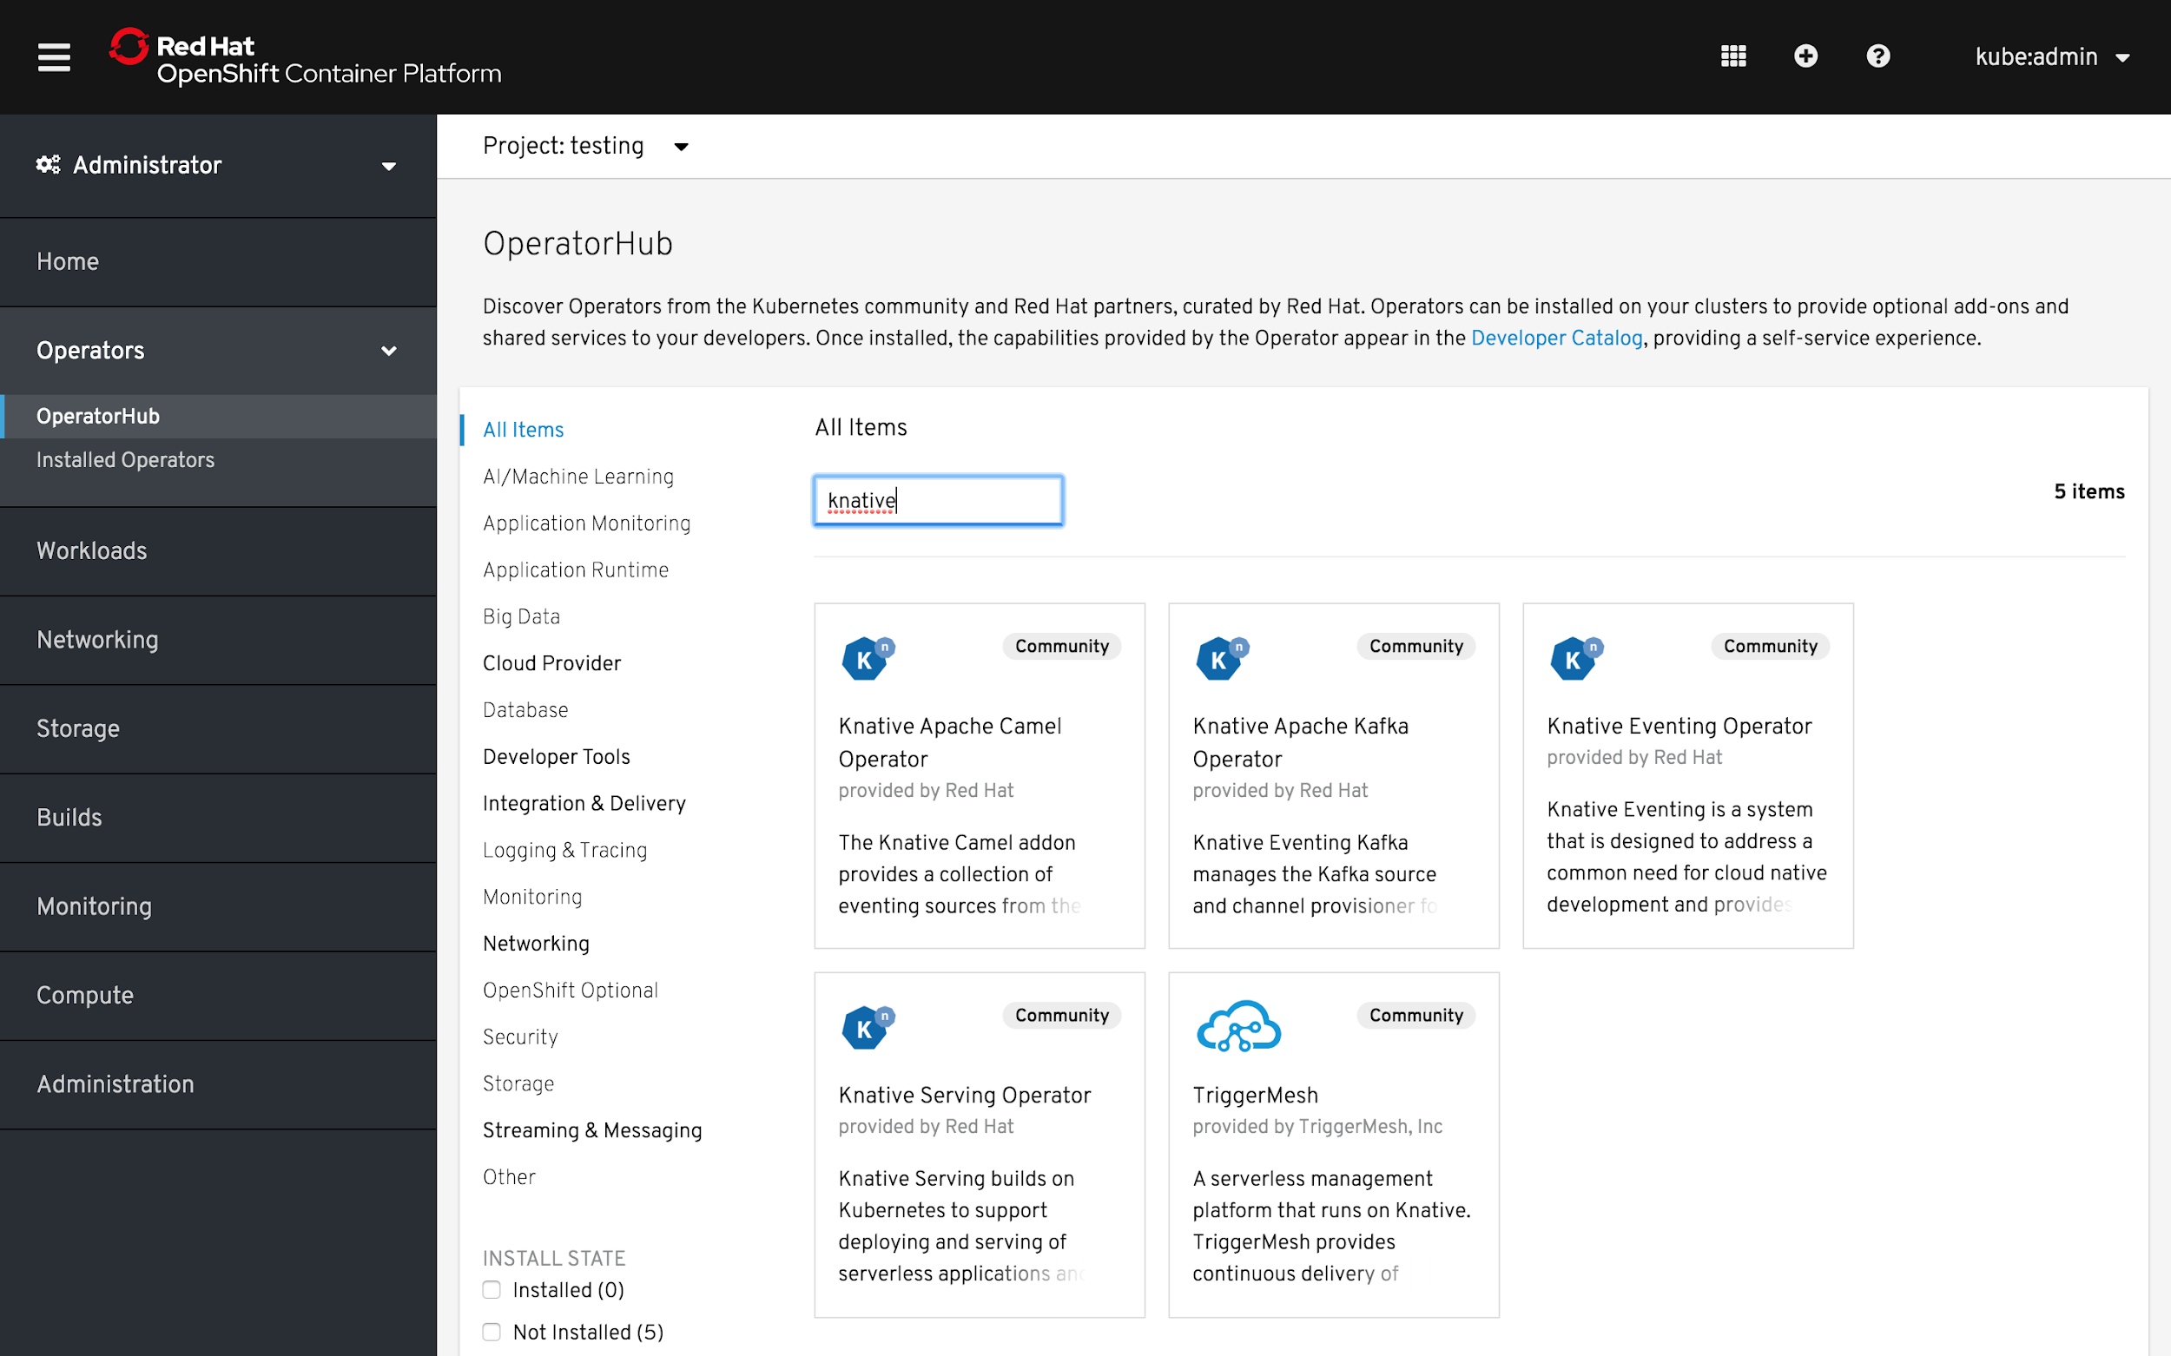

ADMINISTRATION MADE EASY
Knative on OpenShift Serverless via Knative Operators
Build and deploy Serverless applications using an event-driven infrastructure on OpenShift
Product Manager: Ali Mobrem
Notes:
Speaker: Steve Speicher

Slide 70
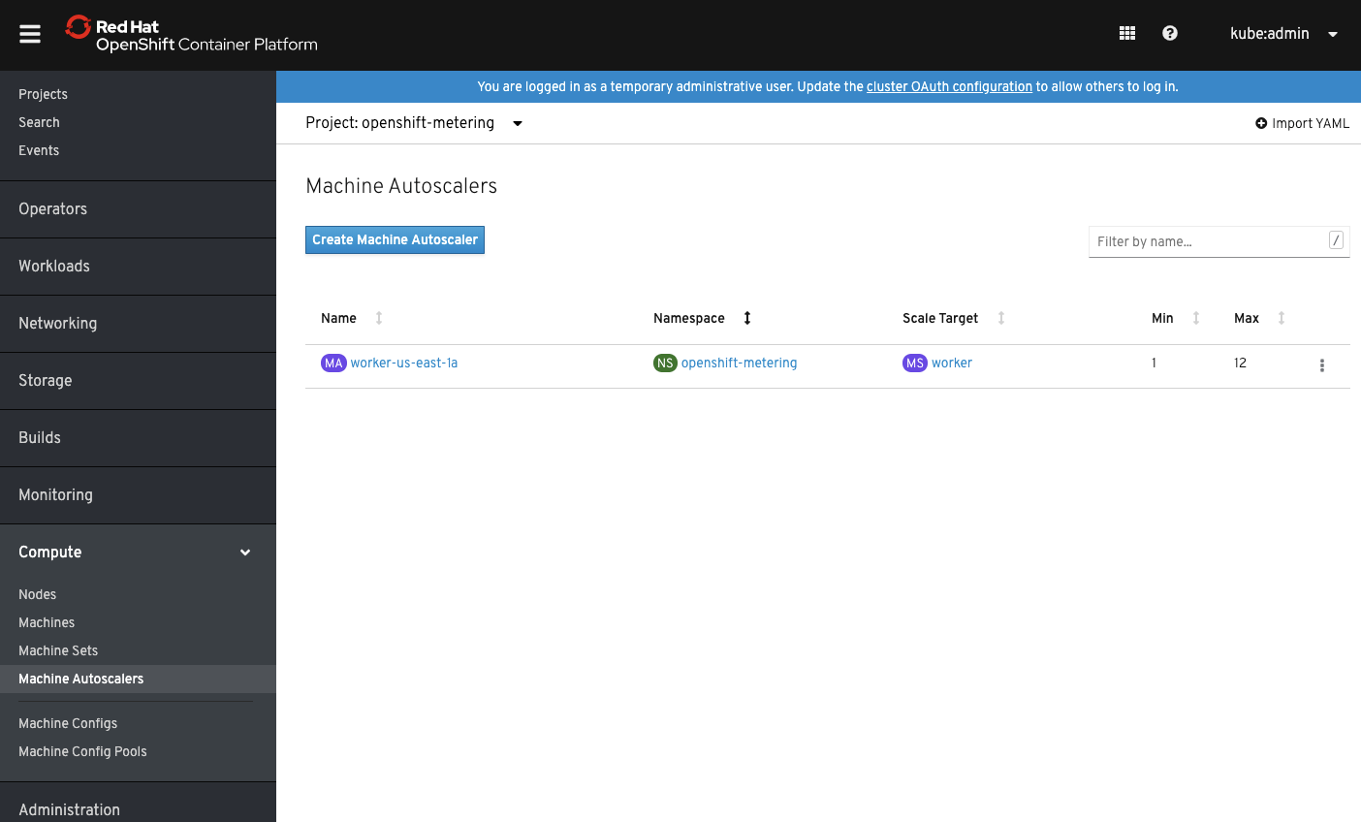
SCALING YOUR CLUSTER
Scaling Your Cluster with the Machine Autoscaler
Machine Autoscaler adjusts the number of Machines in the MachineSets being deployed in your cluster.
Increase Machines when the cluster runs out of resources to support more deployments.
Any changes such as the minimum or maximum number of instances, are immediately applied to the MachineSet that MachineAutoscalers target.
Product Manager: Ali Mobrem
Notes:
Speaker: Steve Speicher

Slide 71
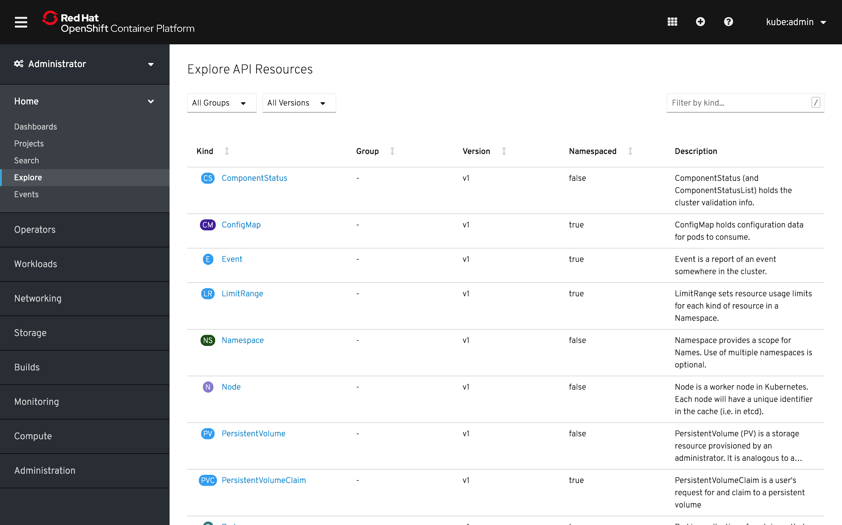
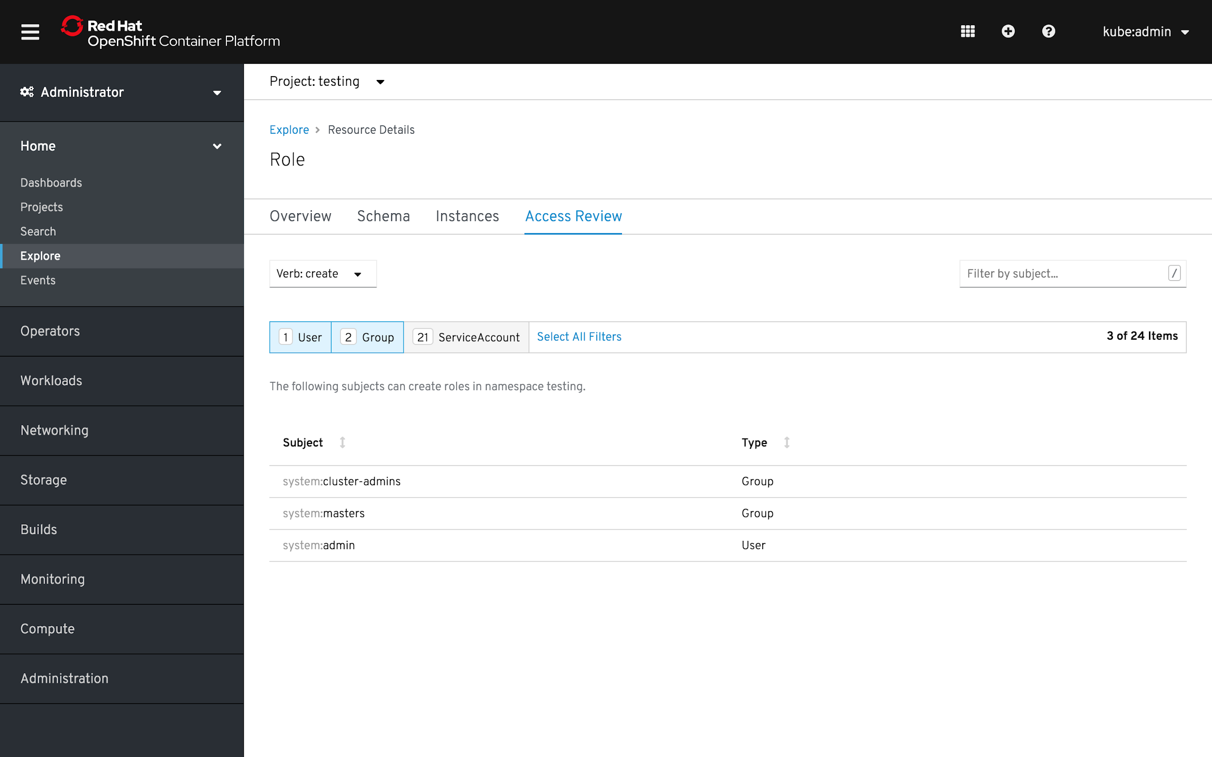
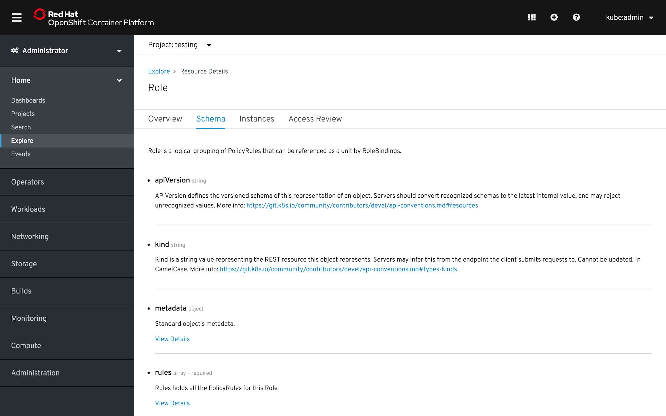
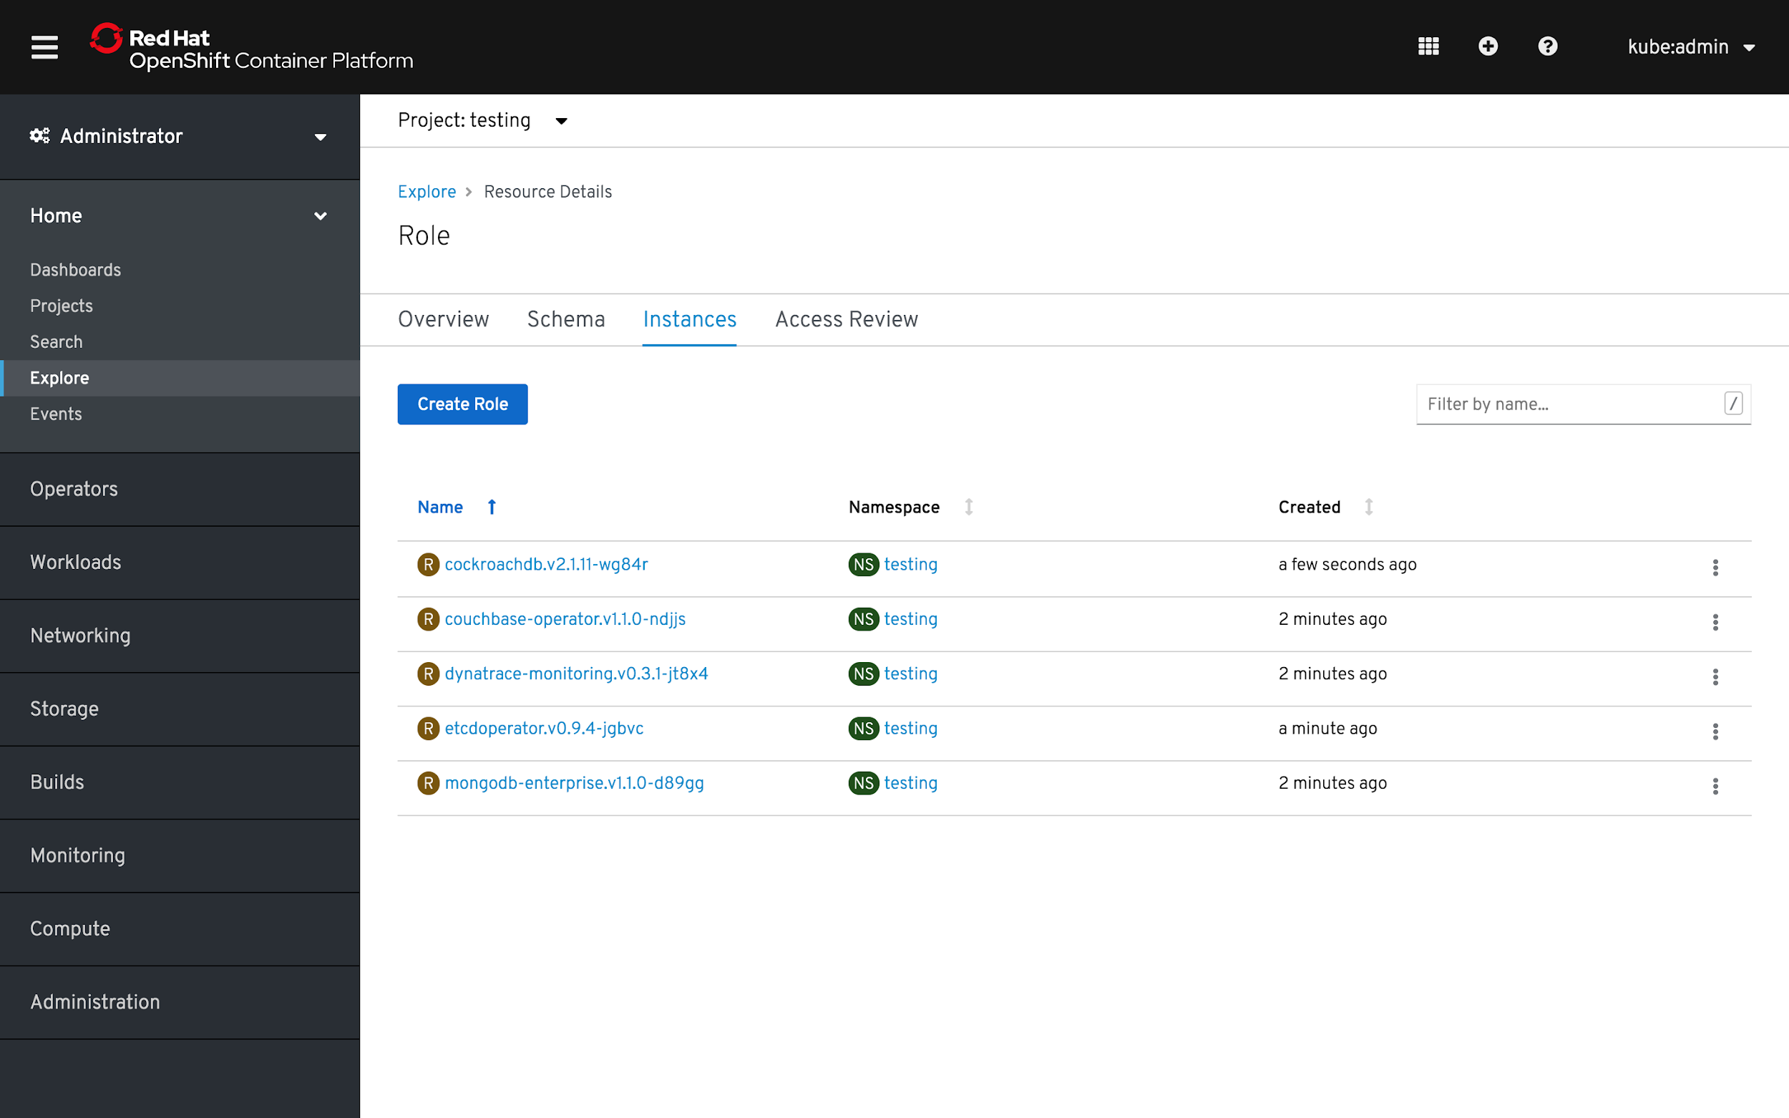
ADMINISTRATION MADE EASY
Explore Kube’s APIs Interactively via API Explorer
Explore and manage various Kubernetes APIs interactively
View the schema for each API and what parameters being supported
Manage the instances of the API
Review the access of each API
Product Manager: Ali Mobrem
Notes:
Speaker: Steve Speicher

Slide 72
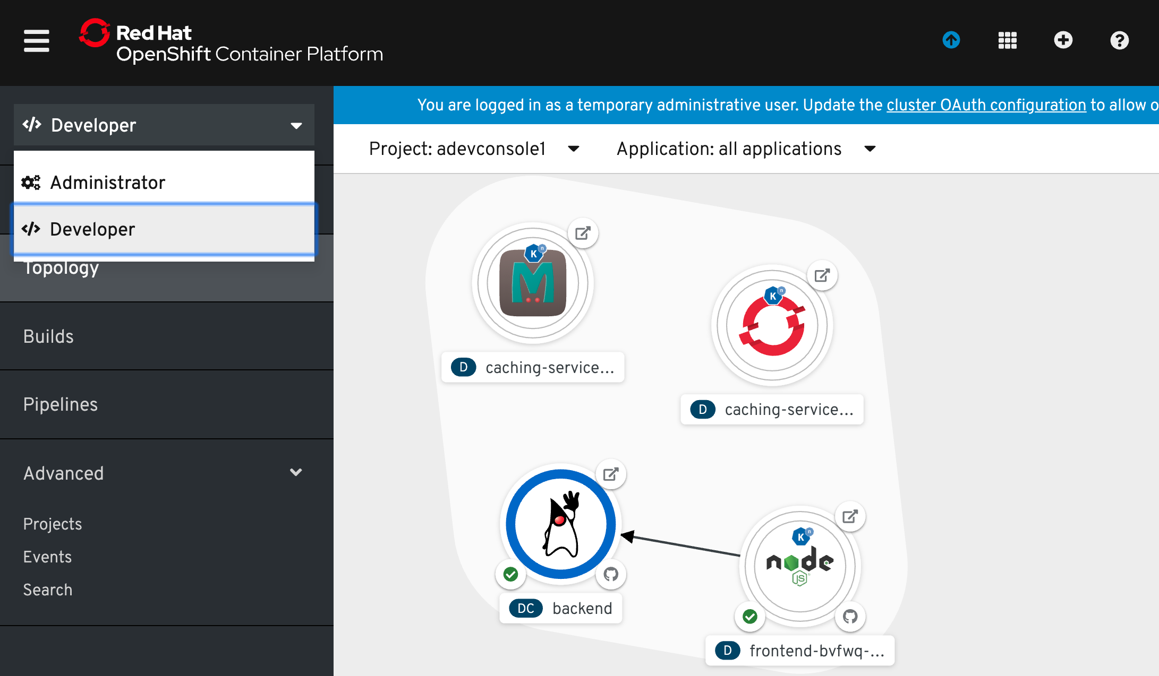
Web Console - Developer Perspective
Developer Perspective
An alternative perspective in the OpenShift UI that will sit beside the admin console and focus on developer use cases.
All OpenShift developer tool UIs will be surfaced here...though some (like CodeReady Workspaces) will be links out to unique UIs.
Product Manager: Steve Speicher
Notes:
The developer console delivers:
A streamlined dev perspective that abstracts away the need for familiarity with Kubernetes concepts and only surfaces information and configuration the developers care about.
With the console developers can:
Import their code from Git
Easier way to build from a dockerfile
See and manage the configuration of their applications (Topology)
- grouping and status
- workload details
- builds, routes, source

Slide 73
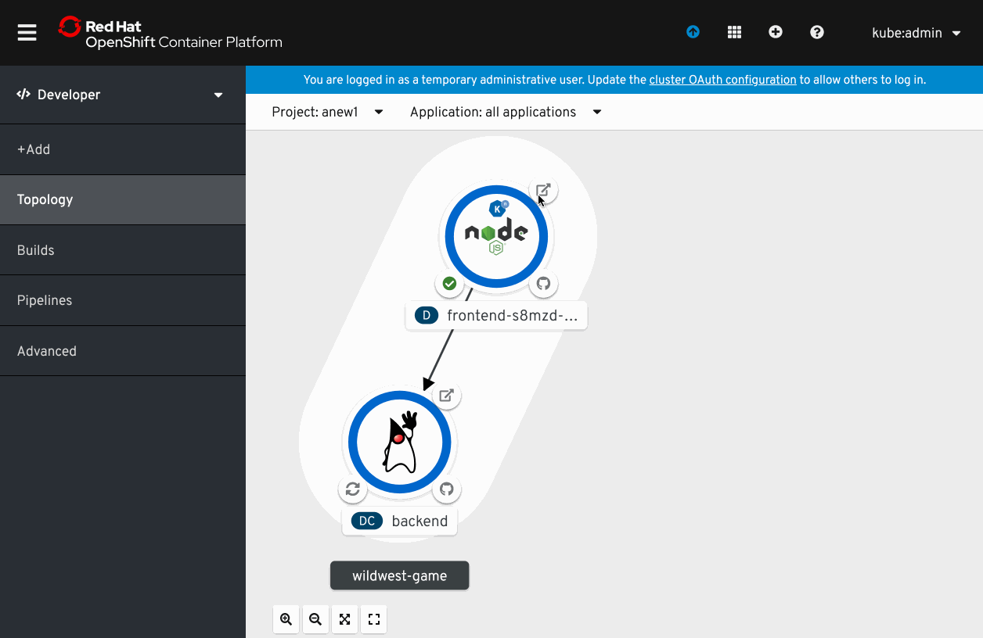
Application Topology
Developer Perspective
Key Features
View structure and status of app components
Drill into specific workloads
Quickly navigate to pod logs
Manually scale
Pod donut!
Access route/URL
Linked build and source
Product Manager: Steve Speicher
Notes:
Speaker: Steve Speicher

Slide 74
Next wave of developer tools
OpenShift has all of the latest tools to make
your devs more productive
Code
Containers
Serverless
Service
Mesh

Slide 75


NEXT WAVE OF DEVELOPER TOOLS
CodeReady Workspaces
The collaborative OpenShift-Native IDE. Free for any customer of OpenShift Dedicated or OpenShift Container Platform.
Container Workspaces
Workspace replicas to end “works on my machine” and enable team collaboration.
DevOps Integrations
Reference developer workspaces from any issue, failed build, or git notification.
Protect Source Code
Full access to source code without any of it landing on hard-to-secure laptops.
Based on the open
Eclipse Che project
Red Hat Linux and Application Infrastructure
Plugin model for extensibility
Serverless support
(coming later)
Use It To: Replace VDI for devs, and enable true container-based DevOps.
Product Manager: Stevan LeMeur
Generally Available
Notes:
Speaker: Steve Speicher
CodeReady Workspaces 1.2 updated around 4.1 timeline
Includes Eclipse Che
Operator available via OperatorHub

Slide 76
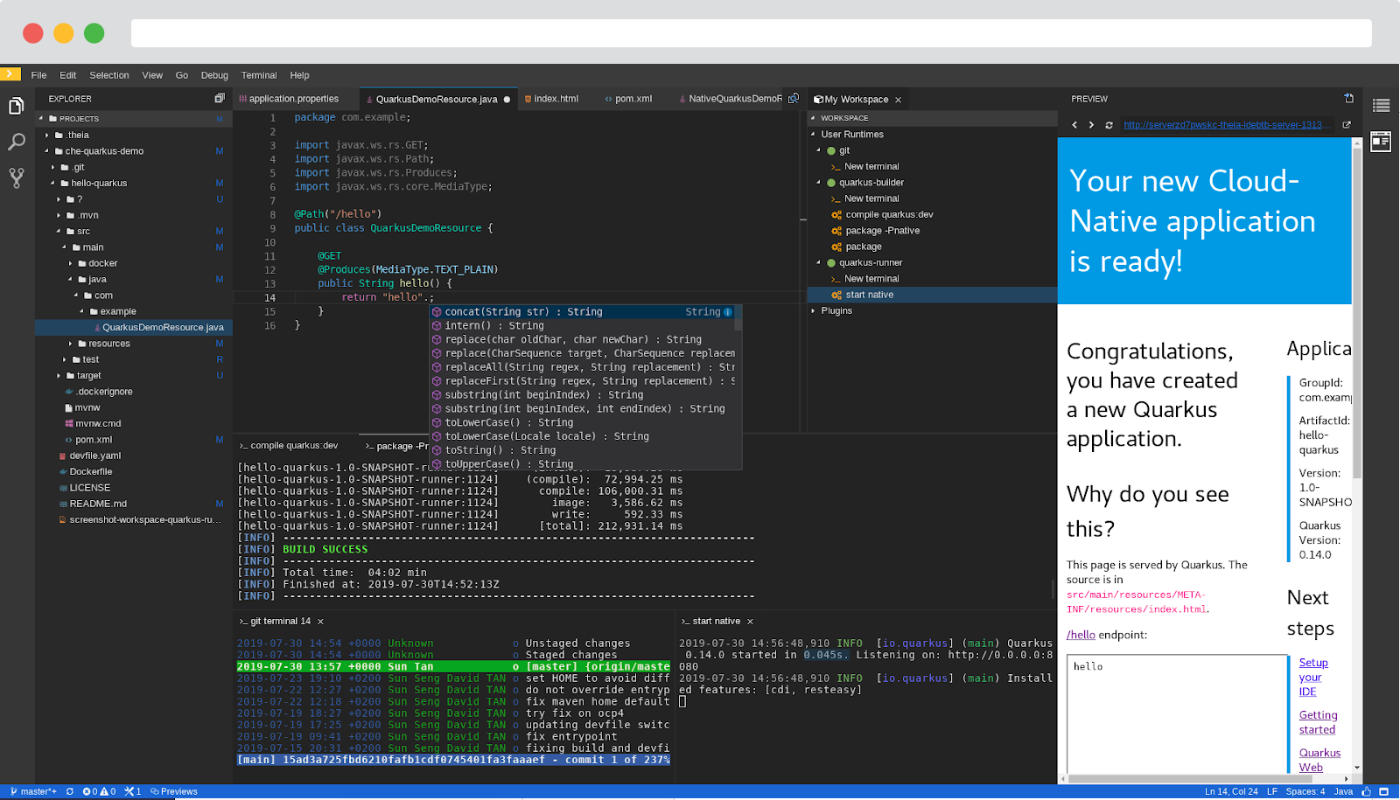
NEXT WAVE OF DEVELOPER TOOLS
CodeReady Workspaces 2.0
Based on Eclipse Che 7
Kubernetes-based developer workspaces: Fully containerized developer workspaces allowing to bring your K8S application runtime easily in your dev environment.
New Editor: New default web-based editor provides a VSCode like experience in the browser.
Devfile: Configure a devfile for your project and get reproducible and portable developer environments.
VSCode plug-ins compatibility
Swappable Editor
OpenShift VSCode Plug-in
Easier to Monitor and Administrate: Prometheus and Grafana dashboards.
Shipped independently from 4.2, shortly after
Product Manager: Stevan Le Meur
Planned for Q3FY20
Notes:
Speaker: Steve Speicher
Kubernetes-based developer workspaces: Fully containerized developer workspaces allowing to bring your application runtime back easily in your dev environment.
New Editor: Based on Eclipse Theia, the new default web-based editor provides a VSCode like experience in the browser.
Devfile - developer environments as code: Configure a devfile for your project and get reproducible and disposable portable developer environments.
New plug-ins and extensibility model: Get the plug-ins you need for your project with VSCode extension compatibility. Swap IDEs with custom ones such as Jupyter, Eclipse Dirigible, or others.
Kubernetes and OpenShift Support: Deploy on any public cloud or on-premise Kubernetes.
Easy to Monitor and Administrate: Prometheus and Grafana dashboards to easily control your Eclipse Che deployment.

Slide 77
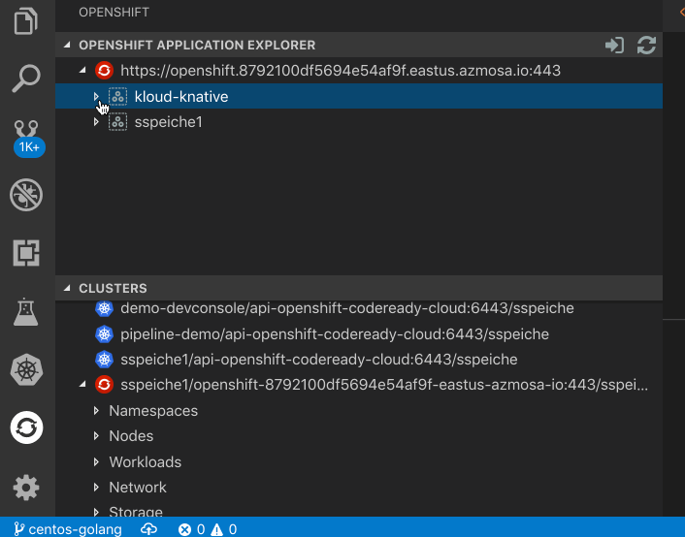
NEXT WAVE OF DEVELOPER TOOLS
VS Code Kubernetes Extension
Kubernetes Extension Improvements
Collaboration spearheaded by Red Hat and OpenShift needs
Many improvements around:
Non-cluster-admin use cases
Auto-hide Helm features when no Tiller installed
Add nodes to navigator
OpenShift Improvements
OpenShift logo on OpenShift clusters
Add: Routes, DeploymentConfig, Projects, ImageStreams
Ability to set Project context
Product Manager: Bob Davis
Generally Available
Notes:
Speaker: Steve Speicher

Slide 78
odo - OpenShift’s Dev-Focused CLI
Developer focused clients
$ odo create wildfly backend
Component ‘backend’ was created.
$ odo push
Pushing changes to component: backend
$ odo create php frontend
Component ‘frontend’ was created.
To push source code to the component run ‘odo push’
$ odo push
Pushing changes to component: frontend
$ odo url create
frontend - http://frontend-myapp.192.168.99.100.nip.io
$ odo watch
Waiting for something to change in /dev/frontend
Developer-focused CLI for rapid development iterations on OpenShift
Simplifies building of microservices applications on OpenShift.
Use It To: Enable the ‘git push’ flow developers love, but with OpenShift Kubernetes.
Product Manager: Steve Speicher
Notes:
Speaker: Steve Speicher

Slide 79
CodeReady Containers: OpenShift on your Laptop
Desktop virtualization
Provides a pre-built development environment based on Red Hat Enterprise Linux and OpenShift for quick container-based application development. Use with OpenShift on-premises or cloud.
Based on OpenShift 4.x
Linux (libvirt)
Windows (Hyper-V)
MacOS (Virtualbox)
External beta available
Replaces the 3.x experiences around:
Minishift
CDK
oc cluster up
$ crc setup
Prepare your machine for running OpenShift
$ crc start -b crc-hyperkit-4.2.0.crcbundle
Start with the Hyperkit 4.2 bundle
$ crc status
Get the status of the cluster
Use It To: Simplify direct-to-OpenShift development on laptops.
Product Manager: Steve Speicher
Notes:
Speaker: Steve Speicher

Slide 80
Build Configurations Defaults
OPENSHIFT PLATFORM
apiVersion: config.openshift.io/v1
kind: Build
metadata:
name: cluster
spec:
additionalTrustedCA:
name: trustedCAsConfigMap
buildDefaults:
defaultProxy: # http, https and no proxy
gitProxy: # http, https and no proxy
env: # key-values
imageLabels:
resources:
limits: # cpu, memory
requests: # cpu, memory
buildOverrides:
imageLabels:
nodeSelector:
tolerations:
Cluster level settings for BuildConfigs
Additional CAs to be trusted for image pull/push
Proxy setting for image pull/push and source download
Proxy settings for git commands
Environment variables to set on all builds
Docker labels to apply to resulting images
Build resource requirements
Default values to override on builds even if user has provided values on the buildconfig
oc edit build.config.openshift.io/cluster
Product Manager: Siamak Sadeghianfar
Notes:
Speaker: Steve Speicher

Slide 81
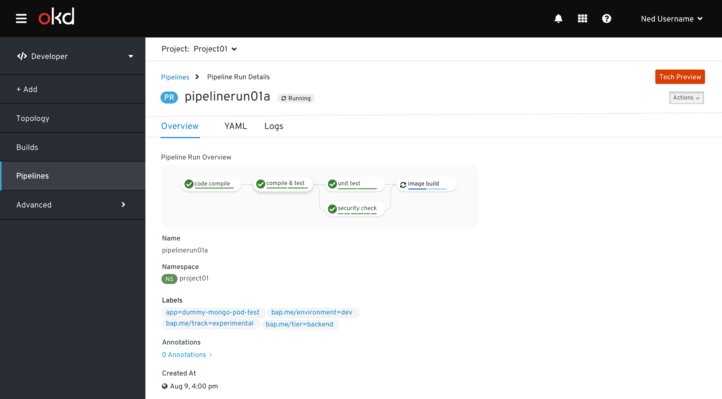
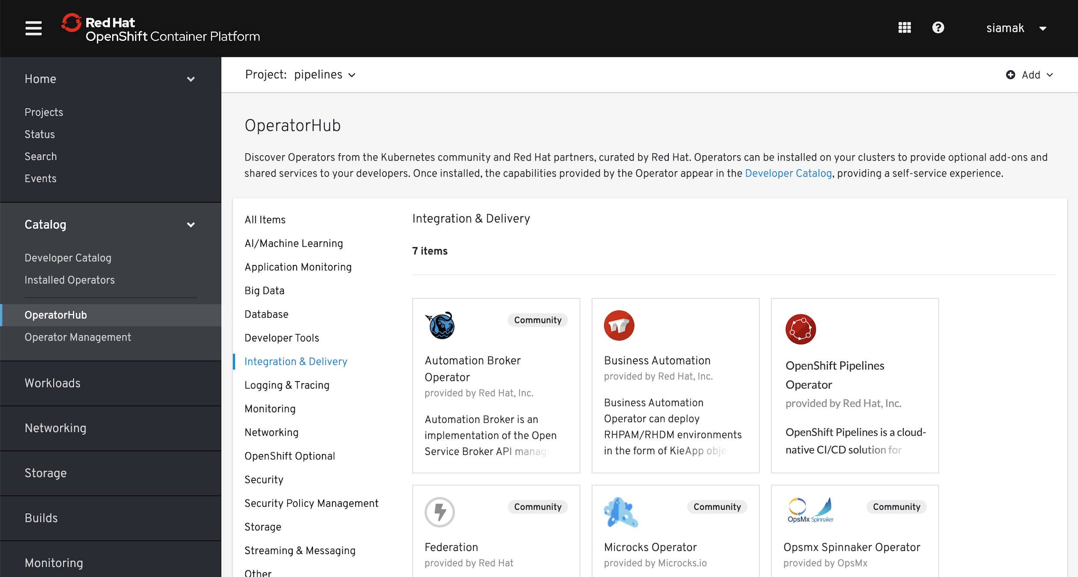
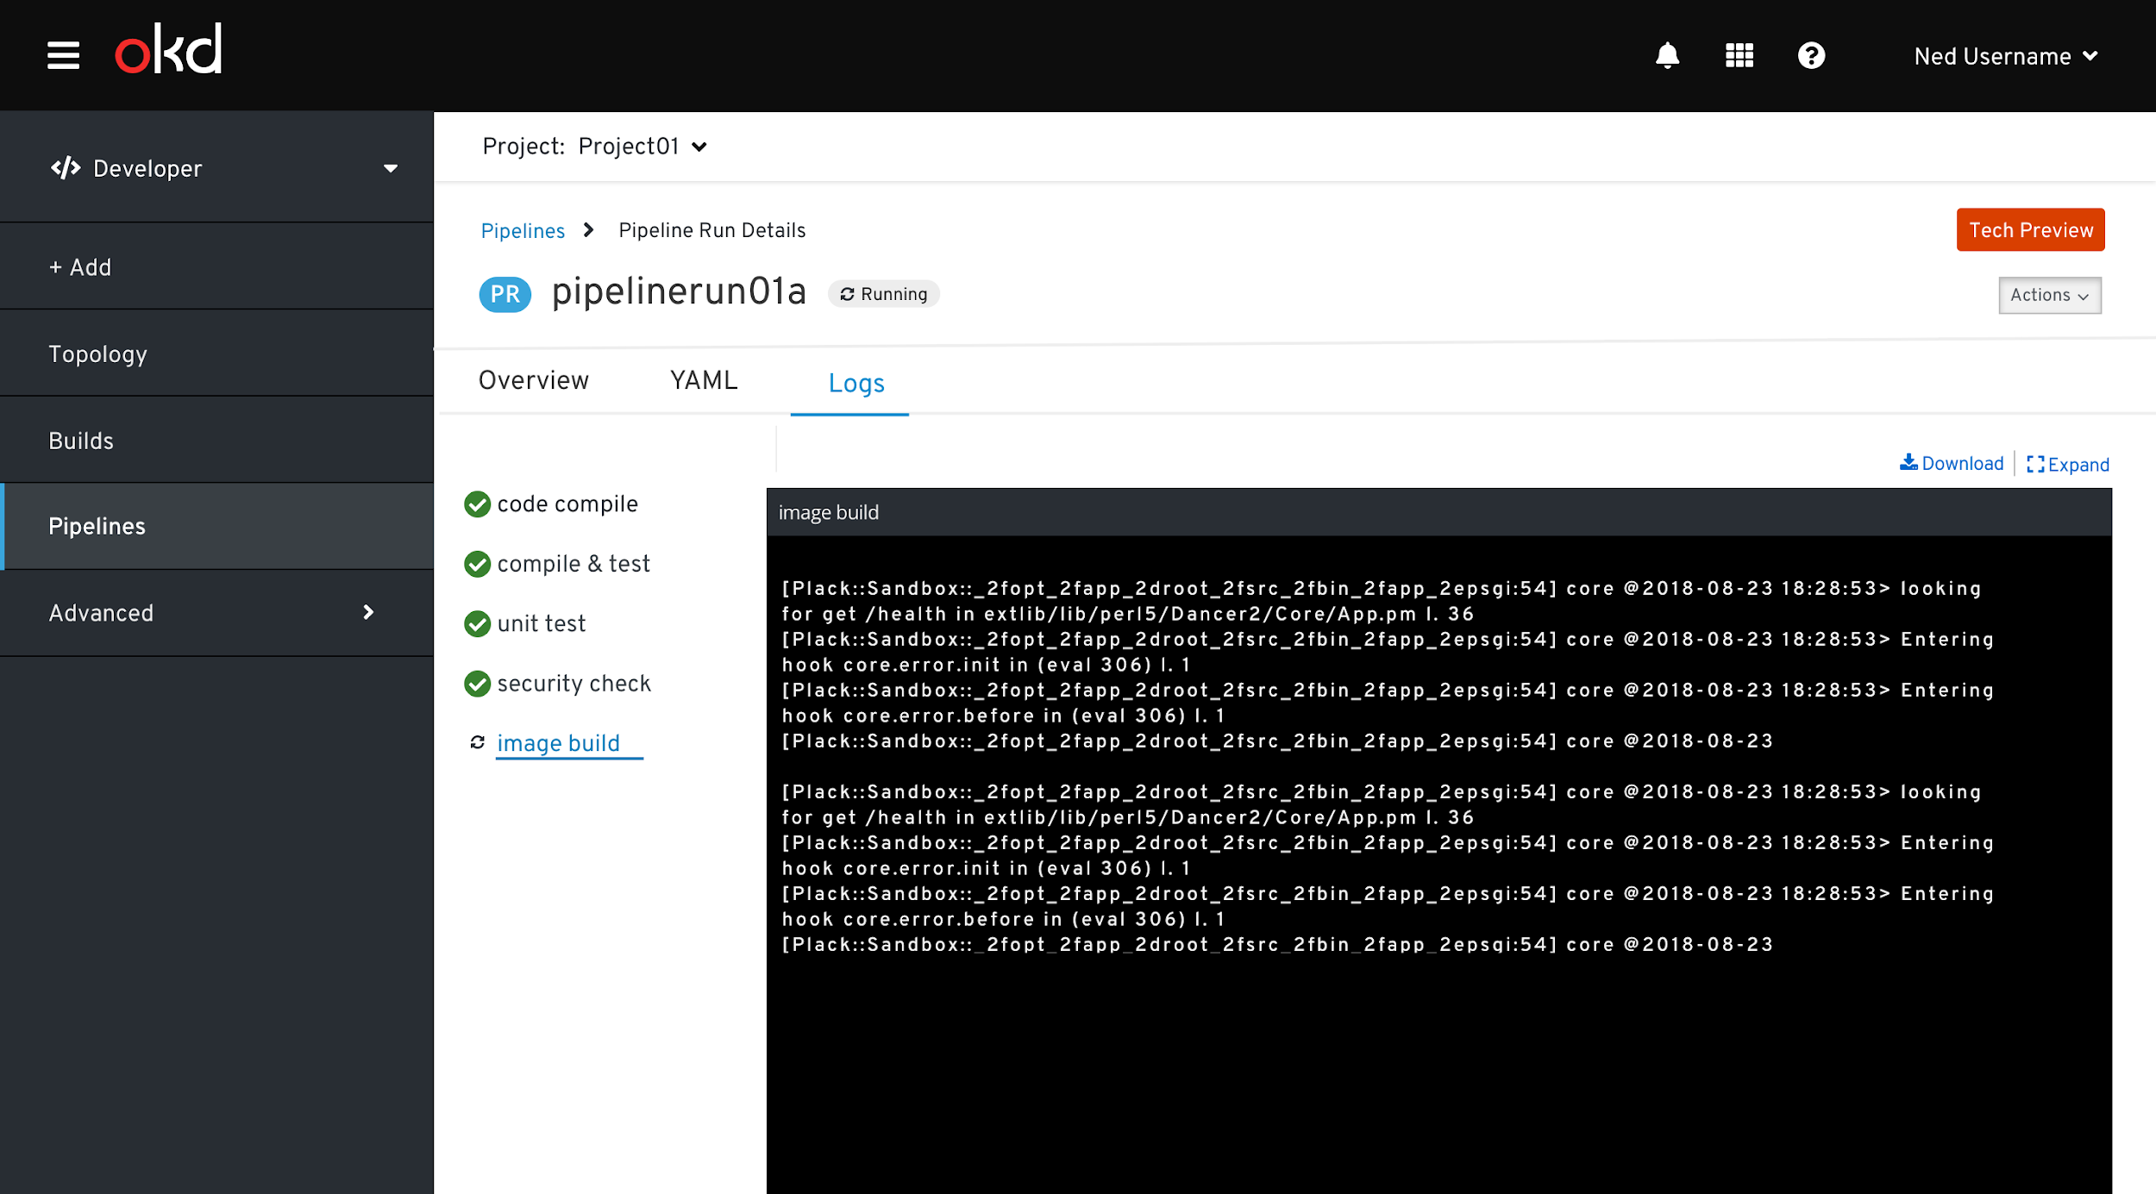
Cloud-native CI/CD with OpenShift Pipelines
NEXT WAVE OF DEVELOPER TOOLS
Developer Preview
Based on Tekton Pipelines
Runs serverless (no babysitting!)
Containers as building blocks
Deploy to multiple platforms
Standard CRDs
Build images with Kubernetes tools (s2i, buildah, kaniko, jib, buildpack, etC)
Pipelines portable to any Kubernetes
Available in OperatorHub
Product Manager: Siamak Sadeghianfar
Notes:
Speaker: Steve Speicher

Slide 82
Cloud-native CI/CD with OpenShift Pipelines
NEXT WAVE OF DEVELOPER TOOLS
Developer Preview
apiVersion: tekton.dev/v1alpha1
kind: Pipeline
metadata:
name: funky-deploy-pipeline
spec:
resources:
... # git, images, etc
tasks:
- name: build-app
taskRef:
name: mvn-build
...
- name: build-image
taskRef:
name: s2i-java
...
- name: deploy
taskRef:
name: openshift-cli
...
Inputs (e.g. git repo) to and outputs (e.g. images) from the pipeline
Provided task library:
s2i, buildah, oc, jib, kaniko, etc
User can create custom ones
Product Manager: Siamak Sadeghianfar
Notes:
Speaker: Steve Speicher

Slide 83

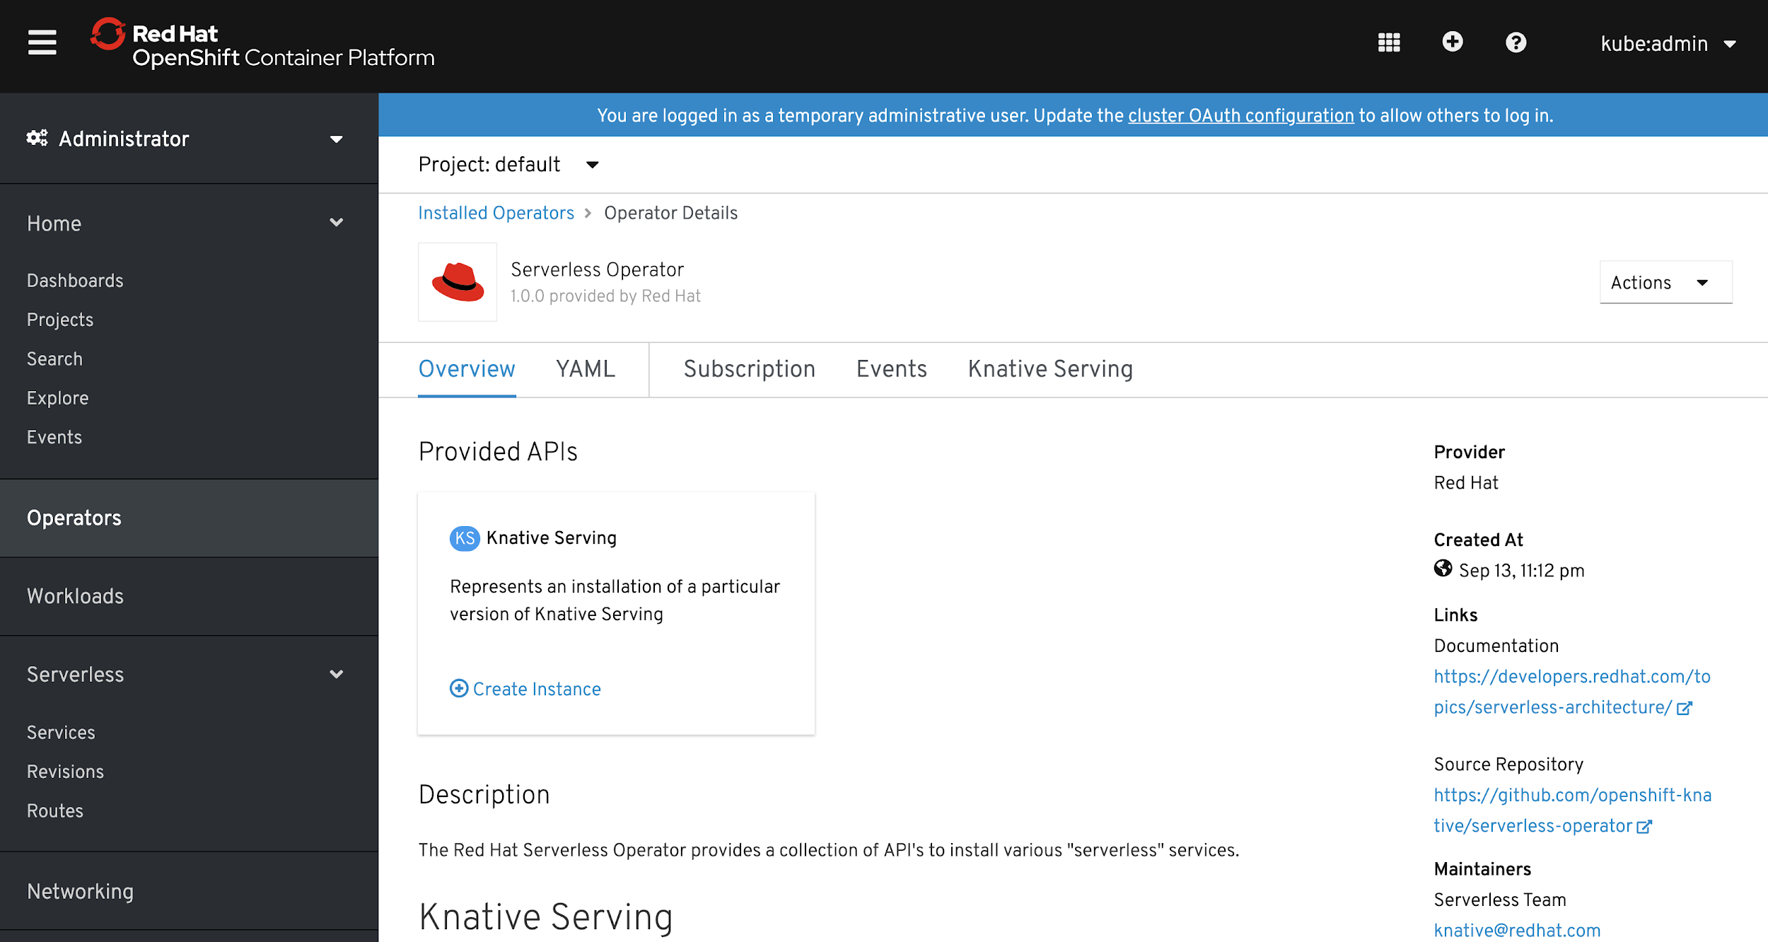
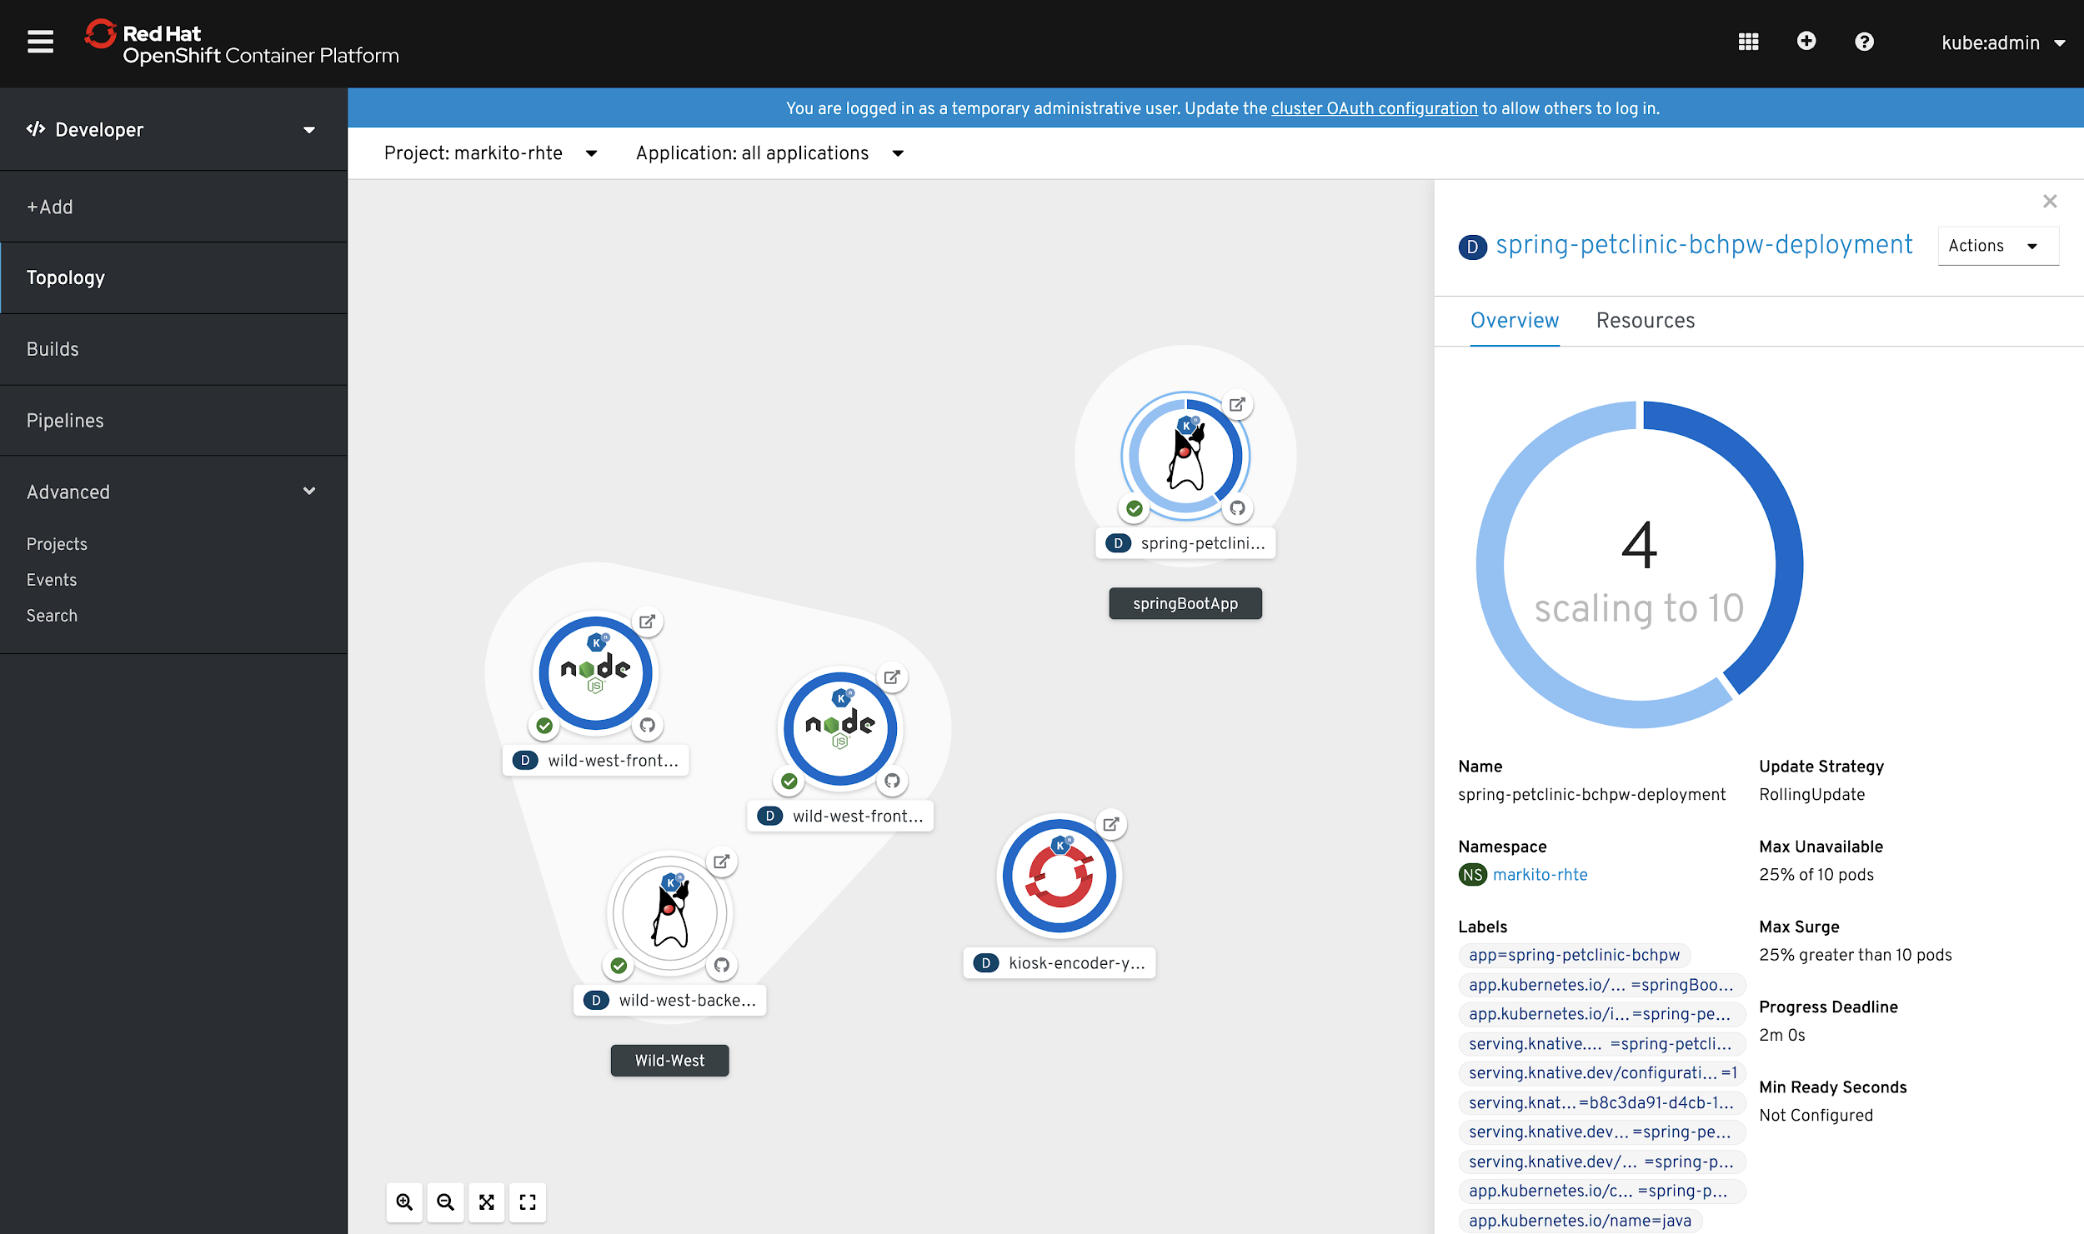
NEXT WAVE OF DEVELOPER TOOLS
Tech Preview 4.2
OpenShift Serverless
Key Features
Familiar to Kubernetes users. Native.
Scale to 0 and autoscale to N based on demand
Applications and functions. Any container workload.
Powerful eventing model with multiple event sources.
Operator available via OperatorHub
Knative v0.7.1 (v1beta1 APIs)
No vendor lock in
Learn more
https://openshift.com/learn/topics/serverless https://redhat-developer-demos.github.io/knative-tutorial
Product Manager: William Markito
Notes:
Speaker: William Markito
Serverless building blocks for any container workload

Slide 84
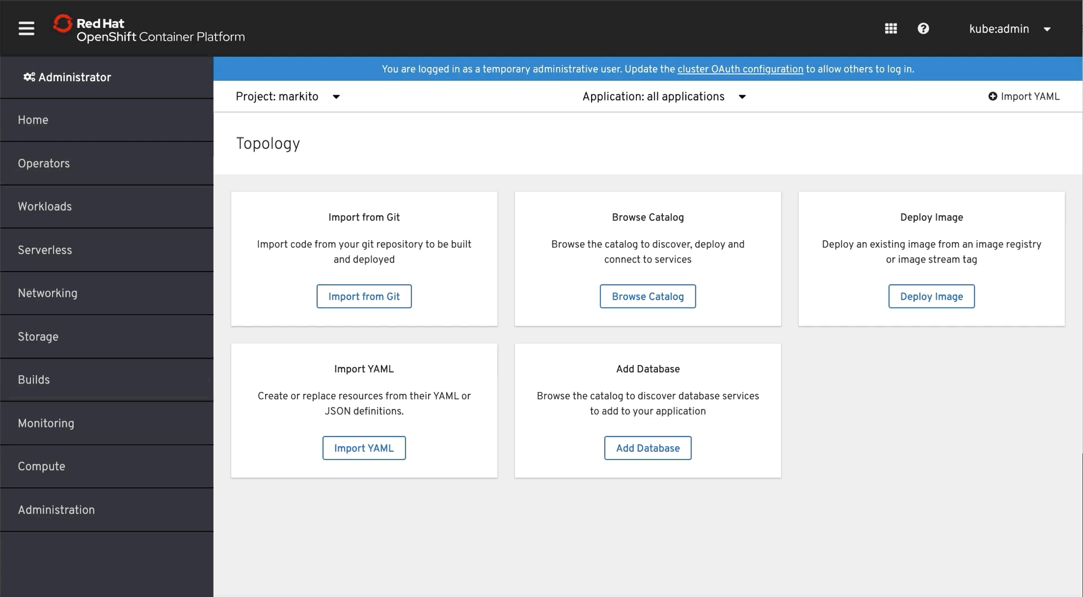
NEXT WAVE OF DEVELOPER TOOLS
Tech Preview 4.2
OpenShift Serverless
Developer Console in 4.2
Deploy Image
Import from Git
Product Manager: William Markito
Notes:
Speaker: William Markito
Serverless building blocks for any container workload

Slide 85



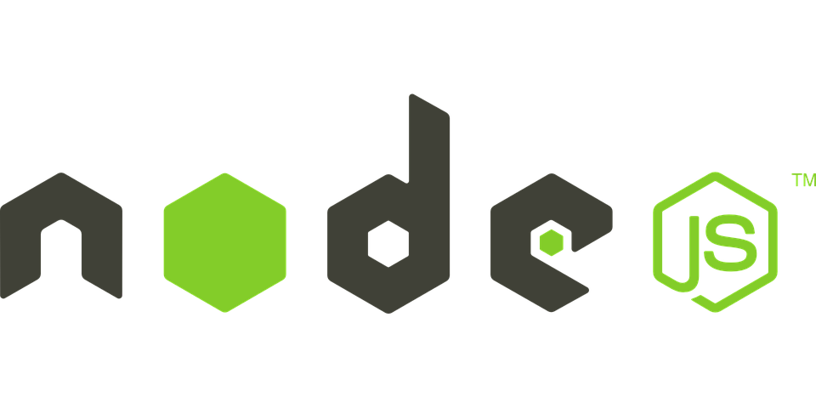






NEXT WAVE OF DEVELOPER TOOLS
Tech Preview 4.2
OpenShift Serverless
Application
Functions
Apps
Microservices
Containers
Containers
Infrastructure
Infrastructure & Scheduling
Platform
Product Manager: William Markito
Notes:
Speaker: William Markito
We continue with our serverless strategy that goes beyond just Functions, but also supports Microservices or any container workload.

Slide 86
OpenShift Serverless Components
NEXT WAVE OF DEVELOPER TOOLS
SERVING
EVENTING
Service
Channel
Filter
Manage the lifecycle of your workload and group necessary objects for your application.
An event forwarding and persistence layer with in-memory and reliable implementations.
Applied to a Broker in order to allow types of events to be selected.
Revision
Importer (Event Source)
Trigger
Immutable point-in-time snapshot of code & configuration.
Register interest in a class of events from a particular system
A desire to subscribe to events of a given Broker or event consumers using a Filter.
Configuration
Broker
Subscription
Maintains deployment state, environment variables and other runtime values.
An "event mesh" that can receive and send events to multiple subscribers.
Connect all events from a given channel to a service
Route
Sequence
Choice
Maps a network endpoint, including an URL to a given revision or service.
Define an in-order list of Services to be invoked as steps.
List of Filter options that will receive the same Event for processing.
Tech Preview 4.2
Developer Preview
Notes:
Speaker: William Markito
Looking a bit deeper in OpenShift Serverless we have the following modules Serving and Eventing, coming from the Knative project. In Serving the main construct is a Service, which represents your application and contains Routes, Revisions and Configurations. Serving APIs are fairly stable and we are considering to release a 1.0 of the project very soon.
Eventing though has grown in scope and has a variety of objects that allow for a powerful and complex applications. But this increase in scope also caused the APIs to change quite a lot and today I'd say is still considered in Alpha.
We will get into more details about how those objects and APIs are used in the next slides. Knative eventing is still a moving target, The APIs should settle down soon. Knative Eventing is becoming more robust than just a basic eventing mechanism, it becoming more like a full blown serverless service bus.

Slide 87


OpenShift Serverless - Lifecycle
NEXT WAVE OF DEVELOPER TOOLS
Tech Preview 4.2
CODE
BUILD
RUN
BUILD
RUN
CHE/VSCODE/IDE
TEKTON
KNATIVE SERVING
"Hello!"
CODE v1
PIPELINE
User Application (Service)
"Hello World!"
CODE v2
PIPELINE
10%
REVISION 1
10%
Network traffic
REVISION 2
"Hello World, ${user}!"
CODE v3
PIPELINE
80%
REVISION 3
Notes:
Speaker: William Markito

Slide 88
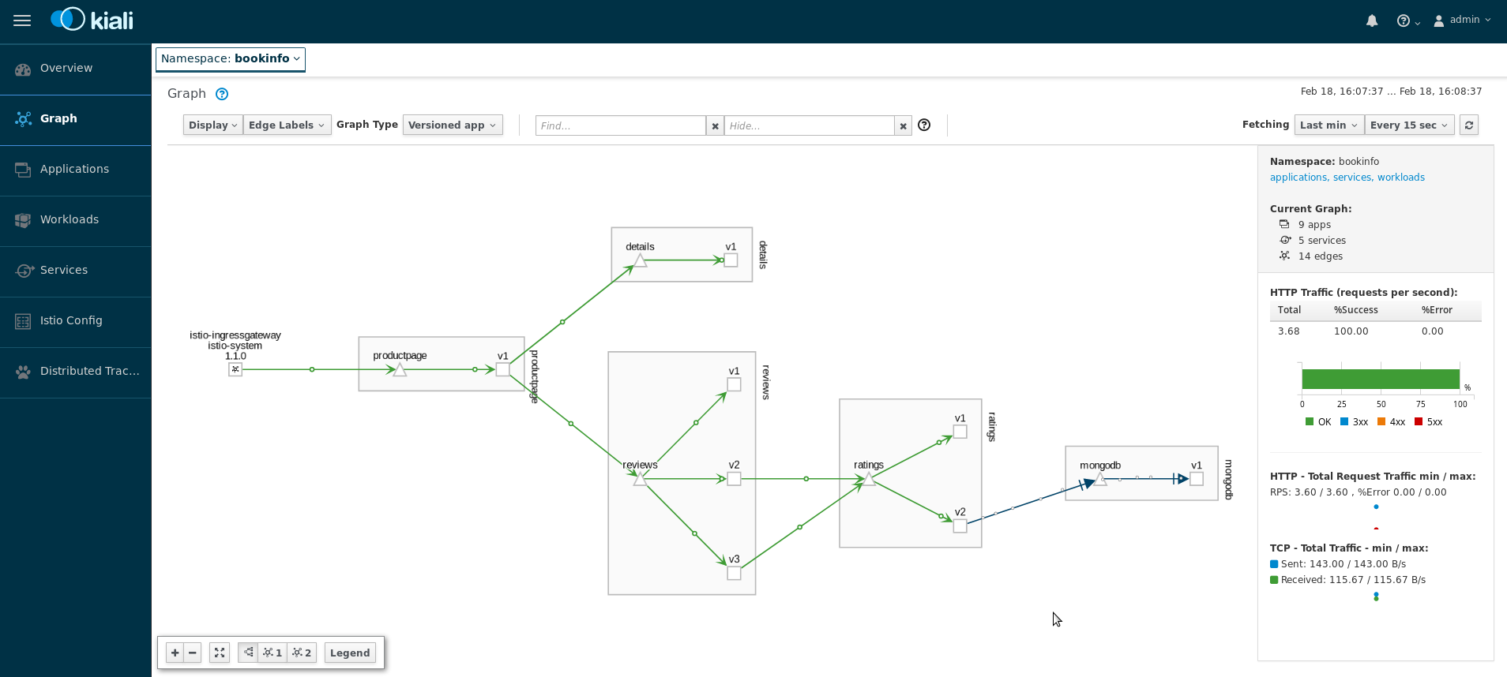





NEXT WAVE OF DEVELOPER TOOLS
Red Hat Service Mesh
Key Features
A dedicated network for service to service communications
Observability and distributed tracing
Policy-driven security
Routing rules & chaos engineering
Powerful visualization & monitoring
Will be available via OperatorHub
Product Manager: Brian ‘redbeard’ Harrington
Generally Available
Notes:
Product Manager: Brian ‘redbeard’ Harrington

Slide 89
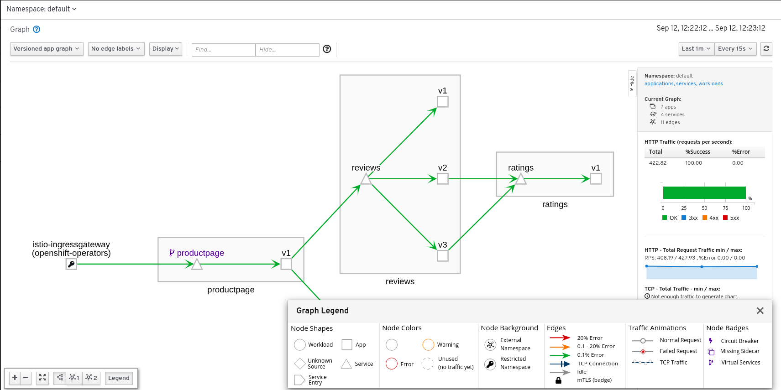
Enhanced Visualization of Cluster Traffic
With Kiali
NEXT WAVE OF DEVELOPER TOOLS
Visualization of what
Matters most:
Application Topology
Traffic throughput
Error Rates
Service Latency
Service Versioning
Product Manager: Brian ‘redbeard’ Harrington
Generally Available
Notes:
While the engine behind OSM is Istio one of our most important differentiators is a Red Hat created project called “Kiali”.
Kiali is the visualization tool which allows application owners to quickly identify where problems are occurring within a constellation of microservices. Whether it’s throughput, latency, error rates, or response codes, users can drill down into the information they need quickly.

Slide 90
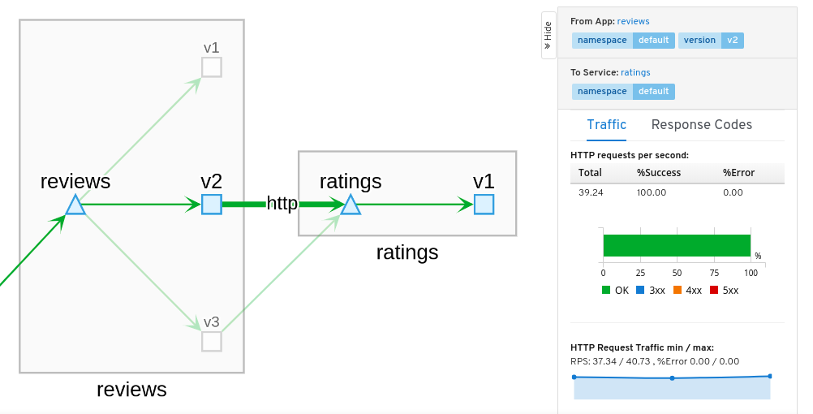
Protocol Specific Analysis and
Drill down
NEXT WAVE OF DEVELOPER TOOLS
Product Manager: Brian ‘redbeard’ Harrington
Generally Available
Notes:
Here we see a user who has deployed three different versions of a “reviews” service. They’ve chosen to route all traffic for stodgy legacy customers to v1 (based on the presence of HTTP headeers), while the majority of traffic is going to v2.
At the same time, they also have a brand new version deployed which is only consumed by internal customers.

Slide 91
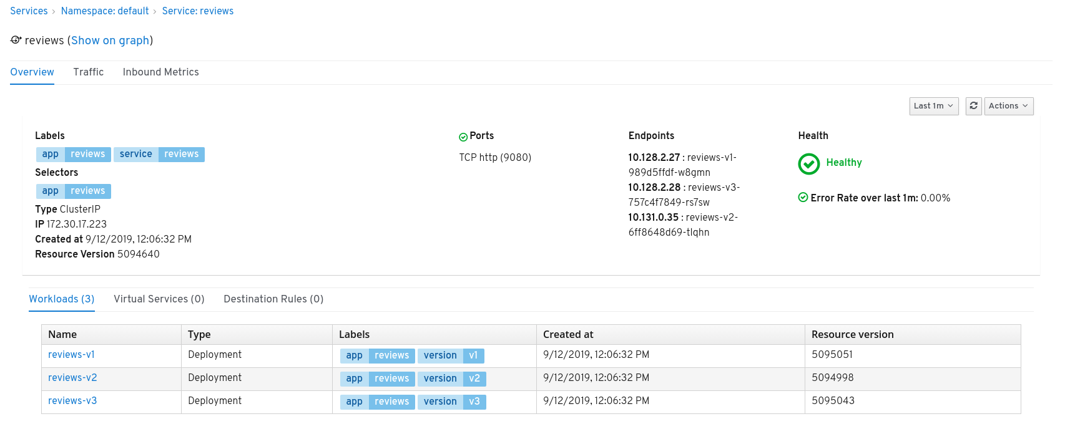
Convenient Overviews of Individual Services
NEXT WAVE OF DEVELOPER TOOLS
Product Manager: Brian ‘redbeard’ Harrington
Generally Available
Notes:
OpenShift Service Mesh allows these users to even see the specific services and deployments which are backing a “virtual service” with a quick color coded health check response so folks can move on to finding problem services.

Slide 92
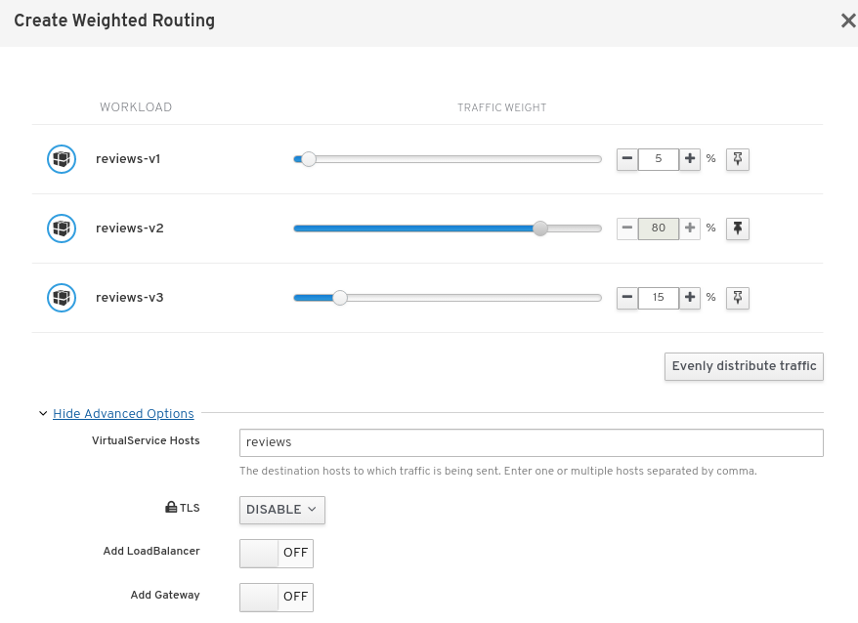
Guided Configuration of Traffic Policies
NEXT WAVE OF DEVELOPER TOOLS
Product Manager: Brian ‘redbeard’ Harrington
Generally Available
Notes:
Users at this point are used to the idea of splitting traffic through load balancing… but what about weighted routing? Using OSM we can specify complex rules around how traffic show flow down to services, using guided tooling to minimize the chance of error and misconfiguration.
Here we have a more simplified version of our previously discussed traffic policy allowing us to do quantile based routing across our services.

Slide 93

Management of URI Matching for Virtual Services
NEXT WAVE OF DEVELOPER TOOLS
Product Manager: Brian ‘redbeard’ Harrington
Generally Available
Notes:
Beyond the basics of weighted routing, we also move one step closer to the promised land of microservices. Digging deeper, we have the ability of performing traffic routing based on headers, URI matching, protocol, method, and more.

Slide 94
Service Mesh Roadmap
NEXT WAVE OF DEVELOPER TOOLS
Q4 CY19
1H CY20
2H CY20
Beginning of multi channel releases:
Tech Preview
Stable
LTS (To come later)
Establish baseline for performance improvements
Expanding automated testing matrix
Upgrade stabilization
Migrate Kiali to Patternfly 4
Release of OSM v1.1 (approx Jan 2020)
Update to Istio 1.3 (Possibly 1.4)
FIPS-140-2 Certification for core components
Telepresence.io Support
Initial eBPF support
Additional configuration via Kiali UI
Multi-cluster mesh support
Mesh Expanison (Federation of resources into the mesh from outside OpenShift)
Initial integration with cloud.redhat.com/openshift for cluster management
Additional protocol support
MySQL
MongoDB
Kafka
Product Manager: Brian ‘redbeard’ Harrington
Generally Available
Notes:
In the coming months we’re going to improve the product, using our operator based update mechanism with a focus on delivering multiple “channels” of content. The idea being that we can allow users to immediately consume our pre-release content with a Tech Preview level of support and even on the same cluster install a second instance of the mesh with full production support.
In our 1.1 release of Service Mesh which should be in December or January we will be introducing a whole host of new features and functionality focused on harnessing performance improvements through the use of extended Berkeley Packet Filters, upgrades to the Istio core, and our most requested features multi-cluster meshes and mesh expansion.
Further out in 2020 users will be excited to see initial integrations with the centralized management of cloud.redhat.com and more protocol support as well.

Slide 95
NEXT WAVE OF DEVELOPER TOOLS
Control Traffic Flow
Control flow of traffic between application components
makes call to
v1
95% of traffic
frontend-app
backend-app (Java)
MySQL Database
app.example.com
5% of traffic
makes call to
v2
frontend-app
backend-app (Go)
Product Manager: Brian ‘redbeard’ Harrington
Generally Available

Slide 96

Hosted OpenShift
Get the best of OpenShift without being on call
Notes:
Speaker: Patrick Strick
You’ve heard about the great new things coming in OpenShift 4. Now I am going to talk briefly about our hosted offerings.

Slide 97



One Platform, Flexible Consumption Models
Azure
Red Hat OpenShift
Managed service offering on AWS and Google (Coming soon)
(OSD on v3.11 & 4 available)
Jointly engineered, operated, and supported by Microsoft and Red Hat
Enterprise-grade Kubernetes platform that you manage
HOSTED SERVICES
SELF-MANAGED
Notes:
Speaker: Patrick Strick
OpenShift is a single product with 3 consumption models to give a choice to customers in order to balance their productivity and operational efforts versus the level control they need over the platform.
OpenShift Dedicated: a professionally managed, enterprise-grade Kubernetes by Red Hat on one of the public clouds (Amazon Web Services) and dedicated to a single customer with custom setups for private networks, etc
Azure Red Hat OpenShift: Jointly engineered, operated, and supported by both Microsoft and Red Hat with an integrated support experience
OpenShift Container Platform: secure Kubernetes platform on your own infrastructure. Build, deploy and manage your container-based applications consistently across cloud and on-premise infrastructure.

Slide 98
Who is interested in Managed OpenShift?
All reasons customers want OCP but looking for as-a-service
App modernization, Hybrid Cloud, IT Transformation , etc
Skills/Resources
Unable to hire/retain Kubernetes skills
No budget to hire new ops folks to manage new platforms
Move to the public cloud
Looking for OpenShift as a Service
Considering AKS/EKS/GKE
MANAGED OPENSHIFT
OPPORTUNITY
Don’t want to manage the platform Day 2 Operations of OpenShift / Kubernetes is hard
Desire to follow best practices for managing OpenShift.
Too many updates, unable to keep up to date
Moving to as-a-service
Purchasing edict to buy only as a service
Notes:
I mentioned that our different consumption models balance operational effort and level of control. OCP is on the full control side of the scale and OSD and ARO are on the low operational effort side.
What are the reasons a customer might be a good fit for one of our hosted offerings?
Cloud initiatives at the company. They could be considering Azure, Amazon, or Google’s Kubernetes platform. Or they may have a purchasing policy to look at IT infrastructure as a service
Resource constraints. Either they do not have people with Kubernetes expertise or they do not want to dedicate the personnel to maintain the systems.

Slide 99

OSD (4 - DEMO 1 - Cluster Provision)
Notes:
= This animated gif demonstrates the process of deploying a new OSD cluster using OpenShift Cluster manager
OpenShift Cluster Manager, which Jake talked about earlier, goes even further with OpenShift Dedicated. A Dedicated customer can specify the configuration and create their OpenShift 4 cluster, complete self service. The options available are based on their subscription. And for their active clusters, customers can scale and soon will be able to configure aspects of the cluster like networking from OCM.

Slide 100

OSD (4 - DEMO 1 - OpenShift Cluster Dashboard)
Notes:
= This animated image shows accessing an active OSD cluster dashboard from OpenShift Cluster Manager.
We have recently added support for customers to install Operators from the in-cluster OperatorHub in OpenShift Dedicated. Currently Operators that do not require elevated permissions are allowed. The next phase, which is in active development, will allow Red Hat operators with elevated privileges.

Slide 101


Azure Red Hat OpenShift roadmap
Fully managed OpenShift service, jointly operated with Red Hat
Private clusters Public preview Q4 CY2019
Create fully managed clusters in a custom VNET with no public endpoints
Express Route support Public preview Q4 CY2019
Connect clusters to Express Route circuits
Azure Monitor integration Generally available H2 CY19 Surface cluster logs and metrics in Azure Monitor
Regulatory compliance H2 CY19
Learn more
Check product availability in your region
Notes:
Let’s shift over to Azure Red Hat OpenShift.
It has seen a lot of interest since it was launched in May, and the team has been working constantly to bring in additional capabilities our customers need. The big two items that will become available over the next couple of months are
Integration with Azure Monitor for logs and metrics
Private clusters, including deploying the cluster into the customers VNET and Express Route connections
Also on the horizon is regulatory compliance. This is something we have been working on from the beginning and has taken longer than expected, but we are nearly there now.
ARO is also always adding regions. For the latest list, check the Azure “Products available by region” page. The link is in the slide.
POCs are available if there is an opportunity registered with both MS and RH. The detail and steps are covered in the recent Hosted OpenShift Enablement session which is available through LMS under “OpenShift Dedicated 4 Product Update (Q3 FY20)” https://learning.redhat.com/course/view.php?id=1639
Once you have a hands on workshop your customer can go through to learn about the system. Contact your Partner Marketing lead for details.
And lastly, we have a lab environment available through RHPDS (Red Hat Product Demo System).

Slide 102
Migrating to OpenShift 4
Tooling and advice for moving from OpenShift 3.x to 4.x
Namespaces
3
4
App objects
Volumes

Slide 103
Application Migration: Migration Process
Watch a migration of MS-SQL Server from OCP 3.11 to OCP 4.1!
Plan
Stage
Migrate
Select Source Cluster
Select Namespaces
Choose Copy or Move for each PV
Specify Destination
Quiesce Application
Migrate any delta bits not captured in stage.
Stages the data from Source to Destination.
May be run multiple times.
Applications are running
no Downtime during step
‹#›
Product Manager: Maria Bracho

Slide 104
Granularity of Namespace(s) & ‘cluster-admin’ required
Migration is at scope of a Namespace.
Future will allow selecting resources inside of a Namespace
Cluster Scoped Resources are not handled
Cluster Role Bindings, SCCs, etc are not handled with migration.
Expectation is that cluster admin handles cluster scoped resources ahead of running a Migration.
‘cluster-admin’ required for initial release targeting OCP 4.2
Future plans to allow end user to migrate what they own post OCP 4.2+
Product Manager: Maria Bracho

Slide 105
Persistent Volume Handling
Move
“Swing the PV”
The data remains where it is in the volume. The definition of the volume is essentially ‘swung’ from the source cluster to the destination cluster.
Quickest migration strategy as it involves no processing of the data. No rollback capability, recommended to ensure a backup exists prior to moving.
1
Copy: Storage Provider Plugin
(AWS EBS, Google, Azure)
Leverage snapshot support from the storage provider such as Amazon EBS snapshots..
Quick
Move
2
Velero Storage Plugin
Copy: Restic Filesystem level copy
Catchall, if no other plugins exist fall through to a filesystem level copy of the data on a PV. Most flexible approach, yet likely not as performant as other methods.
3
Restic: Filesystem Copy
Slowest
Product Manager: Maria Bracho

Slide 106
Questions?

